Slide 1
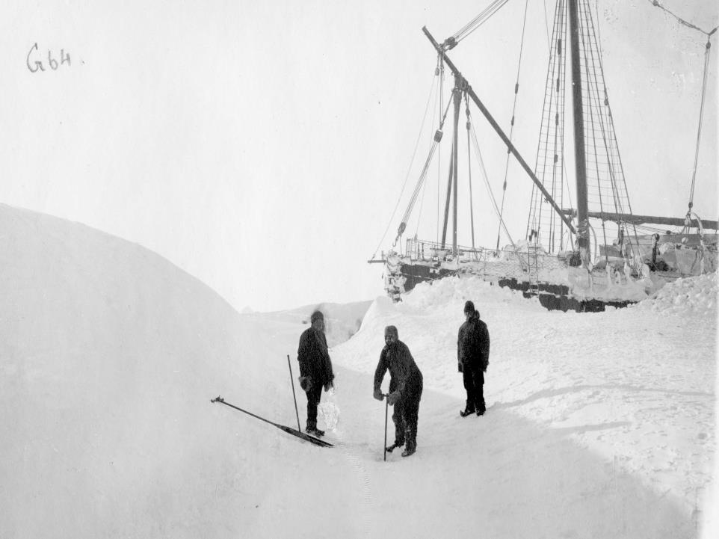



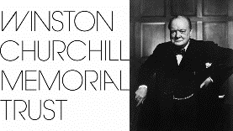
Fascination Antarctica considering the landscape, science and its history
U3A Timaru – 15 July 2024
Dr. Ursula Rack, F.R.G.S.
Polar historian
Email: Ursula.rack@Canterbury.ac.nz
Webpage: https://arcticandantarctic.wordpress.com

Slide 2
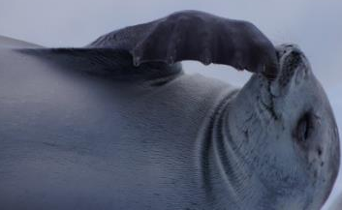
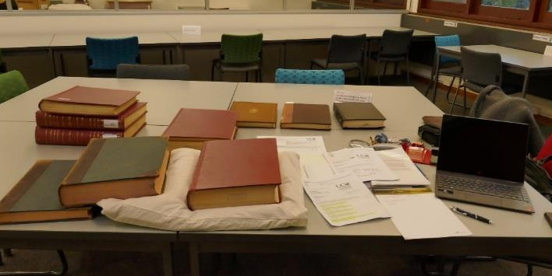
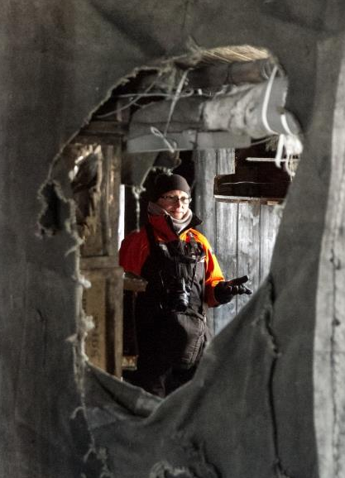
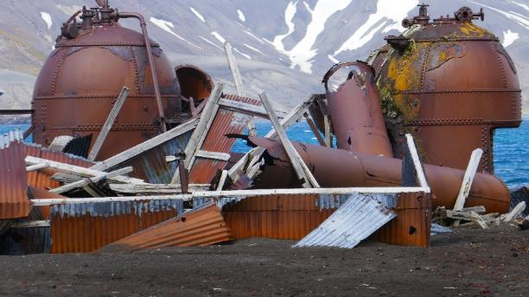
What does a Polar Historian do?
Research (interpreting sources)
Teaching (UC, schools)
Outreach
Lecturing on tourist ships
Macmillan Brown Library/archive
Deception Island/Antarctic Peninsula/Whaling Heritage
Discovery Hut,
McMurdo Sound

Slide 3
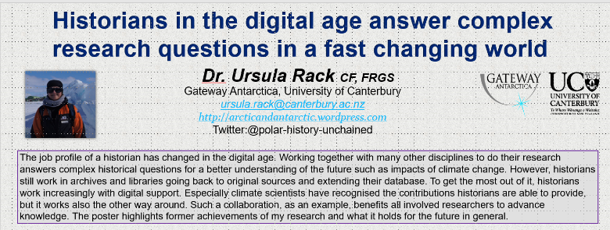
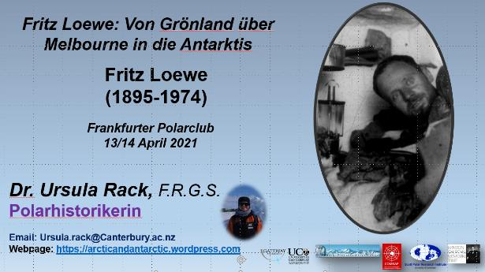
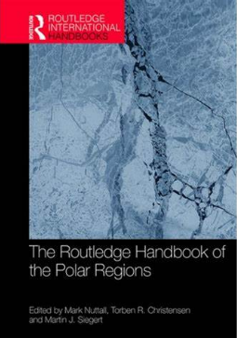
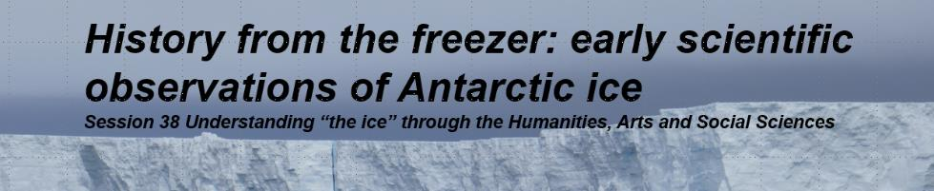
Presentations: national and international conferences
Publishing (books, book chapters, articles, etc.)
Referee/reviewer

Slide 4
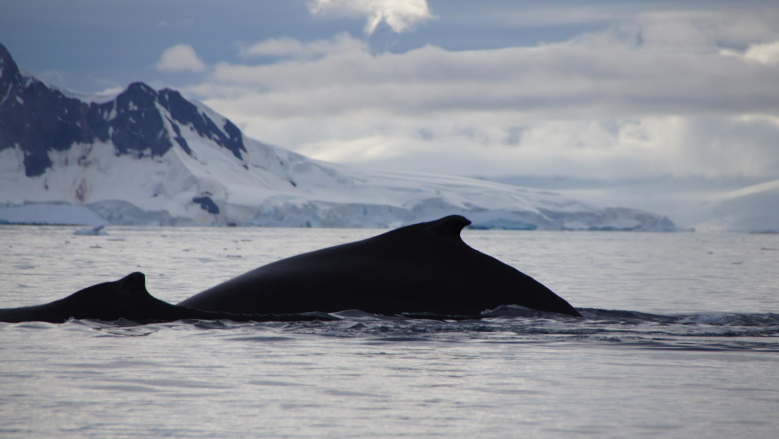
Polar History/Antarctic History
Geopolitics
Politics
Policies
‘Heroic Era’
Stations
Antarctic Gateway Cities
Exploration
Expeditions
History of Science
Social History
Whaling
History of Antarctic Treaty (ATS)
Heritage
Tourism
History of Technology
©Ursula Rack, Wilhelmina Bay, Febr. 2020

Slide 5
From single expedition events to international coordinated collaboration to answer complex earth science questions
Combination of:
Science questions
Economic interests
  Technical innovations
  Political interests - Geopolitics
Notes:
This was now a brief introduction to some expeditions happening as single events, not coordinated but useful for the science they did in the Antarctic.
With more advanced technical innovations, new research questions appeared, especially on the earth systems, so collaboration attempts were on the agenda.
Science established itself more and more in the 19th century and with more knowledge more questions appeared. Economic interests crew and pushed on with colonising many parts of the world. Hand in Hand with the economy were the technical innovations. With better instruments, more advanced research could be performed.
Very much on the plate, especially with growing colonisation, political interests became an issue, hand in hand with economy. So the Antarctic was a perfect spot for claiming parts because of the fact that it was not inhabited except by wildlife.
In some cases, science became a political instrument.

Slide 6
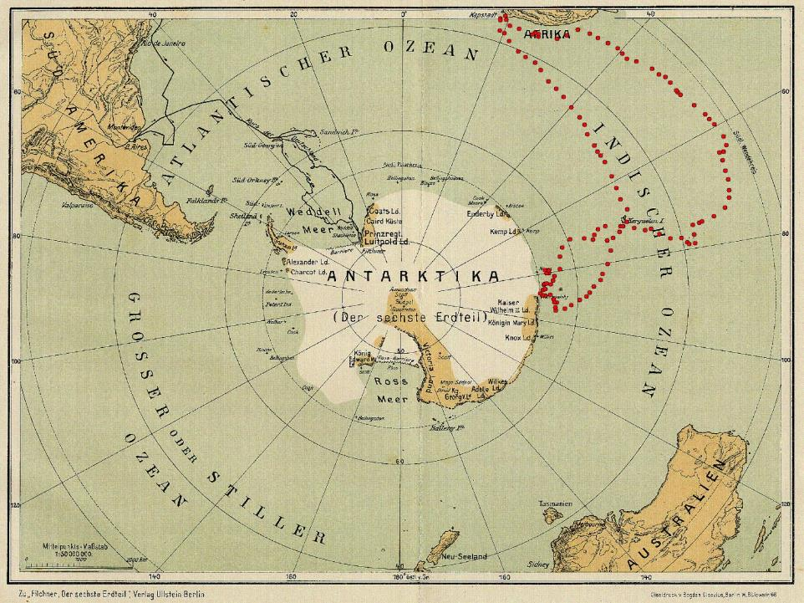
Bruce
1902-1905
Shackleton
1914-1917
Filchner
1911-1912
Nordenskjöld
1902-1904
Charcot
1903-1905
Expeditions of the Heroic Era
1897 – 1917/22
Charcot
1908-1910
Drygalski
1901-1903
Gerlache 1897-1899
Scott
1901-1903
Shirase 1911-1912
Mawson 1911-1912
Scott/Amundsen
1911/12
Borchgrevink
1898-1900
Shackleton
1907-1909
6
Notes:
Back to the Heroic age:
This is a map of 1923 and the brown bits are the known areas at this time.

Slide 7
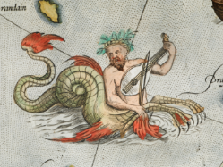
Beginnings
The name Antarctica:
Romanized version of the Greek compound word ἀνταρκτική (antarktiké), feminine of ἀνταρκτικός (antarktikos) = "opposite to the Arctic", "opposite to the North".
No evidence that the word was used in ancient Greek writing.
(see: Hince, Bernadette: The Antarctic Dictionary, Collinwood, 2000, p 6)
Idea: to balance the earth, there must be a counterpart in the South
Land full of special creatures and riches
Notes:
In medieval times the Venerable Bede thought a southern continent as well.
1578: Engl. Elizabeth I start for strong English dominance at sea. / In the 18th c. the French became more influential in the European History and the Dutch, Spanish and Portuguese lost their dominance at sea.
In 1625 Nathanael Carpenter wrote in his Geography: “the Polar circle called Antarctich, passeth through the South part of the world (as yet) undiscovered, except for some fewe parcels, as Tiera de Fuego, and Psitacorum Regio,…”
In the 18th C. it was even thought that NZ is maybe a part of that continent. I t was even believed that 50 million people live there.

Slide 8
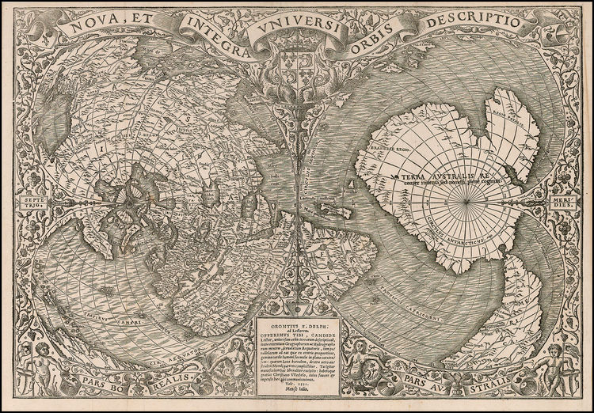
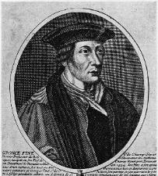
Ideas of the continent and maps
The Oronce Finé map published in 1531 includes Terra Australis.
Oronce Finé
1494 – 1555

Slide 9
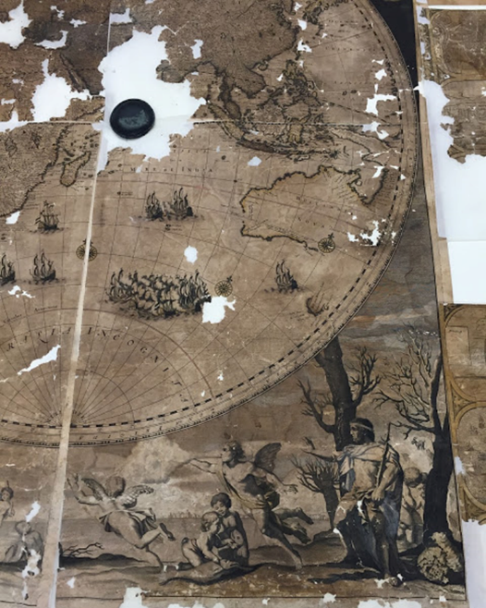
Map – message
“Map in the chimney”
17th century
To see on the 1,60 – 2 m map:
Battles in the Indian Ocean
Status of colonial ambitions from the Dutch
Cruelties in South and Middle Americas by the Spanish occupants – propaganda
Slave trade
Purpose of historic maps in general:
Display and show status, power and ambitions to demonstrate the message not the accuracy
https://archaeologynewsnetwork.blogspot.co.nz/2016/12/17th-century-chimney-map-restored-at.html#oYPUT84o8ckbAltZ.97

Slide 10
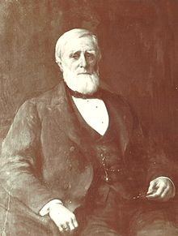
19th century – new science disciplines emerge
e.g. Geography as new establishing discipline
In the 1860s and 1870s – Geography became part of the university systems in Germany and Britain
War and maps – Geography
Chief Justice Charles P. Daly, President of the American Geographical Society (1864 – 99): “a war [is] fought as much by maps as by weapons.”
He attributed German’s victory in 1870/71: to “skilful military movements performed by an army thoroughly acquainted with all the geographical features of the country over which it was moved”.
Quotes: Hudson, Brian, the new geography and the new imperialism (1870 – 1918); in: Antipode 9 (2), p142
File:Daly1 20090820111605 00001.jpg
Charles Patrick Daly, in office 1871 - 1885

Slide 11
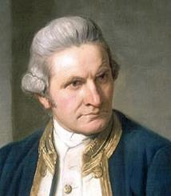
Beginnings Part II - and continues
1769 James Cook (1st voyage) Sub-Antarctic
17th January 1773, James Cook = first crossing of the Antarctic Circle
Early 19th c. - Sub-Antarctic Islands = seal hunting and whaling (Britain, British colonies, France, US)
First sighting of Antarctica: Russian expedition under Fabian Bellingshausen (1819)
1870s onwards = whaling and science
1900 – 1922 = “Heroic Era” (Scott, Drygalski, Bruce, Nordenskjöld, Charcot, Shirase, Filchner, Mawson, Shackleton, Amundsen)
Till today science, whaling and fishery (e.g. tooth fish)
Notes:
Cook: he destroyed the myth of a rich, overpopulated idea of a continent full of strong creatures, etc. (Endeavour, discovery, Resolution)
New technologies in navigation secured discoveries. To calculate the right longitude it was necessary to have an accurate time – no clock or watch was invented so far to do the right calculations, so it could be that some island and coastlines were discovered several times from different “countries”. In Cook’s time a man named Kendall invented the first accurate chronometer and Cook tried the time measurement instrument. His charting was influenced by that as well as he could be more accurate about positions. The navy in Britain became also a very influential part in the power play of the countries France and England. A sort of race for new discoveries started.
In the 19th c. the natural science established itself more and more and the knowledge of magnetism became a real issue. It was a sort of wave of expeditoins to discover new land – 1840 Wilkes and Durmont d’Urville = debate who discovered (had the first sighting) of the Antarctic continent = crossed in the icy watrers but there are theories going on… Wilkes (US) – scribbled in the logbook the sighting – it looks like a entry done long after the event … lots of debates – and it was about claiming land….

Slide 12
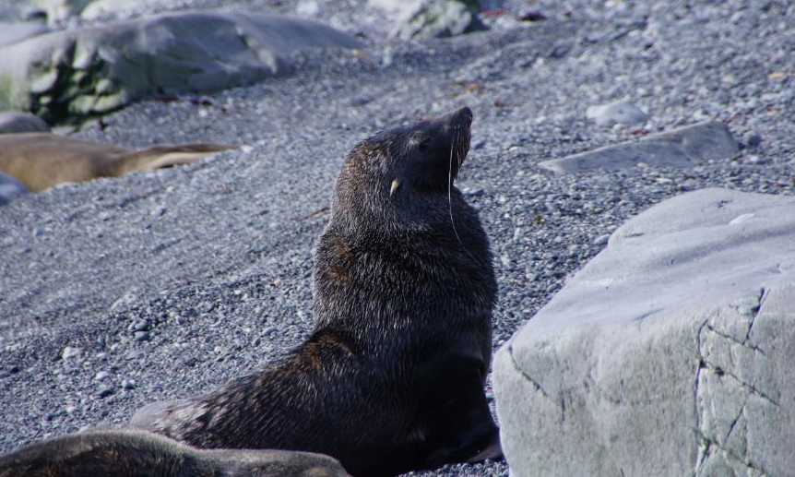
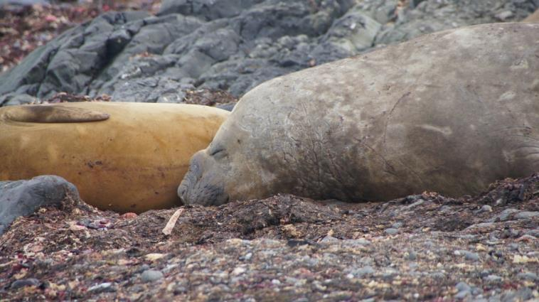
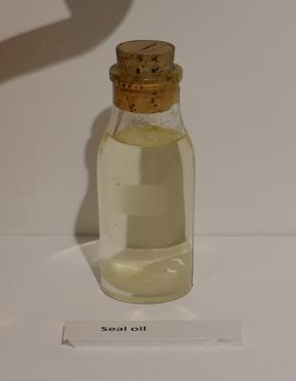
Sealing and Whaling
Seal hunting – Sub-Antarctic Islands: approx. from 1786
Britain, the USA, and China were the most important markets for seal products (e.g. seal wool, fur for hats and much more)
©Ursula Rack February 2020
Fur seal for fur (NZ= kekeno)
                Elephant seal for oil
©Ursula Rack February 2020
©Ursula Rack January 2020
Notes:
Sealing and whaling were important
It is debated if the economic significance was that great, but it was great enough to bring the population of seals in some areas to extinction and whale population to the brink of extinction. Migration patterns were not known that well as today (still lots of research needed on that).
Main hunting grounds around the sub Antarctic Islands and Antarctica peninsula.

Slide 13
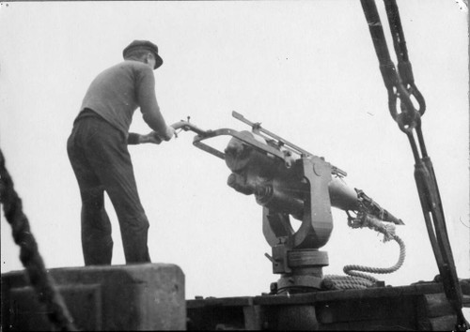
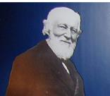
Change in the whaling industry
1870 Norwegian shipping magnate Svend Foyn
Inventions lead to industrial whaling
Harpoon gun
Factory ship and catcher boats
Slip way
Whale claw
https://calisphere.org/item/ark:/13030/c8057d19/
Notes:
A ship, called Admiralen was for 20 years a prototype of a floating factory ship.
This way to do the whaling was necessary because the vessels had to go further south and away from the shores – the whale population was decreasing and the vessels had to search in a wider area. From 1912 onward, the whales were processed more economically. Their meat and bones were also cooked and the oil extracted and after that process the material was crushed for fertiliser.
During WWI, the company Hector lost two ships (factory ships) in battle.

Slide 14
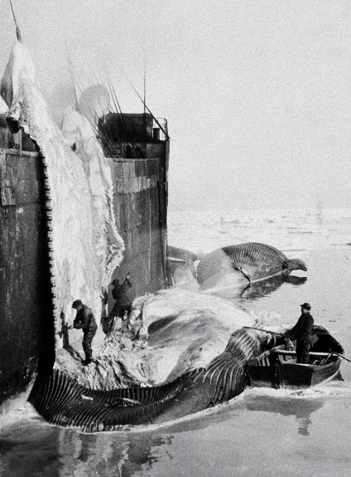
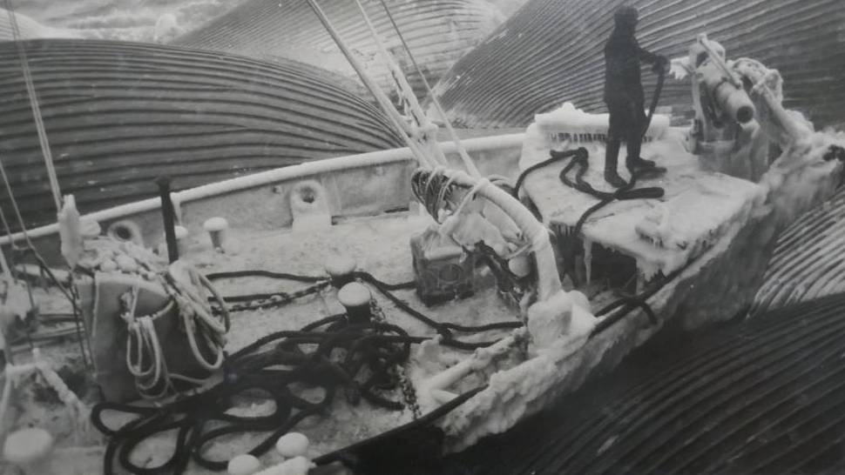
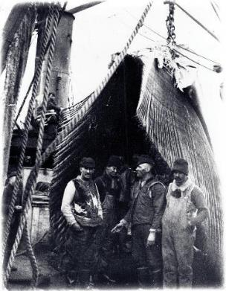
Whaling Working conditions
Flensing/Flanging
Catcher boat with whales in tow
Posing under
the baleen
Notes:
Whaling was a complex and challenging business and needed men who were not only brave but who had a variety of specialized skills.
When the Superior sailed to the Davis Strait in 1834 her master Donald Manson was in command of a surgeon, 4 harpooners, 2 boatswains, 5 boatsteers, 2 carpenters, 2 coopers, a manger in charge of lines, 2 seamen, 3 landsmen, 2 apprentices and a steward. One of the harpooners also acted as mate and another as specktioneer, and one boatswain was also skeeman.
The Master was responsible for the navigation and management of the vessel and the motivation of its crew, often under difficult and dangerous conditions. He also needed a detailed knowledge of the behaviour and distribution of whales and seals if he was to turn a profit.
The Mate was second in command and was often also the chief harpooner. He would usually share the main cabin with the Master and the Surgeon. The surgeon's main duty, of course, was to attend to illness and injuries, but he also usually served as clerk and kept the ship's log up-to-date. The surgeons were usually senior students from the medical schools in Aberdeen, Edinburgh and Glasgow, or recently qualified doctors. Without doubt, the best known surgeon to sail from Peterhead was Arthur Conan Doyle, the author of the Sherlock Holmes novels. In 1880, whilst still a student at Edinburgh, he sailed under Captain John Gray on the Hope (2).
The Spektioneer was in charge of the flensing process but the chopping of the blubber and its stowage in barrels by the harpooners and other crew was controlled by the Skeeman, the officer in charge of the ship's hold.
Whaling was, for the most part, a young man's business, particularly so for the unskilled labourers, with most in their teens or early twenties. The work was back-breaking and extremely dangerous. Like war, whaling consisted of long periods of hard work and sheer boredom, interrupted with moments of sheer exhilaration and terror. The living conditions below deck would have been rather sordid. The food consisted of rancid cheese and butter, salt beef and pork, all packed into barrels. There was so little fresh fruit and vegetables on board that sea-plague (scurvy) was inevitable for most crew.
For such suffering and hardship the crew received a basic monthly wage and usually a share of the profit from the oil and whalebone. In 1834 the master received a total of £120 (£7,229 at today's prices) for about six months work, the surgeon £16 14s (£1,006), the mate £43 8s (£2,614), and the spektioneer £31 18s (£1,921). At the other end of the spectrum the apprentice picked up just 18s 9d (£56), the steward £7 8s 10d (£448) and the line manger £17 4s 3d (£1,037).

Slide 15
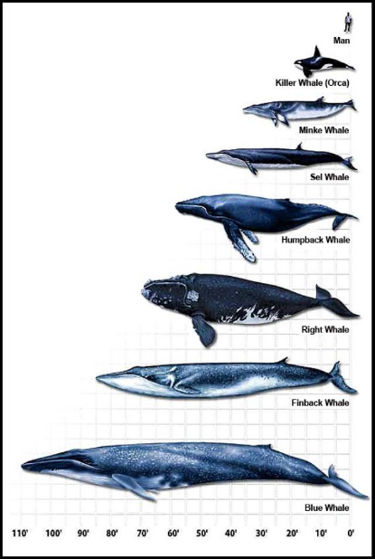
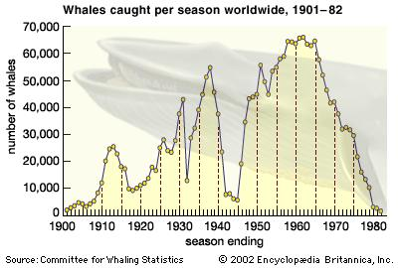
Hunted species
https://www.britannica.com/topic/whaling/media/641450/60413
https://dumielauxepices.net/wallpaper-3486940

Slide 16

1946 International Convention for the Regulation of Whaling – aim:
to provide for the proper conservation of whale stocks and thus make possible the orderly development of the whaling industry.
International Whaling Commission (IWC)
1982: moratorium on commercial whaling established and since 1985/86 in force
Regulates hunting of 13 species of great whales (whales, dolphins, porpoises)
Commercial fishing: Norway, Iceland, First nations in the Arctic, e.g. Inuit
and since December 2018: Japan

Slide 17
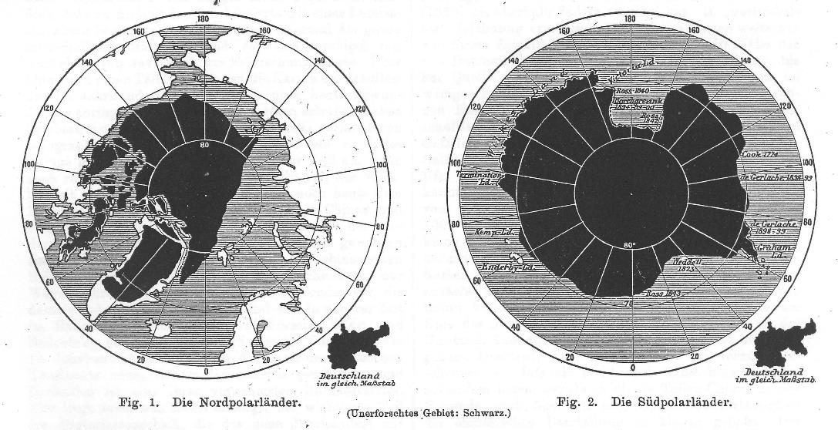
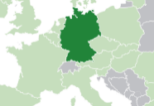
The unexplored areas about 1900
Shape of Germany, 2012
approx. the size of the black shape on the historic chart.
NZ 268,680 km²
Germany 357,022 km²
Notes:
The unexplored parts on the map started to shrink and it was the Antarctic what represented the biggest challenge. The idea was still to put national flags on this continent, even when Cook destroyed the idea as mentioned before.
The sealers and whalers were cautious not to reveal their maps – because the hunting grounds were too valuable.
What brings us to the next slide: interests in the Antarctic.

Slide 18
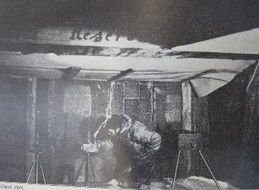
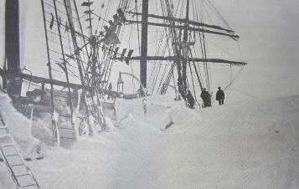
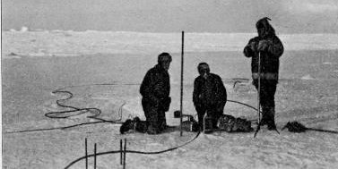
Science
Magnetism
Meteorology
Glaciology
Astronomy
Oceanography
Geology
Geography
Biology
Marine Science
Zoology
Climatology
Bacteriology
Magnetic hut (1901 – 1903)
Snow drift – ship Gauss (1901 -1903)
Ice temperature – Siemens resistance thermometer (1902)

Slide 19
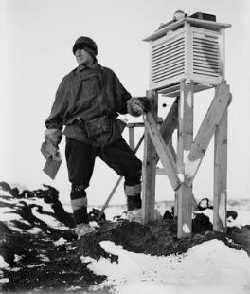
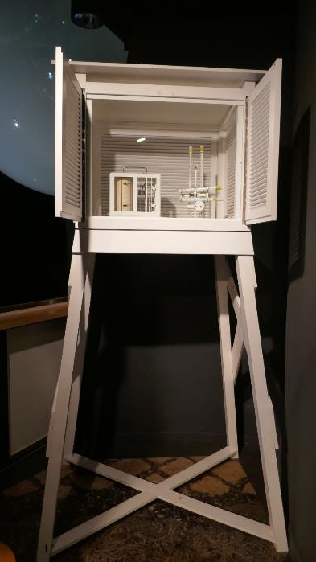
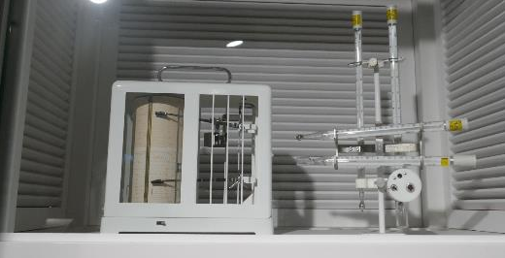
SPRI. Cambridge
Dr. Wilson – weather screen (1911)

Slide 20
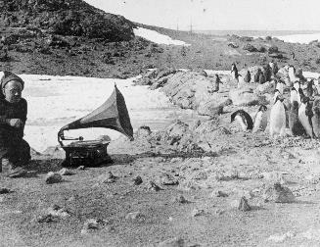
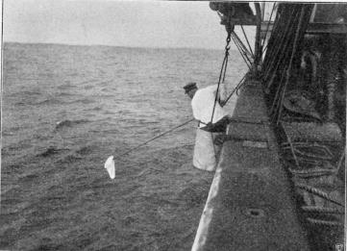
Science
How penguins react to music: Shackleton, Nimrod-expedition (1907 – 1909)
Collecting samples - Drygalski-expedition
Notes:
New instruments – adjustments – trouble shooting
On the way to the ice they started already with their program (biology/zoology, fishing samples, bacteriological samples, surface catches and deeper in the sea samples…..)
The third picture shows also some sort “fun-experiments”: how penguins react to music, there is also another example from William S. Bruce when they tried to find out how penguins react to bag pipe music ☺ - …)
But studies on penguins, seals, mosses, bacteria, etc. were serious business even when it seems sometimes that this was a sort of by-product to the geophysical science (geology, geography) and meteorology and magnetism.
Drygalksi’s output of the expedition: 20 volumes:
Vol 1 Geography
Vol 2 geography and Geology
Vol 3-4 Meteorology
Vol 5-6 Earth magnetism
Vol 7 Bacteriology and Oceanography
Vol 8 Botany
Vol 9-20 zoology
And four volumes of maps

Slide 21
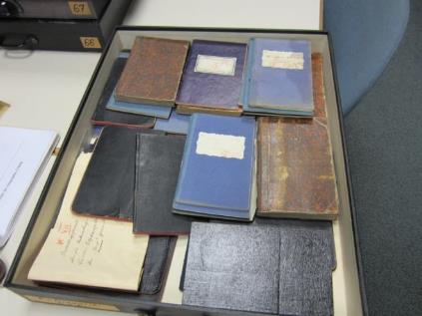
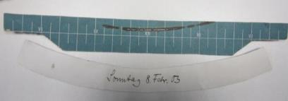
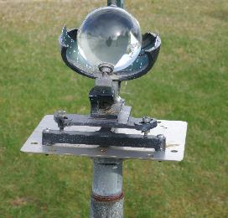
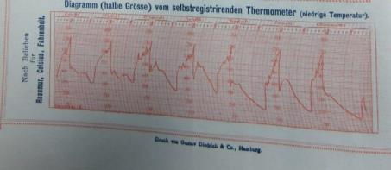
Records
Sun shine recorder strip
Collection of temperature and magnetism records (1901-1903)
Temperature recorder strip
Sun shine recorder in Stewart Island 2017
Images from ifl, Leipzig, Drygalski collection
Notes:
Meteorology and magnetism were very important for ship traffic and the economy (ship was the main transport, then came the train – later aeroplanes, but even today is the ship traffic for big loads of cargo still heavily used).
Some examples here: temperature observations, sunshine recorder, etc.
The historic records are important today for comparison and even some methods have not changed – there are automatic weather stations operating with 10 minutes sequences, but there are also the manual weather stations at Scott Base for overlapping measurements for purpose of comparison to provide long homogeneous measurement series.
Sunshine recorder strips are not used anymore e.g.

Slide 22
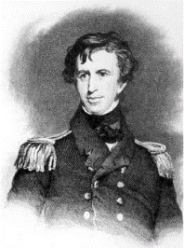
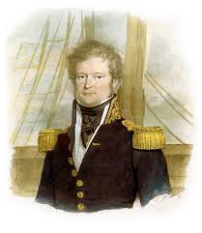
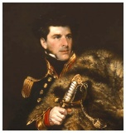
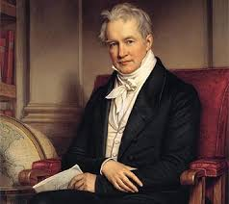
“National expeditions” between 1820s-1840s
Magnetic Poles
important for shipping
new technologies and establishing of science as discipline
Charles Wilkes
(1798 – 1877)
USA
Jules Dumont d’Urville
(1790 – 1842)
France
James Clark Ross
(1800 – 1862)
Britain
Inspired by Alexander von Humboldt
(1769 – 1859)
He was a Prussian geographer, naturalist, explorer – one of the founders of modern geography – his research transformed western science - he influenced many scientists in the 19th century: e.g. Charles Darwin (1809 – 1882)
Notes:
National Expeditions

Slide 23
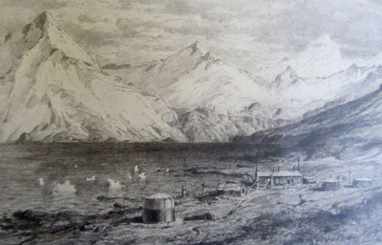
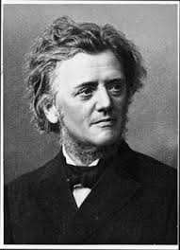
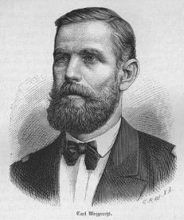
From national to international research
First International Polar Year (IPY) 1882 – 1883
15 coordinated expeditions
Participating countries in the Arctic:
USA (2 stations)
Germany (1 station)
Austro-Hungary (1 station)
Sweden (1 station)
Russia (2 stations)
Netherlands (1 station)
Britain (1 station)
Denmark (1 station)
Norway (1 station)
Finland (1 station)
France (1 station)
Georg von Neumayer
1826 - 1909
Carl Weyprecht
1838 - 1881
2 expeditions in the Antarctic
Germany (1 station)
France (1 station)
Notes:
In the late 19th c. and beginning of the 20th c. science was established in a certain way more or less. The Challenger Expedition (1874)
1882-83 First Intern. Polar year.

Slide 24
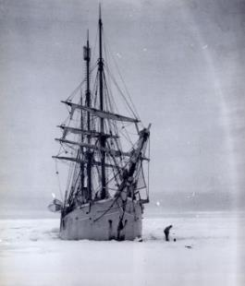




First overwintering in the Antarctic – Belgica Expedition 1897–1899
https://en.wikipedia.org/wiki/Adrien_de_Gerlache
Adrien Victor Joseph de Gerlache de Gomery
1866–1934
https://www.antipodean.com/pages/books/24255/henryk-arctowski-antarctic/antarctic-voyage-of-the-belgica-during-the-years-1897-1898-and-1899?soldItem=true
Literature: ☺
Sancton, J. (2021) The madhouse at the end of the world. ISBN:9780753553466
https://topfacts.org/15-facts-about-roald-amundsen/
Roald Amundsen
1872–1928

Slide 25


The term cryosphere
Hardship in his youth in the Russian occupied part of Poland – took on work with 12 years to pay for his education
Sailor on the Belgica and during journey assigned to the science staff (meteorologist Henryk Arctowski)
Continued studies after expedition and worked as teacher and scientist
Natural history of ice, 1923; cryology/cryosphere first time used as term
Greek: Krios = icy cold
Antoni Bolesław Dobrowolski
1872 – 1954
It took 50 years to accept the concept (all forms of snow and ice on land, water, and under the ground) and the term cryosphere, now used by the wider English speaking research community.
https://www.news-medical.net/life-sciences/Microbiology-of-the-Cryosphere.aspx
Notes:
Dobrowolski was a poor speaker although he was fluent in Polish, German, French, English and Russian, however, he was a great writer. Sixth General Assembly of the International Union of Geophysics and Geodesy, Edinburgh 1936 conference.
The International Association of Scientific Hydrology (IAHS) members persisted that glaciology is a sub-discipline of hydrology.
D was a political activist in his youth – he lived in the Russian occupied part of Poland and was sent to the Caucasus but could escape after two years camp life – went to Switzerland where he met Arktovski who could persuade him to join the Belgica expedition.

Slide 26


Neumayer continued to push on the idea for an Antarctic expedition in terms of the 1st IPY
Geographical congresses and meetings with focus on the Antarctic were held from the 1880s on
Progress was made in the late 1890s
Sir Clements Markham
1830 - 1916
Georg von Neumayer
1826 - 1909
Science developed slowly more an international approach

Slide 27
This was the start for an international collaboration in the Antarctic 1901-1903
After a paper (53 pages) from Neumayer about the importance and significance on research in the South Polar Regions at the 6th Int. Geogr. Congress, 1896, Sir Clements Markham (1830 – 1916), president of the Royal Geographical Society opened the discussion with:
“The completion of such a work as that outlined in Dr. Neumayer’s admirable paper will result in one of the grandest discoveries of the nineteenth century, and our warm and most hearty thanks are due to him for the able manner in which he has brought together all the scientific results which will accrue therefrom.”
In the same meeting Sir Joseph Hooker pointed out:
“In the first place, the key to the future knowledge of terrestrial magnetism lies in the determination of the exact position of the south magnetic pole; […] The second of these great problems is the meteorology of the Antarctic area, of which we know the barest outlines only. The third problem is the geology of the region in question […].”
A plea at the end of the speech that his “[…] Congress will be the means of inducing an international co-operation in polar discovery”
(Report of the Sixth International Geographical Congress. London 1896, pp163 https://ia601702.us.archive.org/1/items/jstor-196860/196860.pdf (last accessed: 1 February 2016)
Notes:
Several Geographical congresses and meetings were held and certain question regarding to the Antarctic research always appeared. Neumayer got not tired to bring it on the table and gave in 1896 a 53 pages paper on the importance of this kind of research.

Slide 28
Expeditions during the “Heroic Era“
Time Leader Ship Country
1898-1900 Borchgrevink Southern-Cross Great Britain
1899-1900 Gerlach Belgica Belgium
1901-1903 Scott Discovery/Morning
since 1903: Terra Nova Great Britain
1901-1903 Drygalski Gauss Germany
1901-1903 Nordenskjöld Antarctic Sweden
1902-1905 Bruce Scotia Scotland
1903-1905 Charcot Français France
1907-1909 Shackleton Nimrod Great Britain
1908-1910 Charcot Pourquai Pas? France
1910-1913 Scott Terra Nova Great Britain
1910-1912 Amundsen Fram Norway
1911-1912 Filchner Deutschland Germany
1911-1914 Mawson Aurora Australia
1911-1912 Shirase Kainan-maru Japan
1914-1917 Shackleton Endurance/Aurora Great Britain
Notes:
A strong sense of nationalism was in all of these expeditions. It was the time of imperialism and colonialism. To gather land, to be on the top of the economic power, the thinking of the dominance of the “white race” Scott the English gentleman and Amundsen as the Viking

Slide 29



Swedish South Polar Expedition 1901 – 1903
The first who explored the Larsen Ice Shelf
Ship “Antarctica”
Recognised the different ice conditions = shelf ice (later: ice shelf)
In historical texts: ice barrier
Otto Nordenskjöld
1869 - 1928
Weather station
Pictures: Nordenskjöld, O. et al. (edit) 1904. Antarctic: zwei Jahre in Schnee und Eis am Südpol. vol.1
Notes:
This was a private expedition but with expectations. Nordenskjoeld was in contact with the British and German expeditions. The place for observation should be Graham Land on the Antarctic Peninsula. A second group shoul work from onboard the ship around the Beagle Channel, the Falkland Islands and South Georgia. To finance the expedition, there should also whaling and sealing going on which was under the command of Captain Carl Anton Larsen, the later whalling station leader in Grytviken. The expedition had to face the loss of the ship and had to overwinter under extreme hard conditions. An rescue mission saved the men from Snow Hill Island, Paulet Island. The scientific collection was than published between 1904 and 1920. They explored the Larsen ice shelf and N. created the term shelf ice which was then swapped in ice shelf be the British in the 1950s.

Slide 30




Hope Bay – Esperanza Base
©Ursula Rack, January 2020
©Ursula Rack, January 2019
Macmillan Brown Library, Q 115.6. S968

Slide 31




©Ursula Rack, December 2022
22 men overwintered at Paulet Island
10 meter
7 meter

Slide 32

1… Snow Hill Island
2… Paulet Island
3… Hope Bay
3
2
Distances between the groups:
SHI – PI 100km
SHI – HB 125km
PI – HP 60 km
1
32

Slide 33


The Larsen Ice Shelf
33
N
Temperature increase
1958-2001: +3 degrees
V
S
V
Swedish Antarctic Expedition 1902
Overwintering at Snow Hill Island
First expedition to the Larsen Ice Shelf
The “first” Ice Shelf (Schelfeis)
Otto Nordenskjöld
As a result of “Polar amplification”, temperature in the Arctic and the Antarctic Peninsula are rising quickly:
https://www.tvnz.co.nz/one-news/world/south-pole-could-disintegrate-if-antarcticas-record-breaking-warmth-keeps-up-experts

Slide 34

Northern Larsen Ice Shelf: retreat and collapse
A
Critical limit for the existence of ice shelves
High vulnerability to climate warming
Seal Nunataks
B
50 km
Notes:
Beschleunigung der Einflußgletscher des Larsen Schelfeises
Abbildungen von Maryland

Slide 35



German South Pole Expedition 1901 - 1903
Discovered:
Kaiser Wilhelm II Land and the Gaussberg
Observations on ice, meteorology and magnetism
Erich von Drygalski
1865 - 1949
Ship: “Gauss”
Result: 20 volumes of scientific results and 2 volumes with maps
Balloon observations 1902
Notes:
50 weeks captivity in the ice – drifted – set free 8.2.1903 (log book) – different position entrees.
Left: the weather station on the ship where the data is from for the graphic right hand side. In the middle the weather station near the ship on the ice.
The problem was often the instruments – they were sometimes not strong enough and in the diaries there are a lot of complains about that (mercury, broken glass, frozen ink etc.)
There is a PhD in process at Gateway Antarctica about the condition and accuracy of the instruments by Andrew Atkins and also a paper by Julian Dowdeswell and Catharine Ward on the Metrological Instruments and observations made during the 19th century exploration of the Canadian Northwest Passage, 2006 (Arctic, Antarctic and Alpine research, vol 38, no 3, Aug 2006) pp 454-464
The datasets what we need from that expedition is published and 800 pages strong. The access to few diaries is available, but not that much as from the following expedition.

Slide 36



Second research group on the Kerguelen Islands
Map 1903

Slide 37

http://www.photolib.noaa.gov/htmls/corp2854.htm
Ship Gauss, frozen into the ice, 29th March 1902
Picture was taken from a balloon which was doing observations on the ice. This was the first aerial picture taken for science purposes in the Antarctic.

Slide 38



Second German Antarctic – Expedition 1911 – 1912
Wilhelm Filchner
Leader, cartographer, magnetism
Wilhelm Filchner
1877 - 1957
Ship: “Deutschland”
Plan: to investigate whether the southernmost portion of the Atlantic and southernmost portion of the Pacific Ocean were separated by a land bridge or whether they were connected by an ice/covered channel.

Slide 39



This expedition had massive problems (see lecture 4); however, they achieved great results in scientific terms:
discovered Prinz Luitpold Land and Filchner-Ronne Ice Shelf
Filchner Trench (deep sea oceanographic measurements)
https://play.google.com/store/books/details?id=EY4NAQAAIAAJ&rdid=book-EY4NAQAAIAAJ&rdot=1&pli=1
Filchner’s scientists
Proposed expedition

Slide 40



The Antarctic Convergence
40
West wind drift is piling up water to the left of the ACC because of the Ekman drift.
Convergence zone encircling Antarctica between 50º-60º S.
This marks the boundary between Subantarctic surface water and the Antarctic circumpolar water.
Wind (ACC) into page
Subantarctic
Antarctic subsurface water masses
Notes:
Is this too complicated?
Is there a way to simplify this?

Slide 41



The “race” to the pole
https://www.worldatlas.com/articles/roald-amundsen-famous-explorers-of-the-world.html
https://fineartamerica.com/featured/1-robert-falcon-scott-antarctic-explorer-mary-evans-picture-library.html
Roald Amundsen
1872 - 1928
Robert Falcon Scott
1868 - 1912

Slide 42



Science
© H Ponting photograph, Pennell collection, Canterbury Museum, New Zealand
http://nhm.ac.uk/nature-online/earth/fossils/glossopteris/index.html
Griffith Taylor and Frank Debenham working in the Cape Evans hut
Fossilized leaf of Glossopteris indica collected by Scott’s polar party 1911-1913 (proof of continental drift)
Penguin eggs collected at the “worst journey in the world” to prove the so-called “law” of phylogenetic recapitulation, which holds that embryos reflect the stages of their evolutionary past as they develop – rebutted today

Slide 43


Science and arts
©Ursula Rack
Leopard seal hunting a penguin Edward Wilson, water colour

Slide 44

International Geophysical Year 1957-1958
Cold war – situation:
International collaboration:
brought together scientists of both “blocks”
– the significance of Antarctic research recognised
– to keep peaceful research in the Antarctic
– Antarctic Treaty system (ATS) established in 1959
http://www.antarctican.org/antarctican_society/PDF%20Files/pack_ice/Antarctic_Recollection_Art_Jorgensen.pdf

Slide 45



Buedeler, Werner; UNESCO and its programme XV. The international geophysical year, France 1957
http://unesdoc.unesco.org/images/0012/001284/128401eo.pdf
Satellite
Glaciology
Seismic and geodetic surveys
Earth magnetic field from core of the planet into space
Aurora Australis
Biology
Oceanography
Aurora
Notes:
neutrinos
a neutral subatomic particle with a mass close to zero and half-integral spin, which rarely reacts with normal matter. Three kinds of neutrinos are known, associated with the electron, muon, and tau particle.

Slide 46

From IGY – Antarctic Treaty System
Purpose: Antarctic Treaty to ensure "in the interest of all mankind that Antarctica shall continue for ever to be used exclusively for peaceful purposes and shall not become the scene or object of international discord.“
Signed on 1 December 1959 by 12 nations involved in the IGY:
Argentina, Australia, Belgium, Chile, France, Japan, New Zealand, Norway, South Africa, United Kingdom, and the USSR
1961 entered into force
Jurisdiction area: under 60ºS
The Antarctic Treaty (1959) full text to see under this link
https://www.ats.aq/devas/

Slide 47

So far: 54 nations have signed the Antarctic Treaty.
No country owns Antarctica, although seven nations (Argentina, Australia, Chile, France, New Zealand, Norway and the UK) have “claimed” portions of it.
All territorial claims are to be set aside. No acts or activities taking place while the present AT is in force shall constitute a basis for asserting , supporting or denying a claim to territorial sovereignty in Antarctica or create any rights of sovereignty in Antarctica.
Antarctica is to be used for peaceful purposes only
All scientific information is to be shared
All vessels and scientific stations are to be open for inspection at all times
Nuclear explosions and the disposal of nuclear waste are prohibited.
https://www.landcareresearch.co.nz

Slide 48

Three international agreements
Convention for the Conservation of Antarctic Seals CCAS (1972)
Convention on the Conservation of Antarctic Marine Living Resources CCAMLR (1980)
Protocol on Environmental Protection to the Antarctic Treaty (1991) also known as Madrid Protocol
Environmental assessments being carried out before any human activity begins
Pollution and waste disposal regulations
Wildlife conservation regulations
Ban on mineral exploration.
Came into force 1998
https://www.bas.ac.uk/about/antarctica/the-antarctic-treaty/
This makes the AT to the ATS (Antarctic Treaty System)
https://www.landcareresearch.co.nz
Notes:
Environmental assessments being carried out before any human activity begins
Pollution and waste disposal regulations
Wildlife conservation regulations
A ban on mineral exploration.

Slide 49


Research in the Antarctic and the
Southern Ocean
.
National Antarctic Programs*: e.g.: https://www.antarctic-office.org.nz/collaborate/national-antarctic-programmes
COMNAP (Council of Managers of National Antarctic Programs) https://www.comnap.aq/
SCAR (Scientific Committee on Antarctic Research) https://www.scar.org/
*37 National Antarctic Programs members of COMNAP (33 members and 4 observers)
e.g: South Africa, New Zealand, Norway, USA, UK
and 4 National Antarctic Programs Observers
© Wendy Clavano 2009/10
http://adam.antarcticanz.govt.nz/nodes/view/32874

Slide 50

68 stations so far in the Antarctic
32 all year-round stations
34 seasonal stations
https://www.comnap.aq/Members/Shared%20Documents/COMNAP_Antarctic_Station_Catalogue.pdf
Notes:
Antarctic Treaty Secretariat in Buenos Aires, organising the annual meetings – provide and distribute information and archive treaty documents.

Slide 51


https://www.linkedin.com/posts/alvinfsc_antarctica-the-confusing-continent-activity-7159682112411865088-lTRd/

Slide 52


©Ursula Rack, January 2024
Ursula.rack@canterbury.ac.nz
©Ursula Rack

