Slide 1

Stress, rhythms and the brain
Professor Richard Porter
Head of Department
Department of Psychological Medicine
University of Otago, Christchurch
Consultant Psychiatrist, Te Whatu Ora

Slide 2
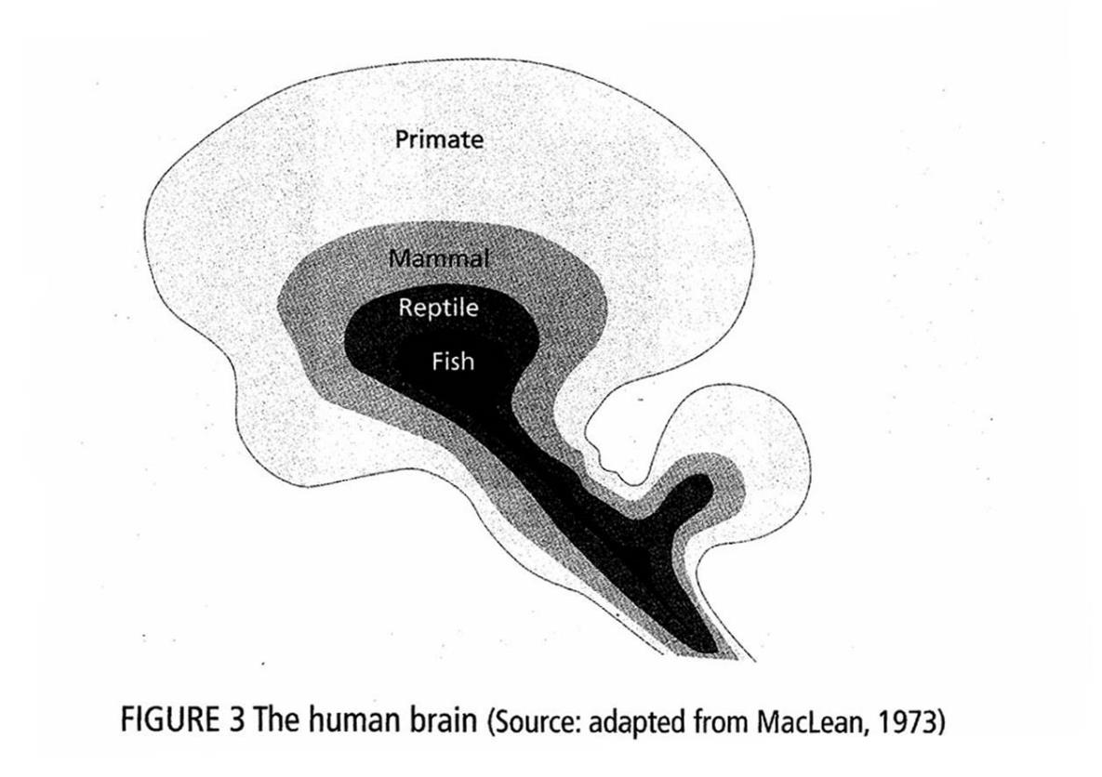
Evolution of the brain

Slide 3
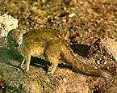
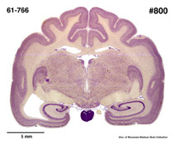

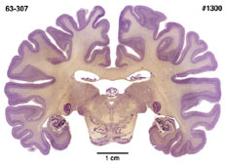

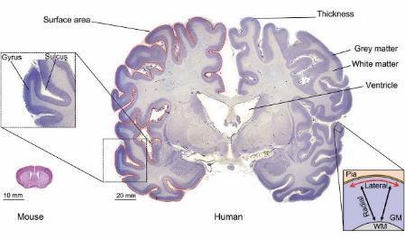

Slide 4
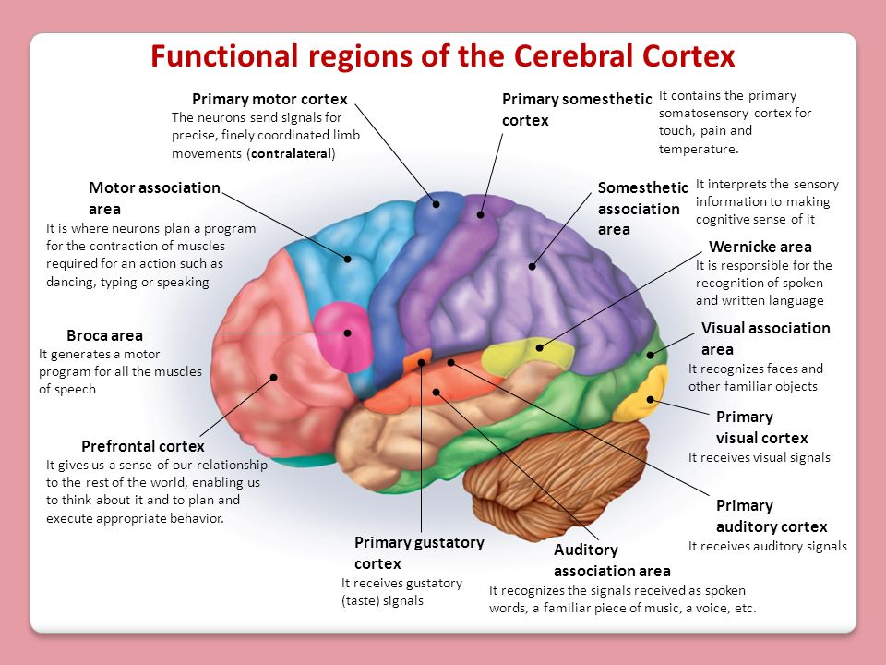

Slide 5
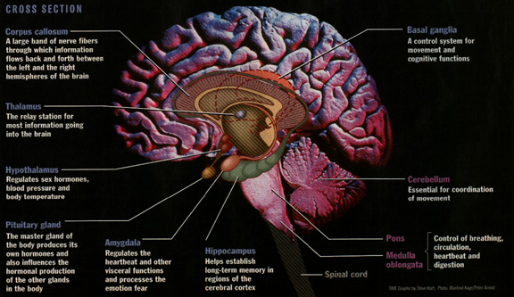

Slide 6
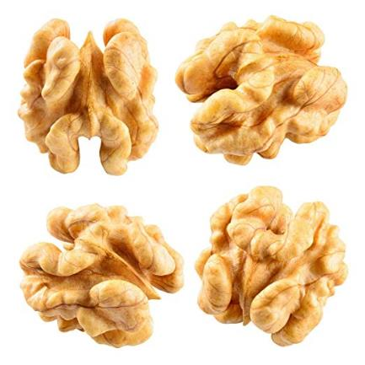
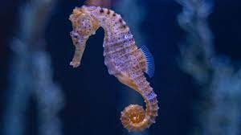
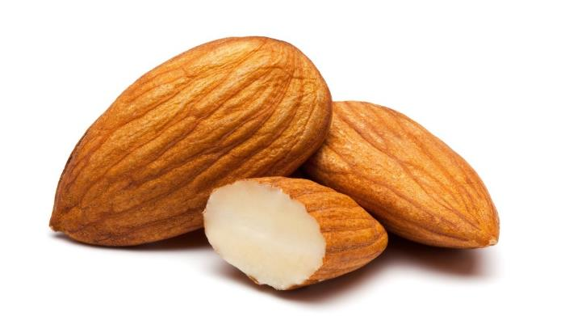
Important bits of the brain!
Prefrontal cortex
Hippocampus
Amygdala

Slide 8

McDonald et al 2000

Slide 9
Rey Verbal Learning Task (Rey 1960)
Drum
Curtain
Bell
Coffee
School
Parent
Moon
Garden
Hat
Farmer
Nose
Turkey
Color
House
River

Slide 12


Slide 13
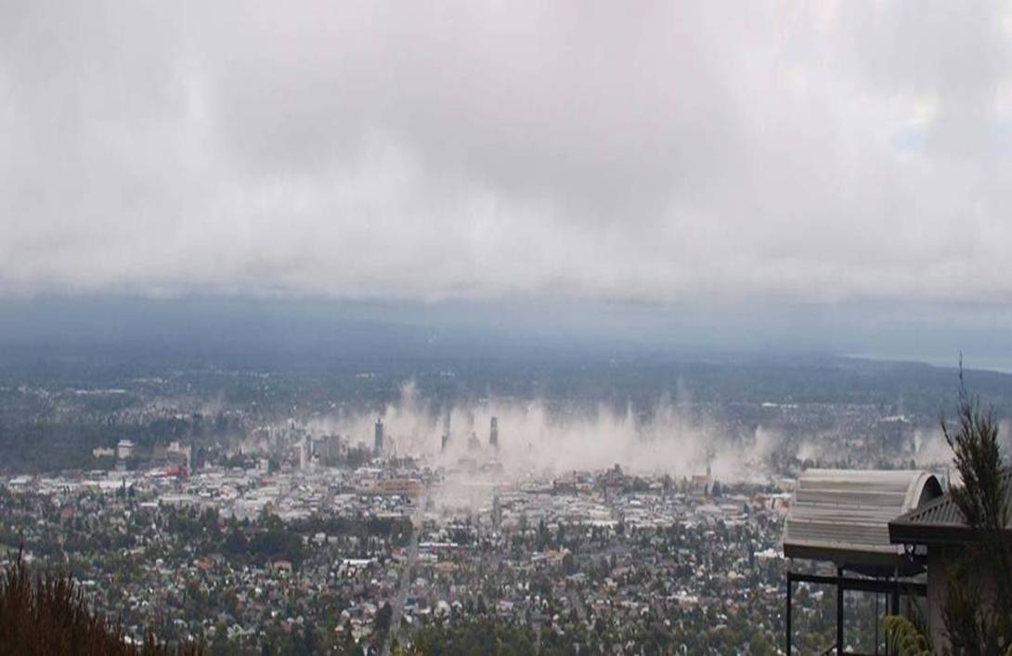

Slide 14
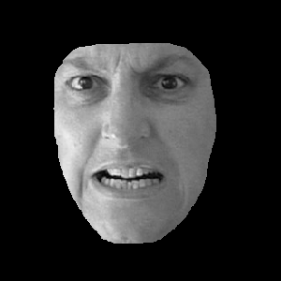


Slide 15



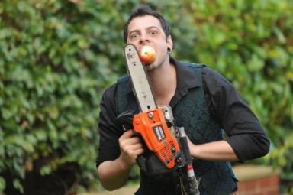
Threat
(Ground Shakes,
Angry face)
Body Senses the Shaking
Eyes see the angry face
Tom Thalamus
Thalamus
(Integrates Sensory Information)
Andy Amygdala
Ilhan -Prefrontal cortex
Harry Hippocampus
Stress Response
(Action + Hormonal Response)

Slide 16



Psychological
Stresses
Sensory experiences
Tom
Amygdala
(Fear/Fight/Flight)
Rambo
Harry
Ilhan
Hippocampus
(Memory)
Stress Response
Cortisol, adrenalin, Changes in perception, rumination
Pre- Frontal Cortex
(Conscious Processing)

Slide 17
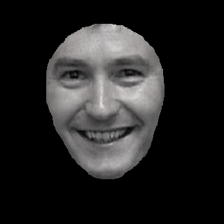
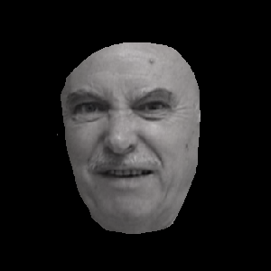
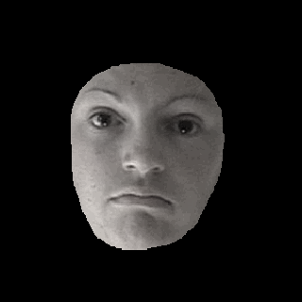
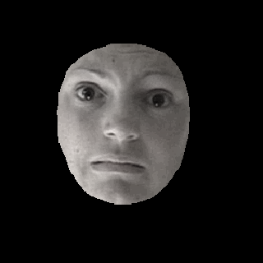
Disgust
Fear
Happiness
Sadness
Anger

Slide 19
Effects of earthquake related stress on Cognitive function
Study conducted over 3 years (2012-2015)
3 groups:
  PTSD patients(n = 28)
  Earthquake-exposed controls (moderate to high exposure to traumatic events) (n = 89)
  Historical non-exposed controls (n = 50)

Slide 20
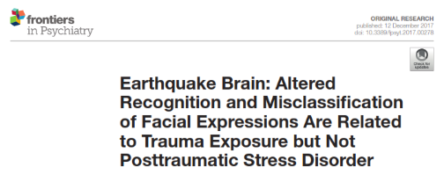
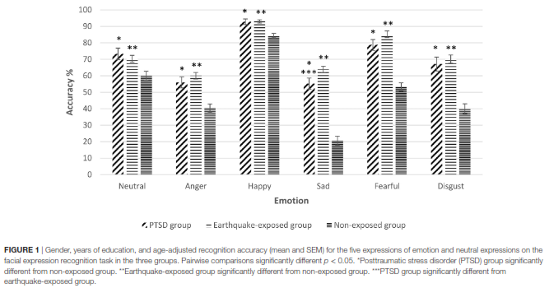

Slide 22


Slide 23


Slide 24
Does this last forever?
8-9 years post earthquake
59 “resilient” people
61 people living in Dunedin

Slide 27
Take home messages
Acute stress causes flight fight areas of the brain to take over
Longer term that is not adaptive and potentially has serious mental health consequences
Post earthquake this appears to have reversed for most people

Slide 28
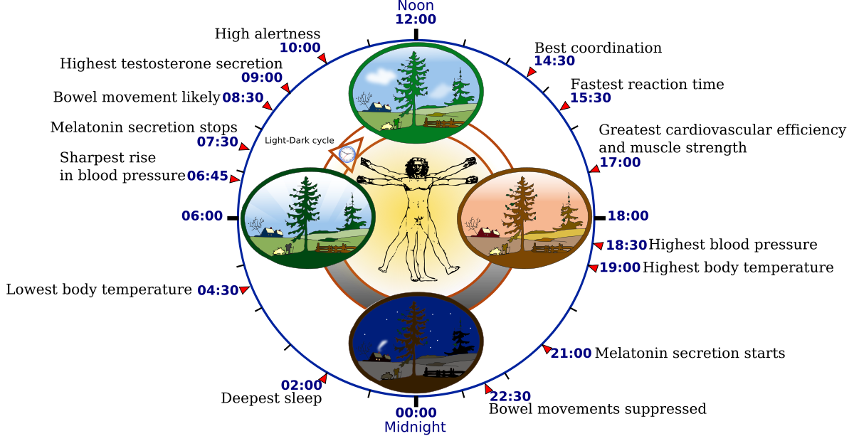

Slide 29
What sets your body rhythm?
LIGHT (especially blue light)
Social information
Local circadian oscillators (rhythm is near 24h) – CLOCK genes
Sleep homeostasis

Slide 30
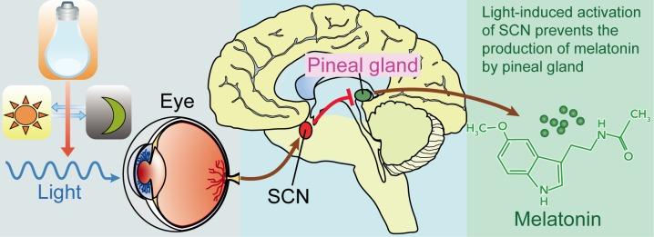
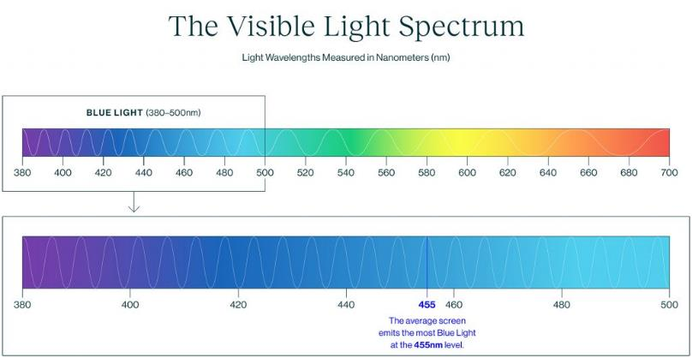

Slide 31
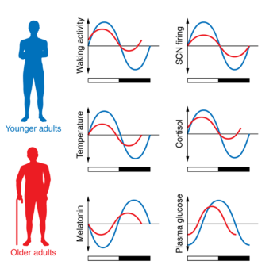
Changes with aging
Yellowing of the lens
Cataracts
Reduced fluctuation of all bodily functions
Change to “morningness”
Less sleep, dreamless sleep, more awakenings, harder getting to sleep

Slide 32
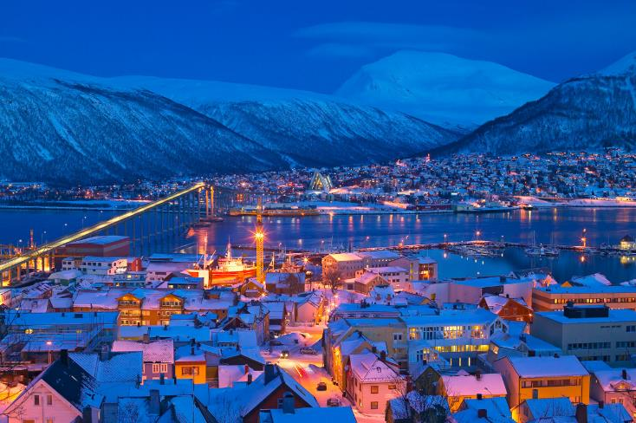


Slide 33
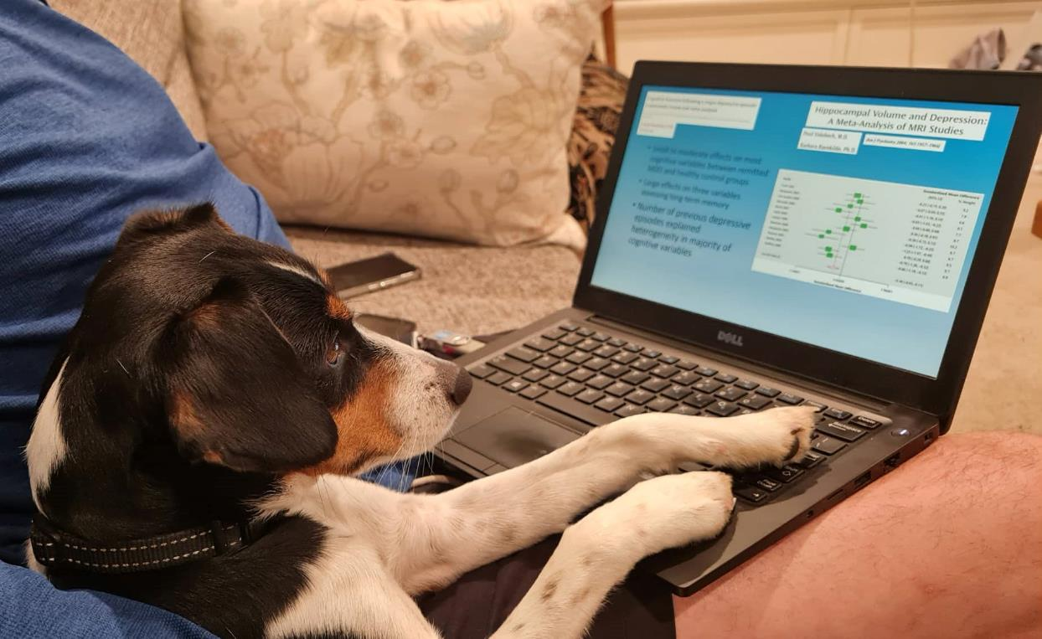

Slide 34

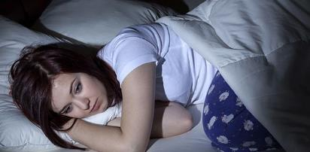


Circadian rhythm and mood – the vicious cycle
Inter-personal Stress
Sleep Loss
Disruption of Circadian Rhythm
Poorer Coping
Lower Mood

Slide 35
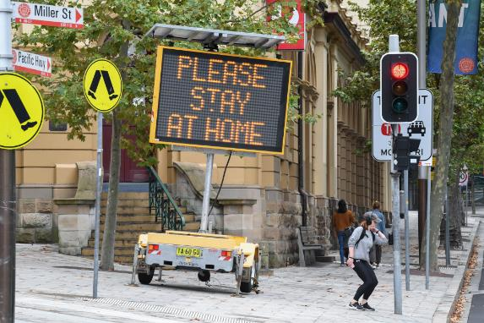
Does a decrease in social rhythmicity worsen mood?
April to June 2020, August to September 2020
Multi-national 2 wave survey
Self reported Mood disorder diagnosis (depression/bipolar disorder), aged 18-65
Scales of social rhythmicity(SRM) and depression (PHQ-9)

Slide 36
Brief social rhythm scale
Diary measure of
Getting out of bed
First social contact
Commencing school/work
Having dinner
Going to bed

Slide 37
Kahawage et al Can J Psychiatry 2022

Slide 38
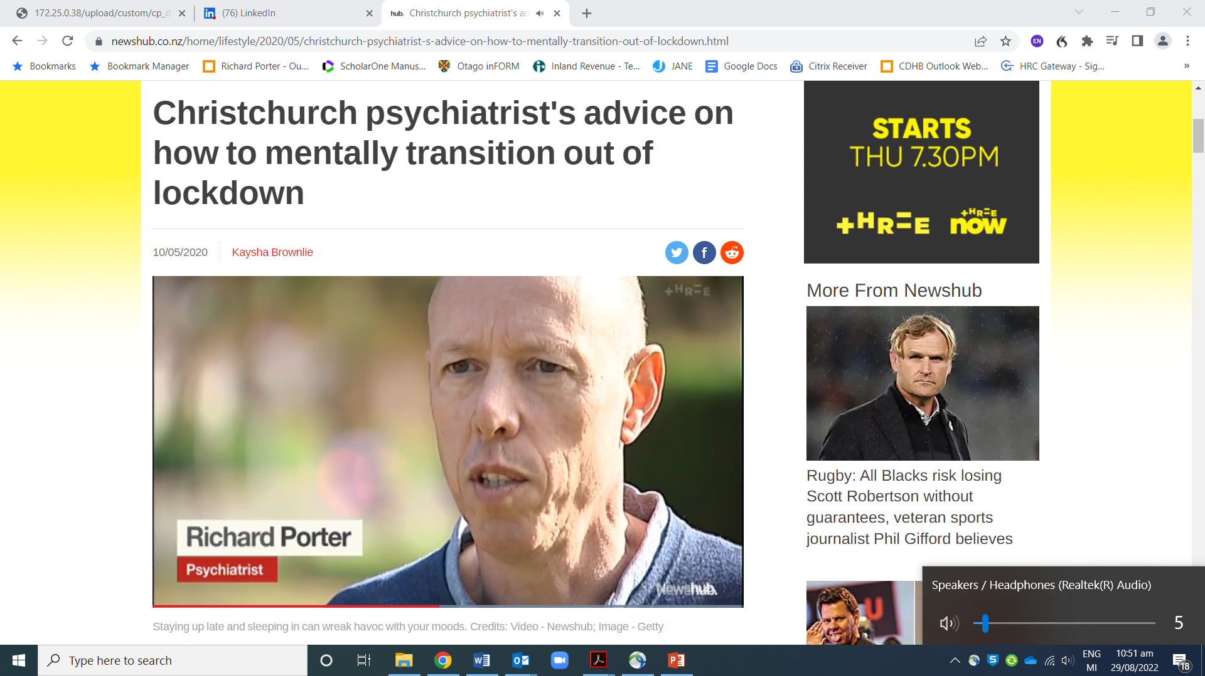

Slide 39
Results
Low mood associated with lower social rhythmicity
In a follow up 3 months later low social rhythmicity predicted low mood

Slide 40
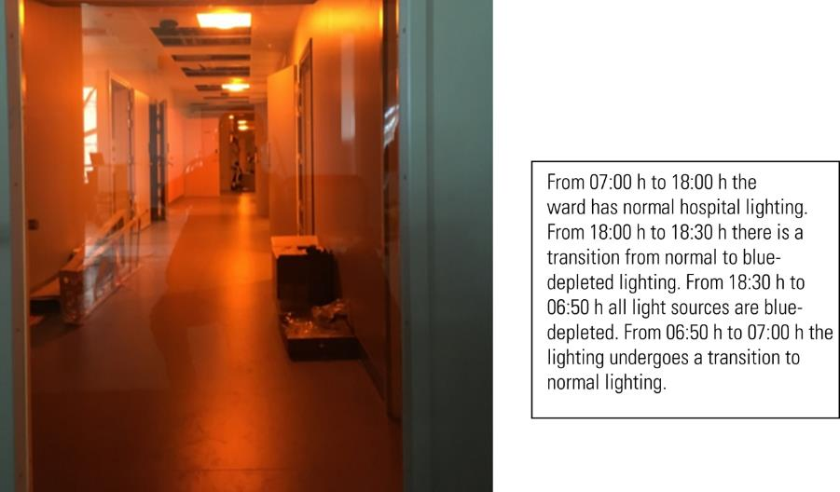
St Olav’s Trondheim

Slide 41


Slide 42

Thank you !

Slide 43





THANK YOU
Caroline Bell Katie Douglas Jenny Jordan Cameron Lacey Gini MacIntosh Chris Frampton Will Moot Rebekah Smith Jenny Jordan | Emily Douglas Andrea Bartram Bridget Kimber Hayley Wells Rachel Day-Brown Melissa Purnell Helen Colhoun Francis Carter Leila Marie Janet Carter

