Slide 1
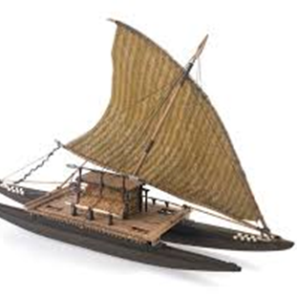
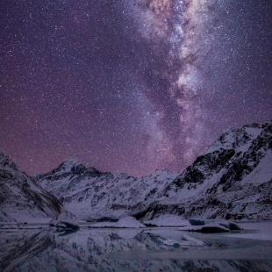
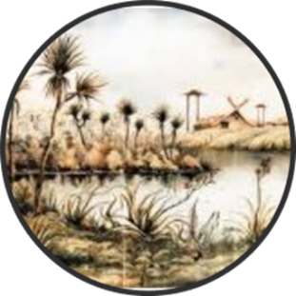
Kāi Tahu
Our ancestors were the first long distance seafarers who explored and populated the Pacific. Riding the ocean currents, navigating by stars, trade winds, and the migratory patterns of species Aotearoa became home.
We learnt to adapt quickly living in this formidable southern environment, establishing permanent and semi-permanent settlements throughout Te Waipounamu.
Kāi Tahu/Ngāi Tahu means ‘the people of Tahu’ acknowledging our lineage and connections.

Slide 2
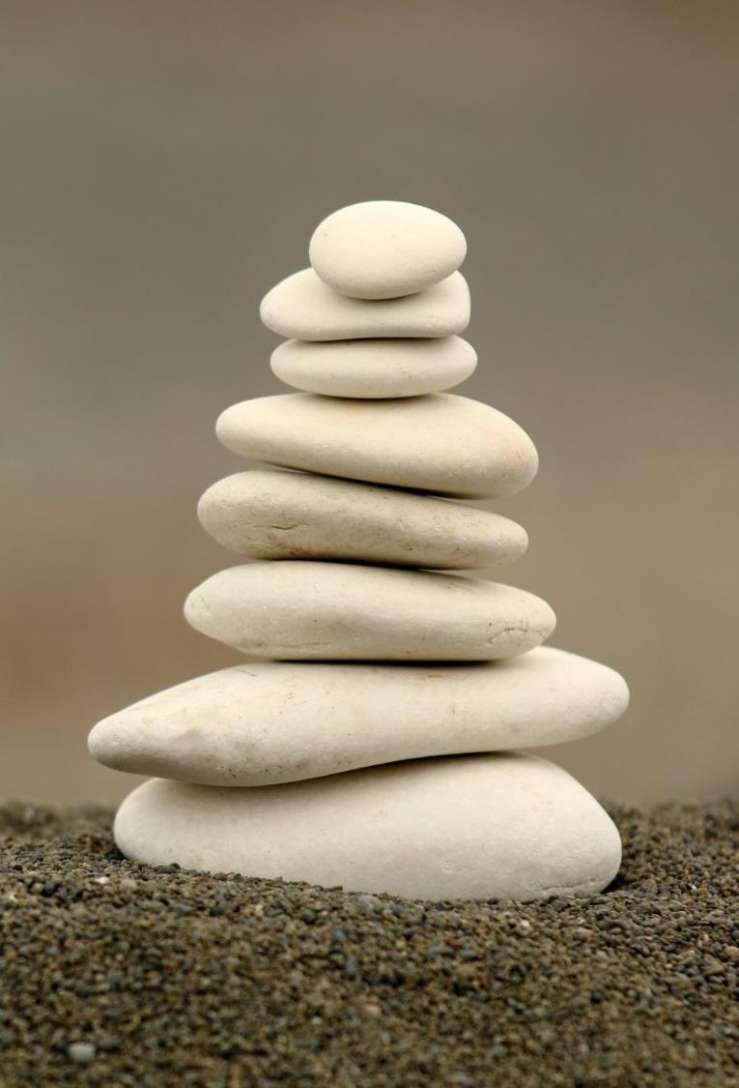
Cultural Narratives
A corpus of knowledge that follows a framework based on values and priorities.
The skyscape and landscape are embedded with the names and deeds of our ancestors serving as markers that illustrate our oral traditions.
Observing, reading and interpreting the stars and sky builds our knowledge and understanding of the natural world/universe.

Slide 3
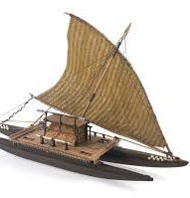
Mātauraka Māori- Indigenous knowledge
Modern term – combined knowledge of Polynesian ancestors and the experiences of iwi living in the Aotearoa environment/Te Waipounamu.
Tātai aroraki: observing, recording, reciting the stars. Applied in time keeping systems.
Study the sky to determine weather patterns and mark season (the return of birds with the appearance of stars).

Slide 4
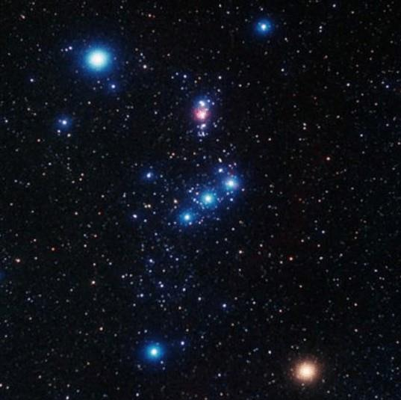
What is Puaka?
Star (Rigel in Orion)
Phase in the luni-solar time keeping system
Mahika kai - Tītī, Tuna
Weather/Season
setting in the West, a time of frost.
Rising in the East during winter, Spring on way

Slide 5
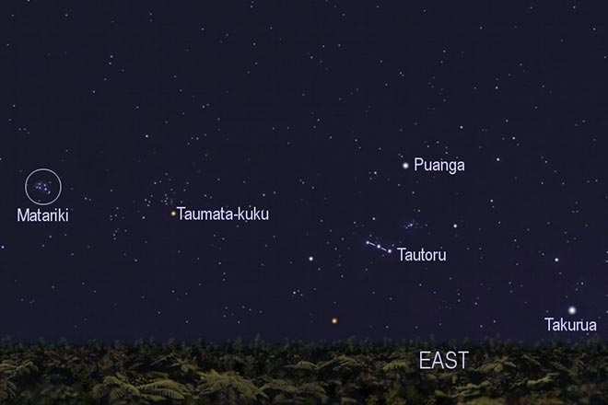
What is Matariki?
Star (Alcyone)
Star cluster (Pleiades/M45)
Phase in the luni-solar time keeping system – winter solstice
Mahika kai – seasonality
Internationally associated with seasons, planting, harvesting, weather, religion, death and new life.

Slide 7
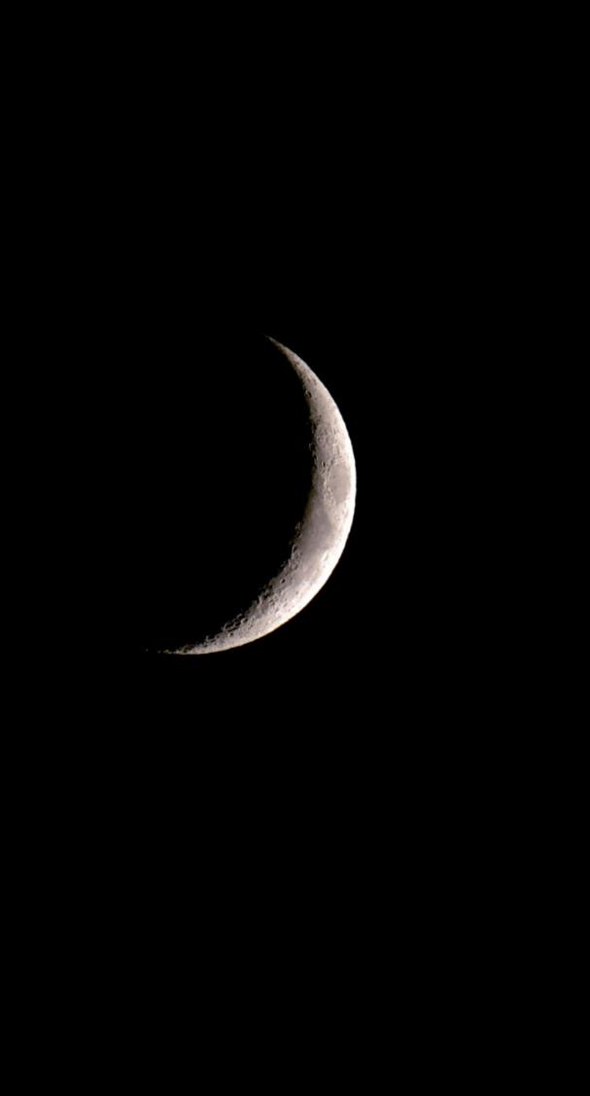
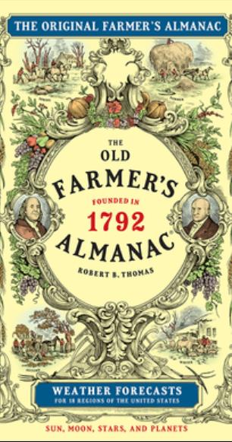
Maramataka
Marama Moon
Taka Almanac
Maramataka Moon almanac
Nā Rangi Mātāmua-Te Tau Toru Nui o Matariki 2023

Slide 8
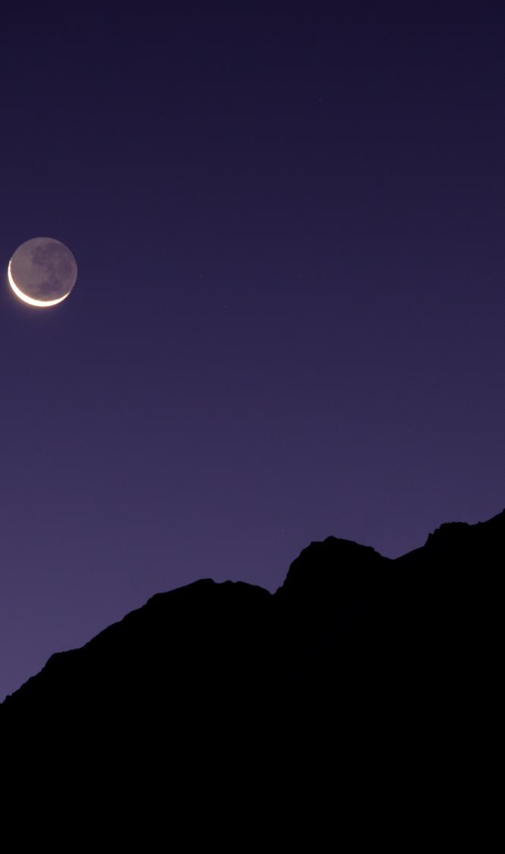
Luni-solar calendar
Position of the sun
Phase of the moon
Heliacal rising, rising of stars
Environmental indicators
Reconciliation of the moon and the sun

Slide 9
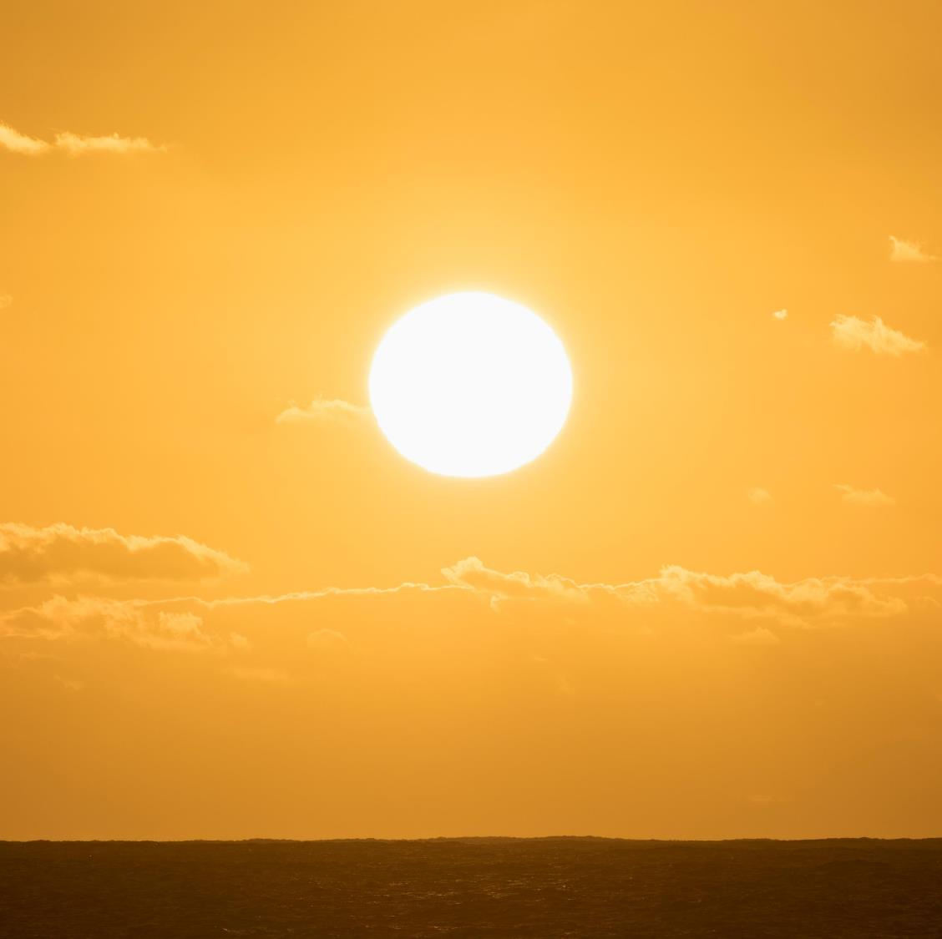
Te Rā (The Sun) Season
RākuraRātuoi Hineraumati
Hinetakurua
Te Ara Whānui a Tāne

Slide 10
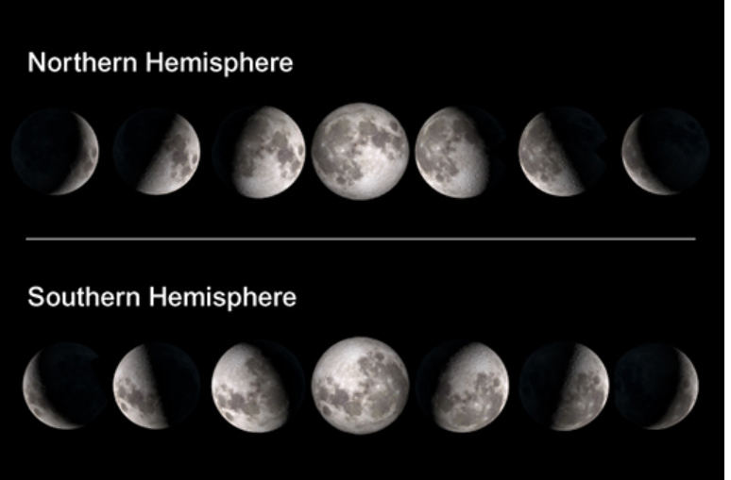
Te Marama (The Moon)
days/nights of the month
Activity

Slide 11
Takaroa

Slide 12
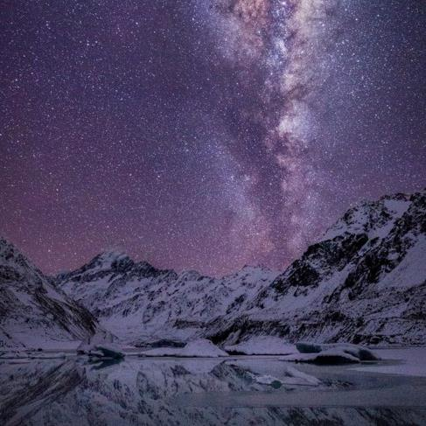
Kā Whetū The Stars
Period of the season/Activity
Setting of stars – ending the season
Rising of stars – denoting the new season
13 stars system

Slide 13
The Environment
Winter – time to gather
Spring – time to dig, blooms, birds
Summer – garden and biodiversity time
Autumn – harvest time

Slide 14
Maramataka Luni-Solar
Sun = season
Star (dawn sky) = period of season
Moon phase = activities for the period
Environment= natural indicators

Slide 16
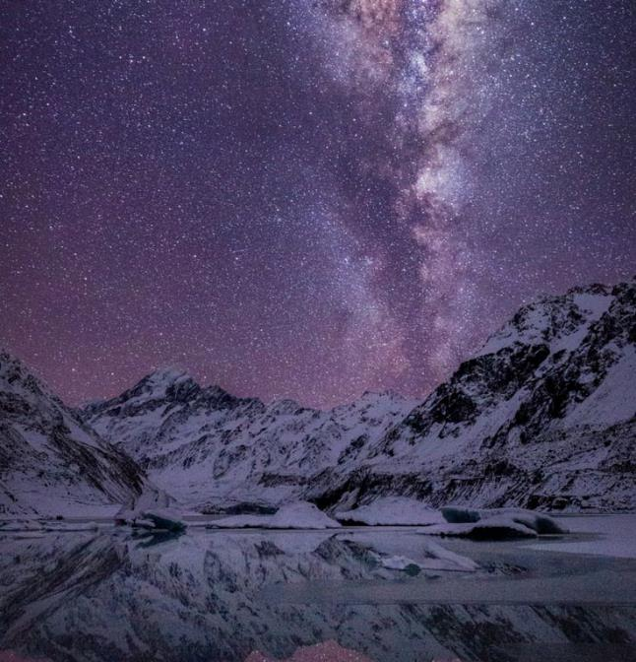
Matariki
Remembrance – Honouring those we have lost since the last rising of Matariki.
Celebrating the present – Gathering together, sharing.
Looking to the future – Preparing for the impending season, goal setting.
Friday 28 June 2024
Friday 20 June 2025
The Matariki public holiday dates fall on the closest Friday to the Takaroa lunar period during the lunar month of Pipiri

