Slide 1
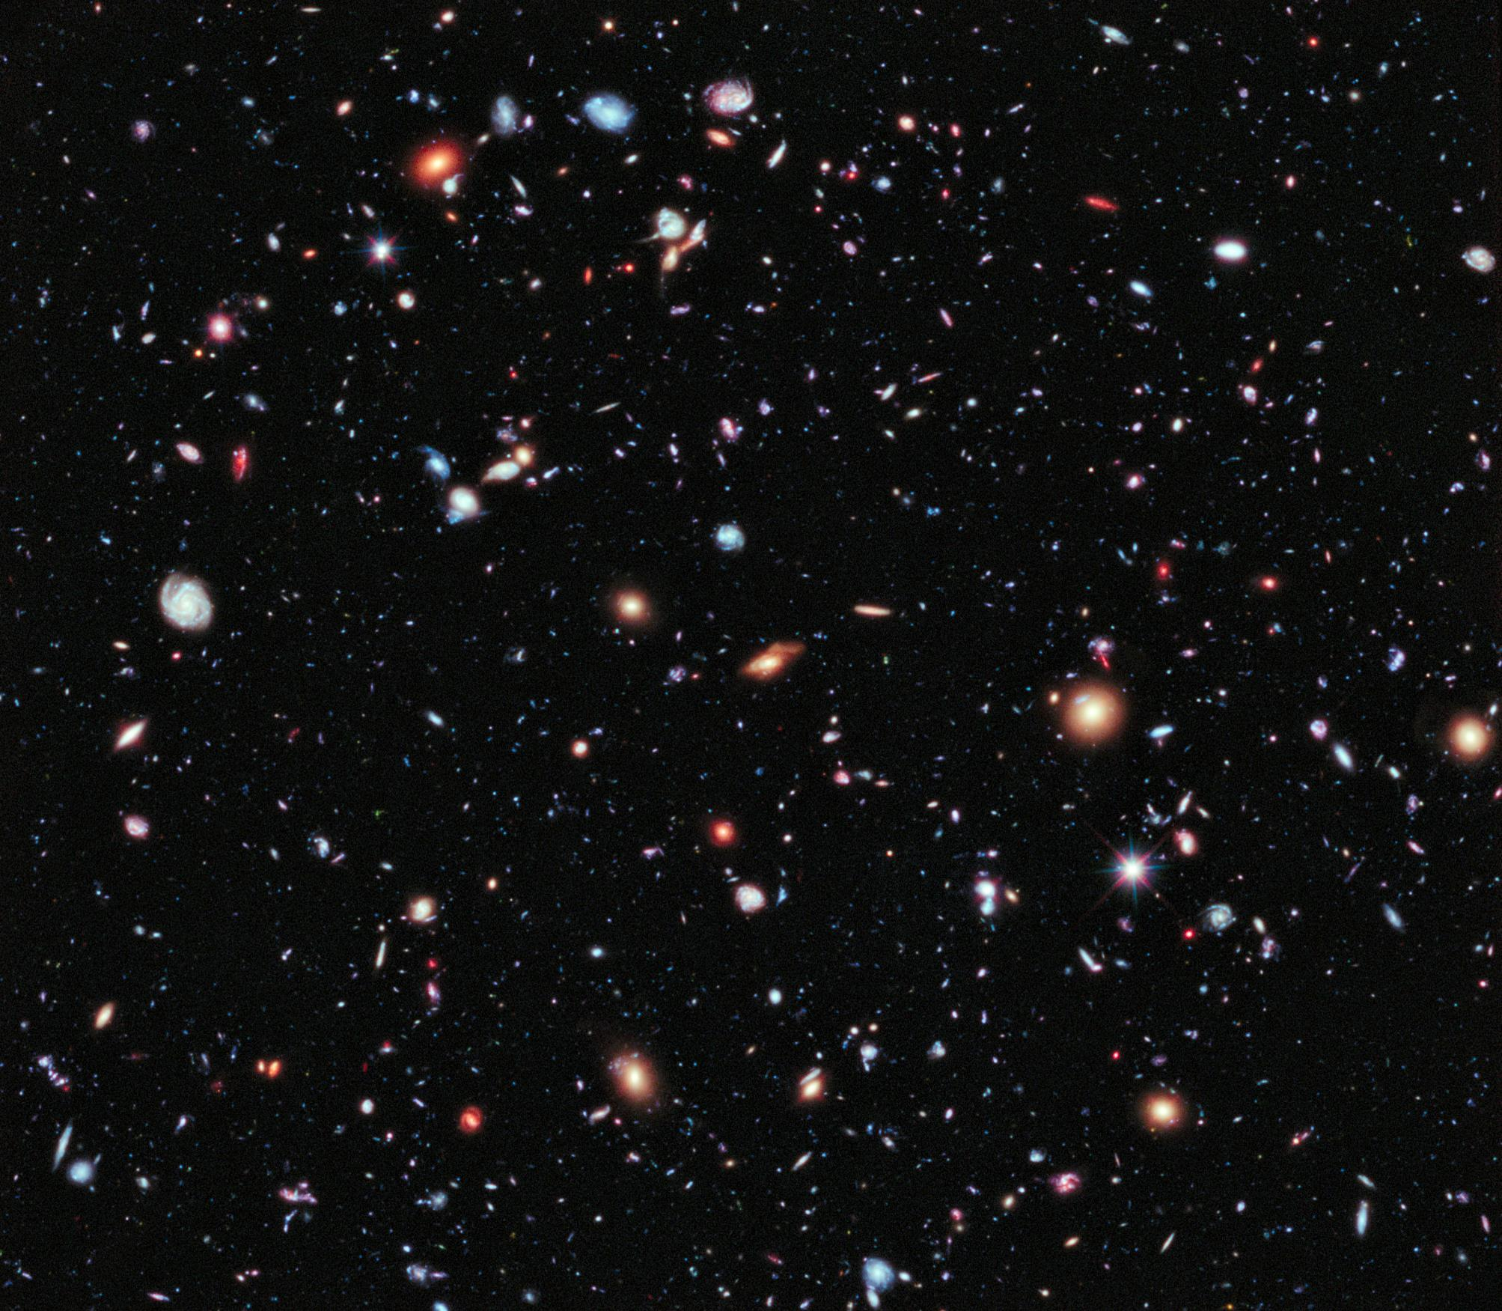
How do we understand the Universe?
The science of observational cosmology
Dr Yvette Perrott, Victoria University of Wellington
The eXtreme Deep Field (in the Hubble Ultra Deep Field).
Credit: NASA; ESA; G. Illingworth, D. Magee, and P. Oesch, University of California, Santa Cruz; R. Bouwens, Leiden University; and the HUDF09 Team.
From https://www.nasa.gov/mission_pages/hubble/science/xdf.html
U3A Timaru
17/6/2024

Slide 2
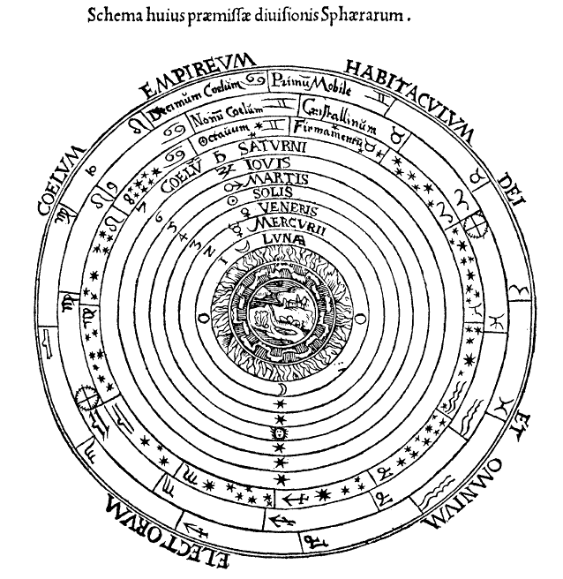
In the beginning …
the Earth was the centre of the Universe*
Most ancient civilizations observed the stars, and assumed a geocentric model
  Sun, Moon, planets and stars all appear to rotate around Earth
Pythagorus (~500 BC), Aristotle (~350 BC) argued that the Earth was spherical
  Eg shadow of Earth on the Moon during a lunar eclipse is round
Dr Yvette Perrott, Victoria University of Wellington
Peter Apian's 1524 representation of the universe, heavily influenced by Aristotle's ideas.
From Edward Grant, "Celestial Orbs in the Latin Middle Ages", Isis, Vol. 78, No. 2. (Jun., 1987), pp. 152-173. Public Domain, https://commons.wikimedia.org/w/index.php?curid=317560
U3A Timaru
17/6/2024

Slide 3
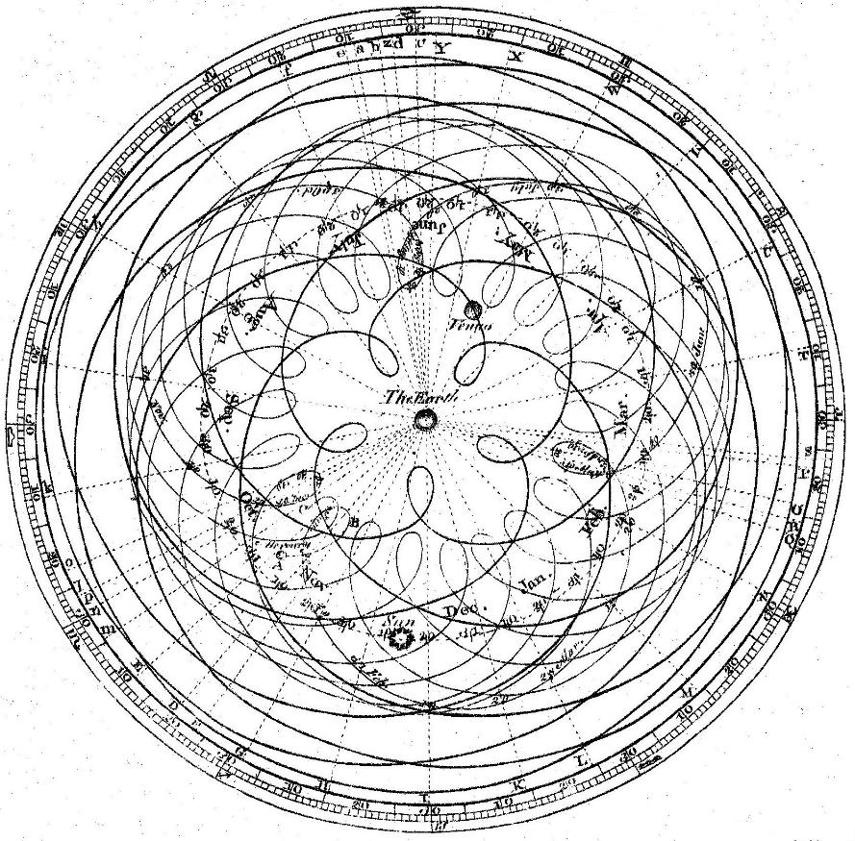
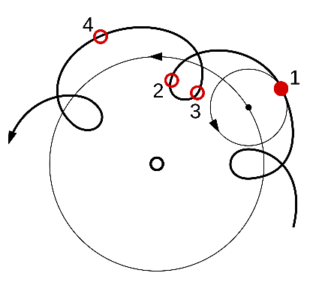
In the beginning …
the Earth was the centre of the Universe
Ptolemy standardized the geocentric system in the 2nd century AD
To explain observed planetary motions, epicycles were required
Dr Yvette Perrott, Victoria University of Wellington
Epicycles in the Ptolemaic model
James Ferguson (1710-1776), based on similar diagrams by Giovanni Cassini (1625-1712) and Dr Roger Long (1680-1770); engraved for the Encyclopaedia by Andrew Bell. Public domain, https://commons.wikimedia.org/wiki/File:Cassini_apparent.jpg
U3A Timaru
17/6/2024

Slide 4
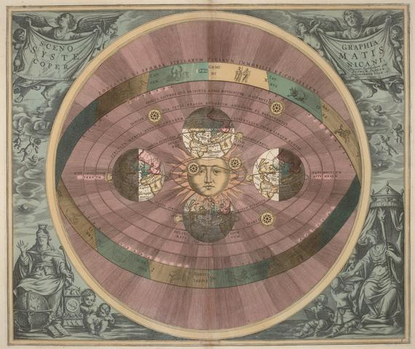
Or is the Sun the centre of the Universe?
Aristarchus of Samus (~250 BC) first proposed a heliocentric model of the Universe
The theory was not developed further until Nicolaus Copernicus developed a mathematical model in the 16th century
… why not?
Dr Yvette Perrott, Victoria University of Wellington
Andreas Cellarius’s 1660 illustration of the Copernican system, from the Harmonia Macrocosmica, Public domain, https://commons.wikimedia.org/wiki/File:Heliocentric.jpg
U3A Timaru
17/6/2024

Slide 5
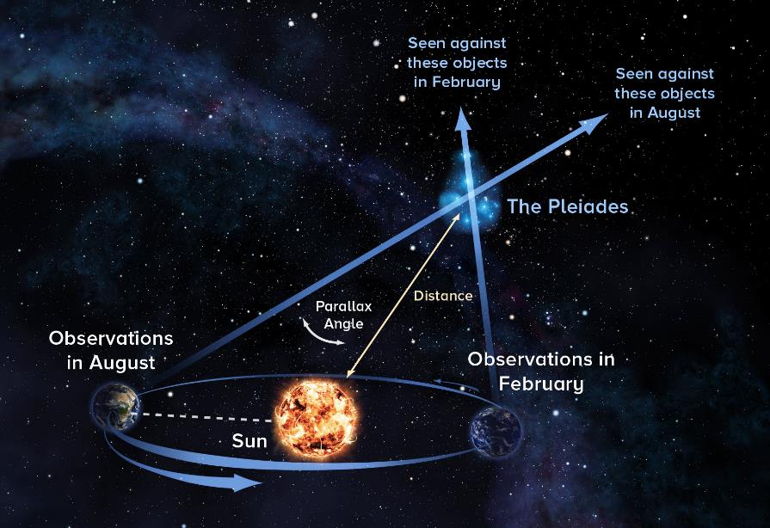
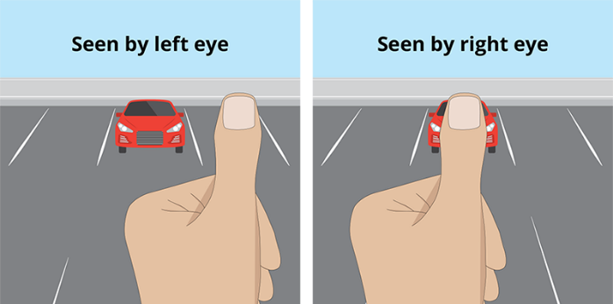
Stellar parallax (or lack thereof)
Parallax is the apparent motion of a nearby object against more distant objects when seen along different lines of sight
If the stars are fixed relative to the Sun and the Earth is orbiting the Sun, we should see stellar parallax shifts
Dr Yvette Perrott, Victoria University of Wellington
https://public.nrao.edu/gallery/measuring-the-distance-to-the-pleiades-2/
The fact that we don’t see this was one main reason why the heliocentric model was not adopted more readily
https://www.cupix.com/news-info/how-to-take-360deg-photos-at-a-fixed-npp-and-manually-stitch-them
U3A Timaru
17/6/2024

Slide 6
Or is the Sun the centre of the Universe?
Nicolaus Copernicus published his De Revolutionibus in 1543
Around 1620, Johannes Kepler developed a heliocentric model with planets on elliptical orbits based on Tycho Brahe’s observations
In the 1600s, Galileo Galilei began looking at the sky through a telescope for the first time
He observed:
  Jupiter has its own moons
  The Sun rotates (based on sunspots)
  Venus has phases
Opposition from the Catholic Church…
Dr Yvette Perrott, Victoria University of Wellington
Andreas Cellarius’s 1660 illustration of the Copernican system, from the Harmonia Macrocosmica, Public domain, https://commons.wikimedia.org/wiki/File:Heliocentric.jpg
U3A Timaru
17/6/2024

Slide 7
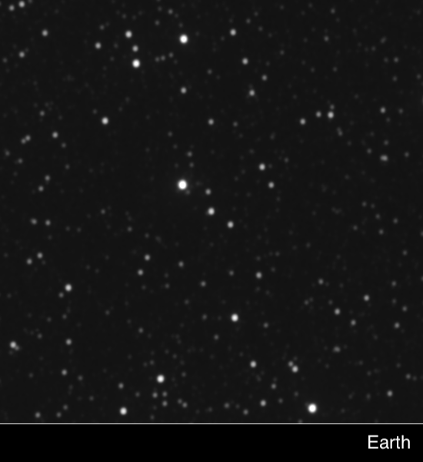
Acceptance of heliocentrism
Isaac Newton’s universal theory of gravitation (1687) developed the theoretical foundation
1727: James Bradley measured stellar aberration (proving Earth’s motion)
1838: Friedrich Wilhelm Bessel measured a stellar parallax of 0.314 arcsecs
1851: Leon Foucault showed Earth’s rotation with a long pendulum
Dr Yvette Perrott, Victoria University of Wellington
Parallax effect of Proxima Centauri – as viewed from Earth and the New Horizons spacecraft (past Pluto)
https://www.nasa.gov/solar-system/nasas-new-horizons-conducts-the-first-interstellar-parallax-experiment/
U3A Timaru
17/6/2024
Notes:
0.314 arcsec = roughly a meter ruler seen from the other end of the South Island

Slide 8
How big is the Universe?
Bessel’s parallax measurement corresponded to a distance of 10.3 light years
What is a light year? The distance that light travels in a year – similar to saying “Timaru is a two hour drive from Christchurch”
10 light years = 90,000,000,000,000 km = 630,000 AU
The Earth is 8 light minutes from the Sun
The Universe suddenly got a lot bigger!
Next question: what is its structure?
Dr Yvette Perrott, Victoria University of Wellington
Parallax effect of Proxima Centauri – as viewed from Earth and the New Horizons spacecraft (past Pluto)
https://www.nasa.gov/solar-system/nasas-new-horizons-conducts-the-first-interstellar-parallax-experiment/
U3A Timaru
17/6/2024
Notes:
0.314 arcsec = roughly a meter ruler seen from the other end of the South Island

Slide 9
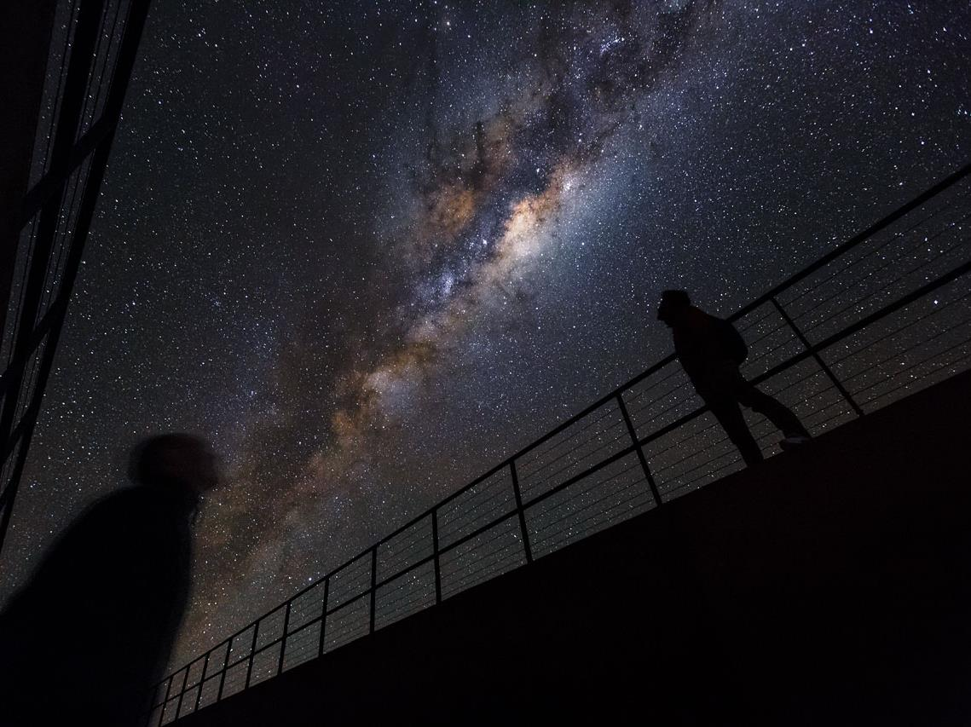
How is the Universe structured?
Difficult to observe from inside!
But we can see the band of the Milky Way, and infer that we are looking out from inside a disc
What else can we observe?
By ESO/Luis Calçada/Herbert Zodet - http://www.eso.org/public/images/potw1613a/, CC BY 4.0, https://commons.wikimedia.org/w/index.php?curid=47840645
U3A Timaru
17/6/2024

Slide 10
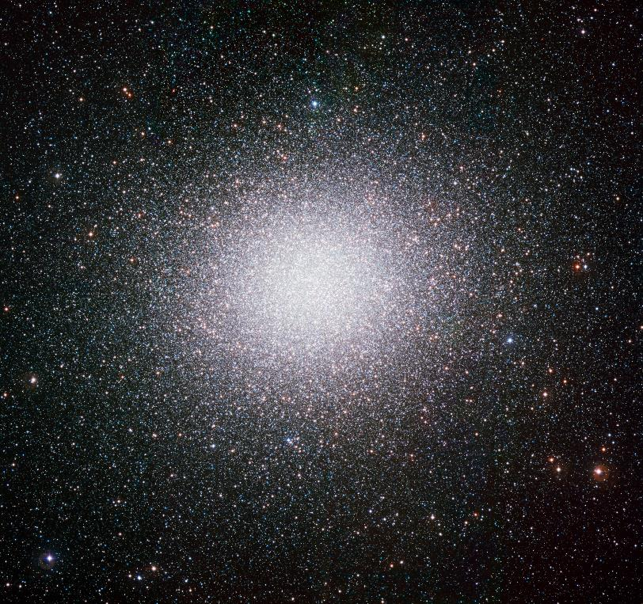
Globular clusters
Away from the Milky Way disc we see isolated stars, but also star clusters: globular clusters, open clusters, stellar associations
Globular clusters are tight, round-looking associations of (typically) hundreds of thousands of stars
If the Earth orbited one of the inner stars, the closest stars would be light-months away!
The most massive globular cluster in the Milky Way, Omega Centauri (up to ten million stars) as observed from ESO's La Silla Observatory. https://www.eso.org/public/images/eso0844a/
U3A Timaru
17/6/2024

Slide 11
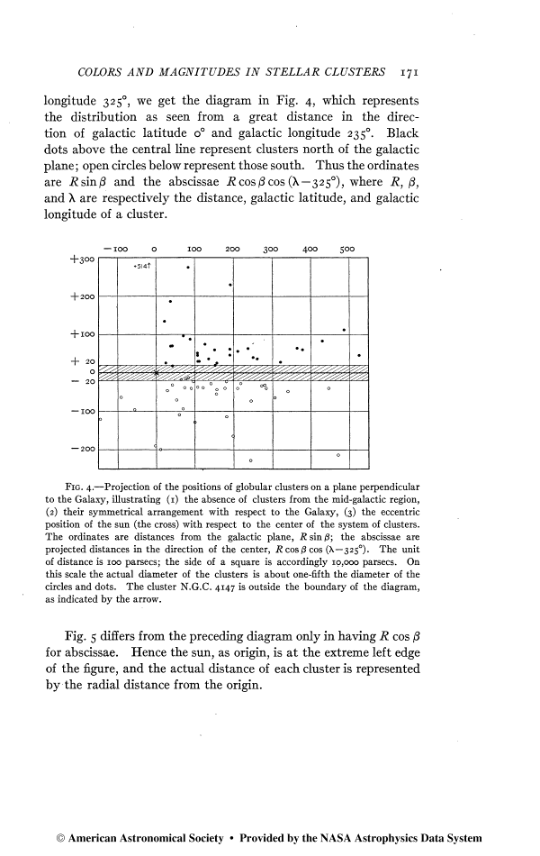
Harlow Shapley’s globular clusters
If we can measure positions and distances to the globular clusters we see, and assume their distribution is spherical, we can measure the size of the Milky Way!
Sun
Galactic disc
Positions of globular clusters, projected on a plane perpendicular to the Galaxy. From Shapley 1918, “Studies based on the colors and magnitudes in stellar clusters. VII. The distances, distribution in space, and dimensions of 69 globular clusters.”
U3A Timaru
17/6/2024
Notes:
So how can we actually measure the size of the Milky Way? The earliest, and simplest way to do so is using globular clusters. Assuming they’re bright so we can see all of them, if we measure all their positions on the sky and also the distance to them, we can map out their distribution in 3d. Assuming it’s roughly spherical, we can then measure the size of the MW. The first person to do this was Shapley in 1918, and this is a plot from his paper.

Slide 12
Harlow Shapley’s globular clusters
100,000 ly
200,000 ly
If we can measure positions and distances to the globular clusters we see, and assume their distribution is spherical, we can measure the size of the Milky Way!
Shapley got the size ~2 – 3x too large, but correctly placed the Sun away from the centre
Sun
Galactic disc
Positions of globular clusters, projected on a plane perpendicular to the Galaxy. From Shapley 1918, “Studies based on the colors and magnitudes in stellar clusters. VII. The distances, distribution in space, and dimensions of 69 globular clusters.”
U3A Timaru
17/6/2024
Notes:
This was about 10x bigger than astronomers had previously estimated. Another paradigm shift.

Slide 13
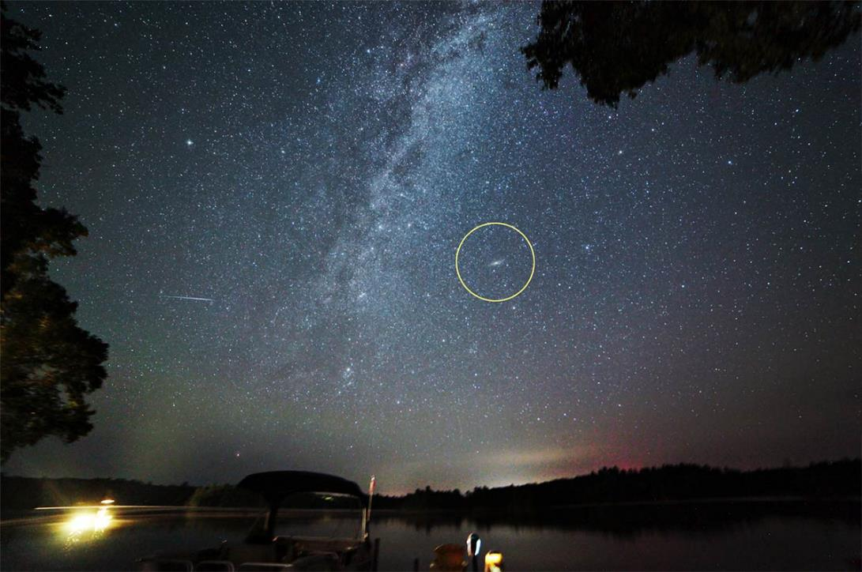
Nebulae or galaxies?
Without a powerful telescope, distant galaxies just look like fuzzy blobs
They were initially included in catalogues of “nebulae” (Messier, NGC) along with other Milky Way objects
The “fuzzy blob” of Andromeda from the ground. https://astrobackyard.com/andromeda-galaxy/
U3A Timaru
17/6/2024
Notes:
Hubble’s discovery marked the beginning of extragalactic astronomy

Slide 14
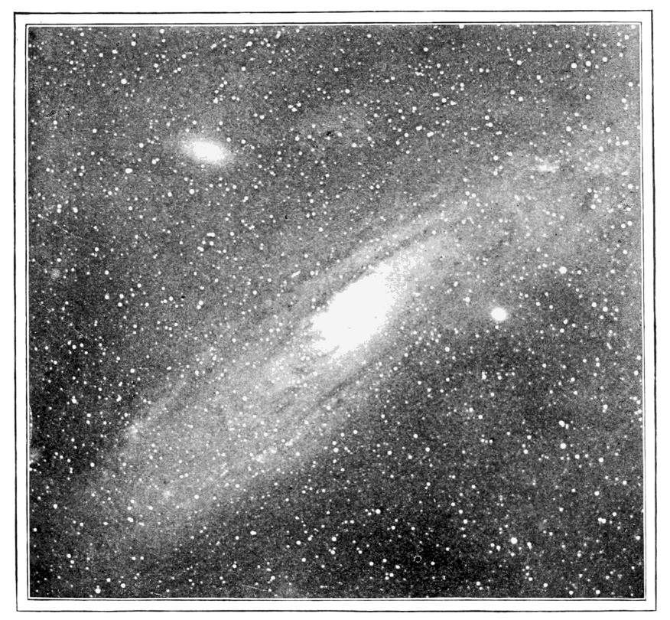
Nebulae or galaxies?
Without a powerful telescope, distant galaxies just look like fuzzy blobs
They were initially included in catalogues of “nebulae” (Messier, NGC) along with other Milky Way objects
Even with early telescopes, individual stars could not be discerned. Maybe the light was glowing gas, or a solar system in the process of formation?
A photograph of ”The Great Andromeda Nebula” from around 1900. Taken by Sir William Roberts FRS, published in The Popular Science Monthly, Volume LVIII, November 1900 to April 1901
U3A Timaru
17/6/2024
Notes:
Hubble’s discovery marked the beginning of extragalactic astronomy

Slide 15
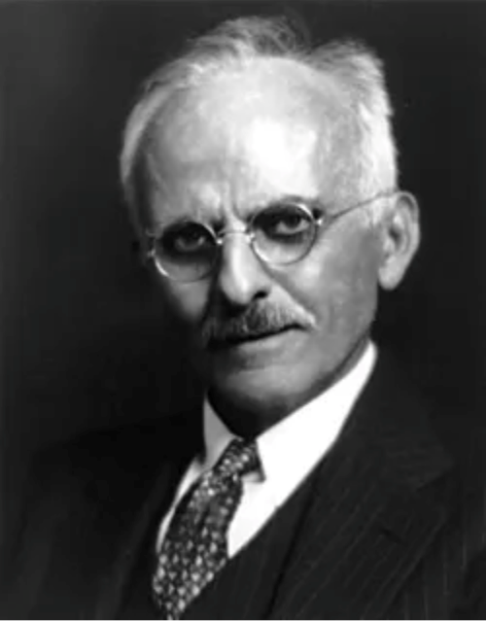
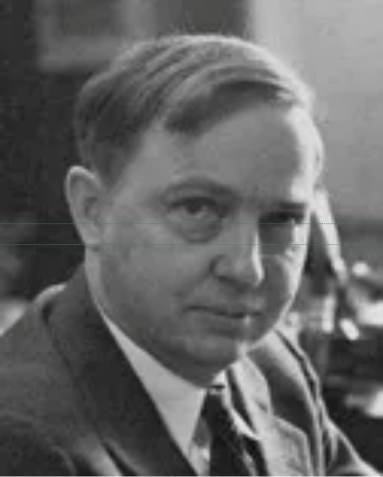
The “Great Debate” (1920)
The Milky Way is really big! It must be the whole Universe and everything is inside it.
Nonsense! We see novae in spiral nebulae like in our own Milky Way, they must be distant “island universes”!
Heber Curtis
(Credit: University of Michigan)
Also see https://www.astronomy.com/science/the-great-debate-of-shapley-and-curtis-100-years-later/
Harlow Shapley
(Credit: National Academy of Sciences)
U3A Timaru
17/6/2024

Slide 16
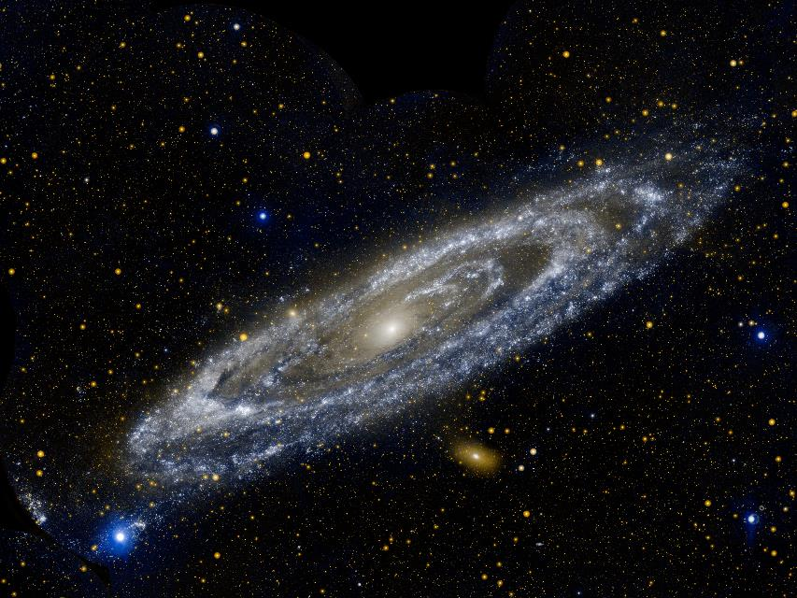
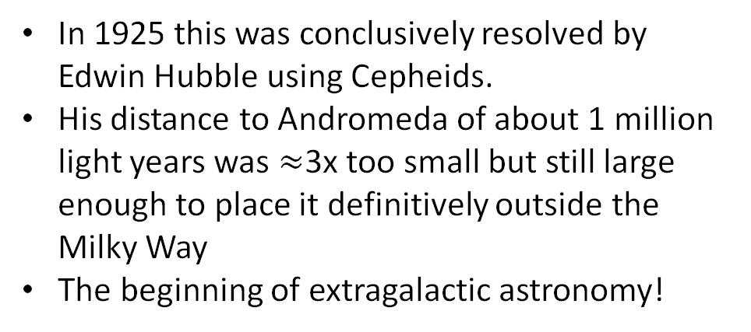
“Island Universes”
In 1925 this was conclusively resolved by Edwin Hubble using Cepheids.
His distance to Andromeda of about 1 million light years was $≈$3x too small but still large enough to place it definitively outside the Milky Way
The beginning of extragalactic astronomy!
GALEX two-colour UV composite image of Andromeda (M31), the nearest galaxy to the Milky Way.
Credit: NASA/JPL-Caltech, http://www.galex.caltech.edu/media/glx2012-03r_img01.html
U3A Timaru
17/6/2024
Notes:
Hubble’s discovery marked the beginning of extragalactic astronomy

Slide 17

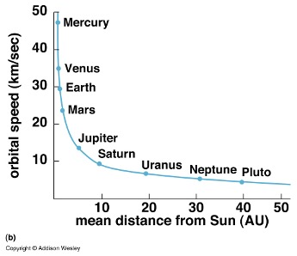

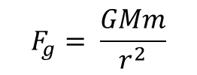
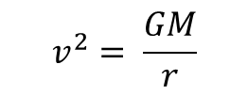
Gravity and orbits
Gravitational force
$$F_{g}= \frac{GMm}{r^{2}}$$
$$v^{2}= \frac{GM}{r}$$
$$F_{g}$$
https://www.britannica.com/science/mechanics/Conservation-of-momentum
U3A Timaru
17/6/2024
Notes:
Hubble’s discovery marked the beginning of extragalactic astronomy

Slide 18
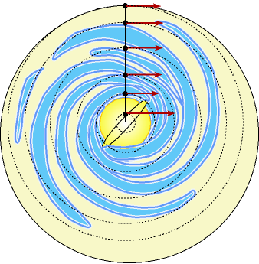
Stars in spiral galaxies
We can measure velocities of stars in galaxies and infer how much mass exists inside their orbit!
orbital speed
distance from centre
Image credit: astronomynotes.com
U3A Timaru
17/6/2024

Slide 19
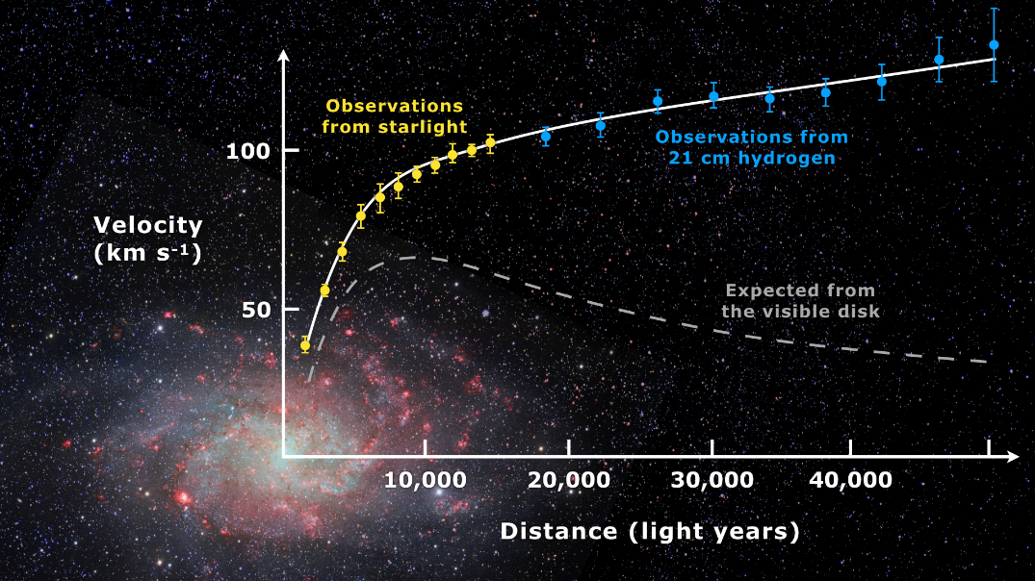
Galaxy rotation curves
We find speeds don’t go down with radius as expected: there is a dark matter component!
The dark matter goes out much further than the visible disc
Spiral galaxy M33 and its measured and predicted rotation curves.
Credit: Mario De Leo, CC BY-SA 4.0
U3A Timaru
17/6/2024

Slide 20
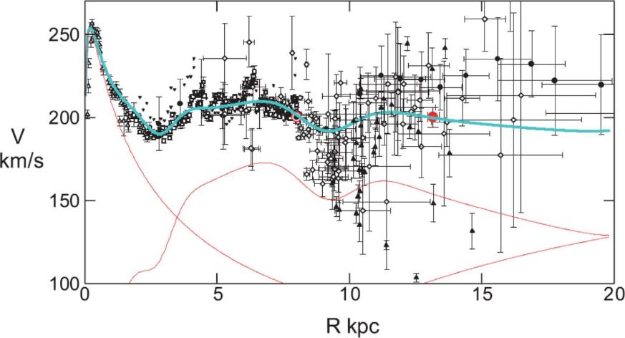
Galaxy rotation curves
This seems to be true for all spiral galaxies!
Bulge
Disc + rings
Dark halo
From Sofue et al 2009, “Unified Rotation Curve of the Galaxy — Decomposition into de Vaucouleurs Bulge, Disk, Dark Halo, and the 9-kpc Rotation Dip”
From Rubin et al 1978, “Extended rotation curves of high-luminosity spiral galaxies. IV. Systematic dynamical properties, Sa → Sc”.
U3A Timaru
17/6/2024

Slide 21
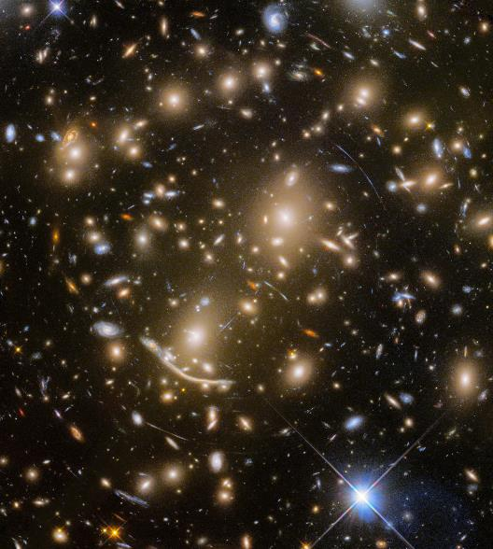
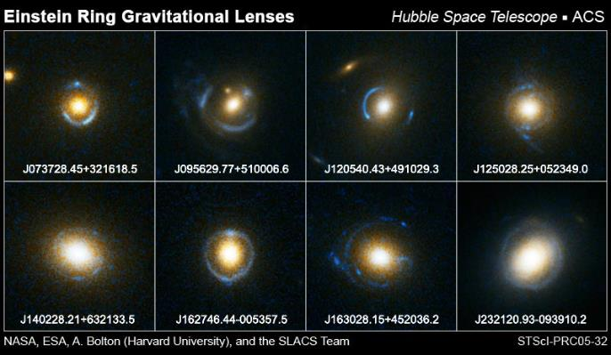
Overall conclusion…
There is something there that does not emit light, but provides gravitational force
About 85% of the matter in the Universe is dark matter!
https://www.nasa.gov/vision/universe/starsgalaxies/hubble-20051117.html
Credit: NASA, ESA/Hubble, HST Frontier Fields
https://www.spacetelescope.org/images/heic1711a/
U3A Timaru
17/6/2024

Slide 22
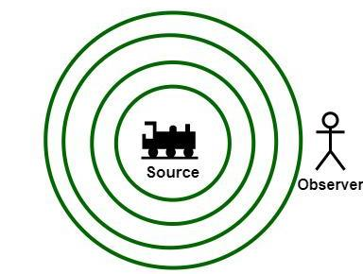
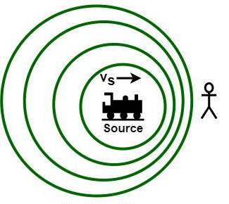
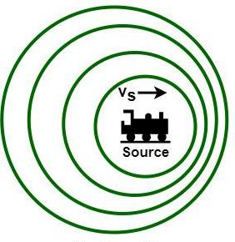
Doppler shift
https://www.geeksforgeeks.org/difference-between-doppler-effect-and-doppler-shift/
U3A Timaru
17/6/2024
Notes:
Illustrated for sound but works in a similar way to light

Slide 23
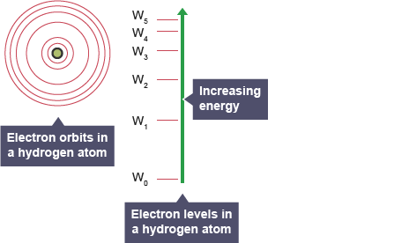
Spectral lines
Electrons can only exist in “orbits” with fixed energy levels
They can jump between levels by absorbing or emitting a photon of exactly the right energy
This leads to absorption lines in stellar spectra
https://www.bbc.co.uk/bitesize/guides/zwwjjxs/revision/1
U3A Timaru
17/6/2024

Slide 24
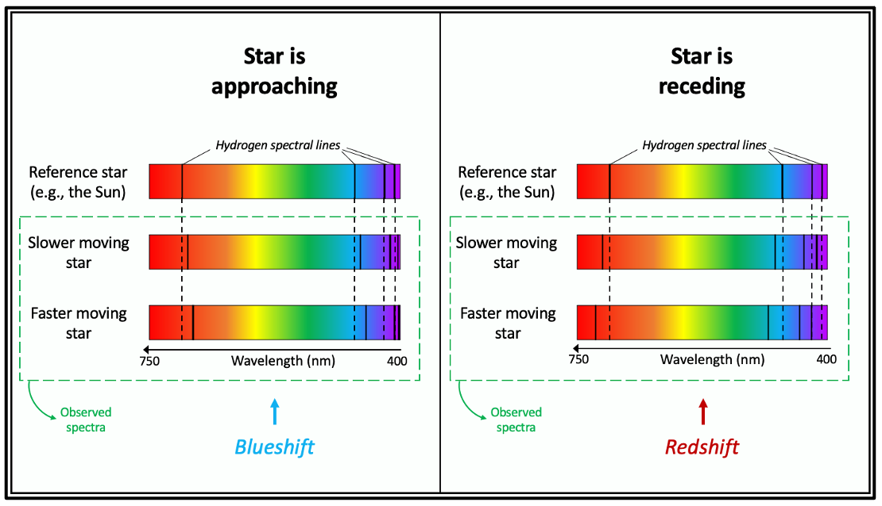
Doppler-shifted spectral lines
By observing Doppler-shifted spectral lines, we can observe how fast a star (or galaxy) is moving toward or away from us!
https://medium.com/predict/messages-from-above-783bfb0f125c
U3A Timaru
17/6/2024

Slide 25
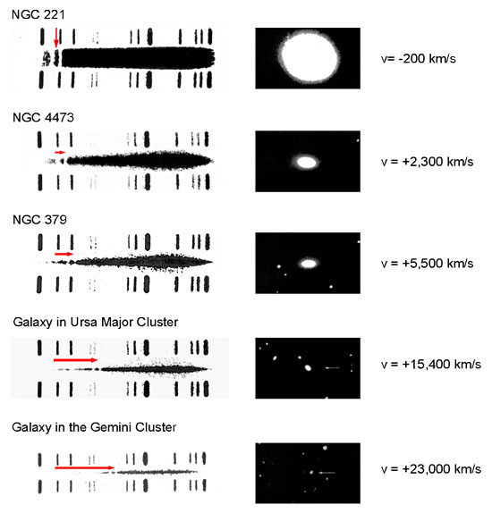
Doppler-shifted spectra
Examples of historic galaxy spectra
Top and bottom are reference spectra measured in the laboratory
Middle is galaxy spectra
Second bright hydrogen line shows red- or blueshift
Credit: Humason, 1936, “The Apparent Radial Velocities of 100 Extra-Galactic Nebulae”. https://imagine.gsfc.nasa.gov/features/yba/M31_velocity/spectrum/doppler_galaxies.html
U3A Timaru
17/6/2024

Slide 26
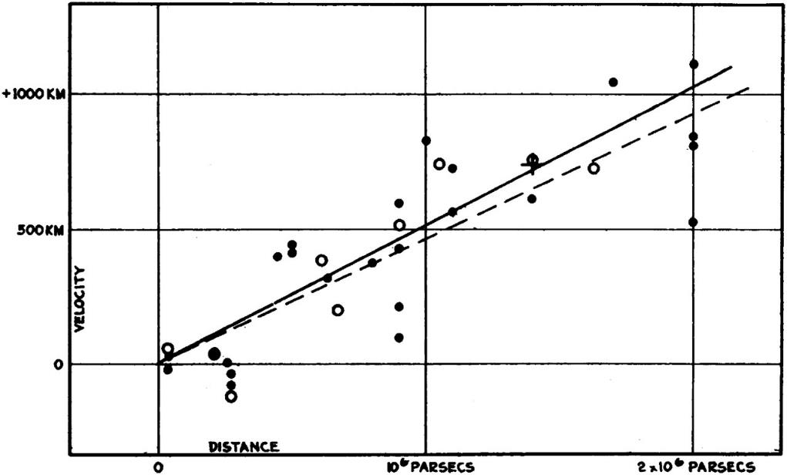
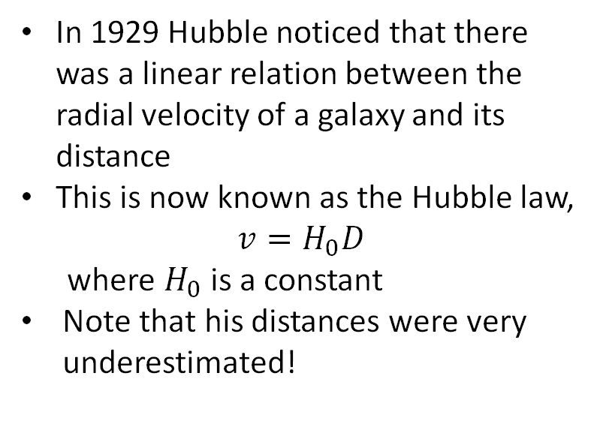
Hubble’s Law
In 1929 Hubble noticed that there was a linear relation between the radial velocity of a galaxy and its distance
This is now known as the Hubble law,
$$v=H_{0}D$$
where $H_{0}$ is a constant
Note that his distances were very underestimated!
From Hubble 1929, “A relation between distance and radial velocity among extra-galactic nebulae”. Note y-axis units should be km/s
U3A Timaru
17/6/2024

Slide 27

Expanding Universe
The only way this makes sense is if the Universe is expanding!
Imagine being on the top of a beach ball which is being blown up
Every other part of the ball looks like it’s moving away from you
Things further toward the equator look like they’re moving away faster
Convince yourself it doesn’t matter where you are on the ball!
U3A Timaru
17/6/2024

Slide 28
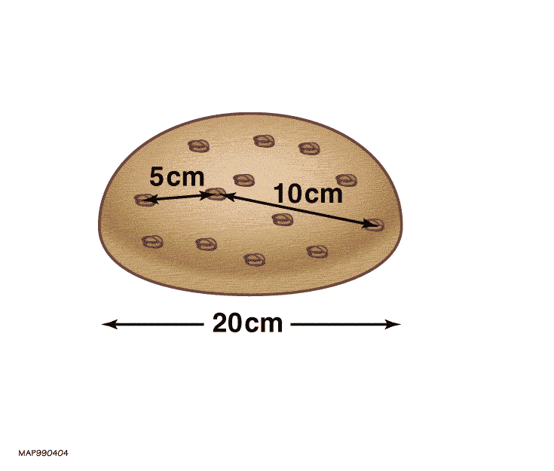
Raisin loaf analogy
Or: a raisin loaf expanding as it bakes
Every portion of the loaf expands uniformly Imagining we are sitting on a given raisin, all other raisins appear to recede
Nearby raisins recede more slowly than more distant raisins
Picture is the same no matter which raisin you sit on
The raisins themselves are not moving: they are being carried along by the expansion of the dough
The raisins themselves also do not expand
https://map.gsfc.nasa.gov/universe/bb_tests_exp.html
U3A Timaru
17/6/2024
Notes:
Along with the balloon analogy, another good picture to help us understand the expansion of the Universe is a baking raisin loaf

Slide 29
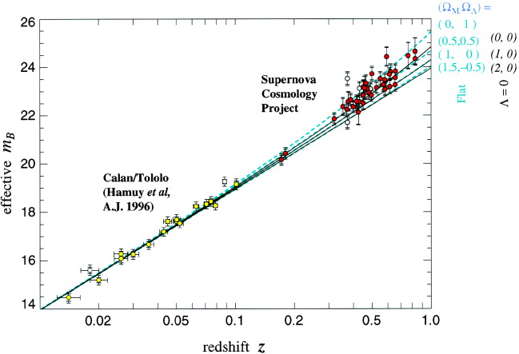
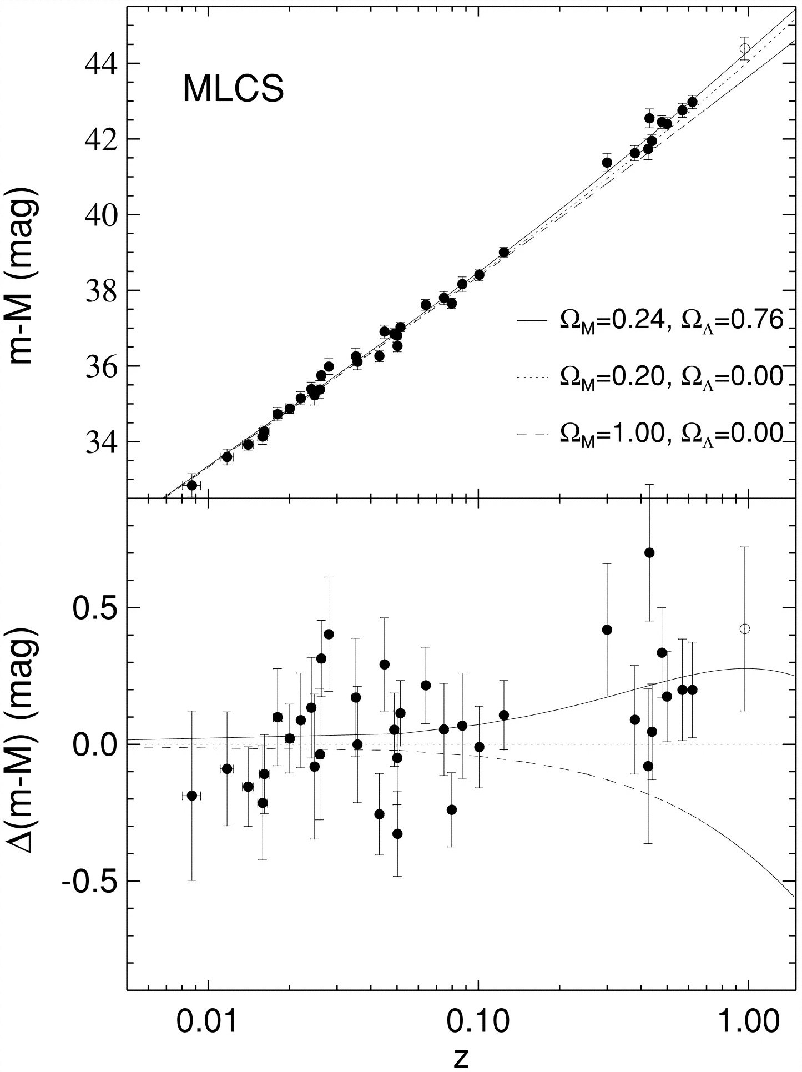

Accelerating, expanding Universe
In 1998, two teams independently measured distances to and redshifts of supernovae out to higher redshift than had previously been achieved
Surprisingly, the high-redshift measurements deviated from the Hubble law
The expansion of the Universe is accelerating – an extra ingredient is needed to explain this!
From Riess et al 1998, “Observational evidence from supernovae for an accelerating universe and a cosmological constant”
From Perlmutter et al 1999, “Measurements of $Ω$ and $Λ$from 42 high-redshift supernovae”
U3A Timaru
17/6/2024
Notes:
If v=H0 D then that’s a constant expansion rate, like v=D/t. Points depart from the straight line showing the expansion of the Universe is actually accelerating. This was a real surprise and fundamentally changed the way we thought about the Universe

Slide 30
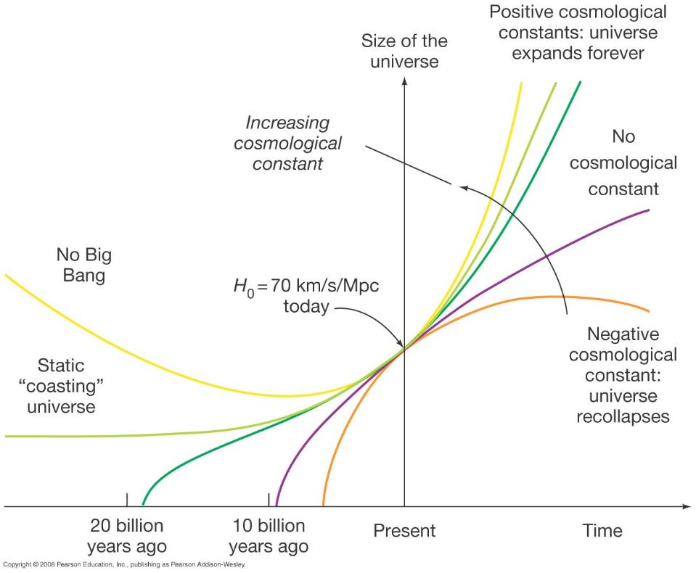
History of the Universe’s expansion
This is our current understanding
Perlmutter, Schmidt and Riess were awarded the Nobel Prize in 2011 for this discovery
U3A Timaru
17/6/2024
Notes:
Our simple picture of the three options for the evolution of the scale size of the Universe has got a lot more complicated! So what do our supernovae data tell us about this, can we distinguish between some of these possibilities?

Slide 31
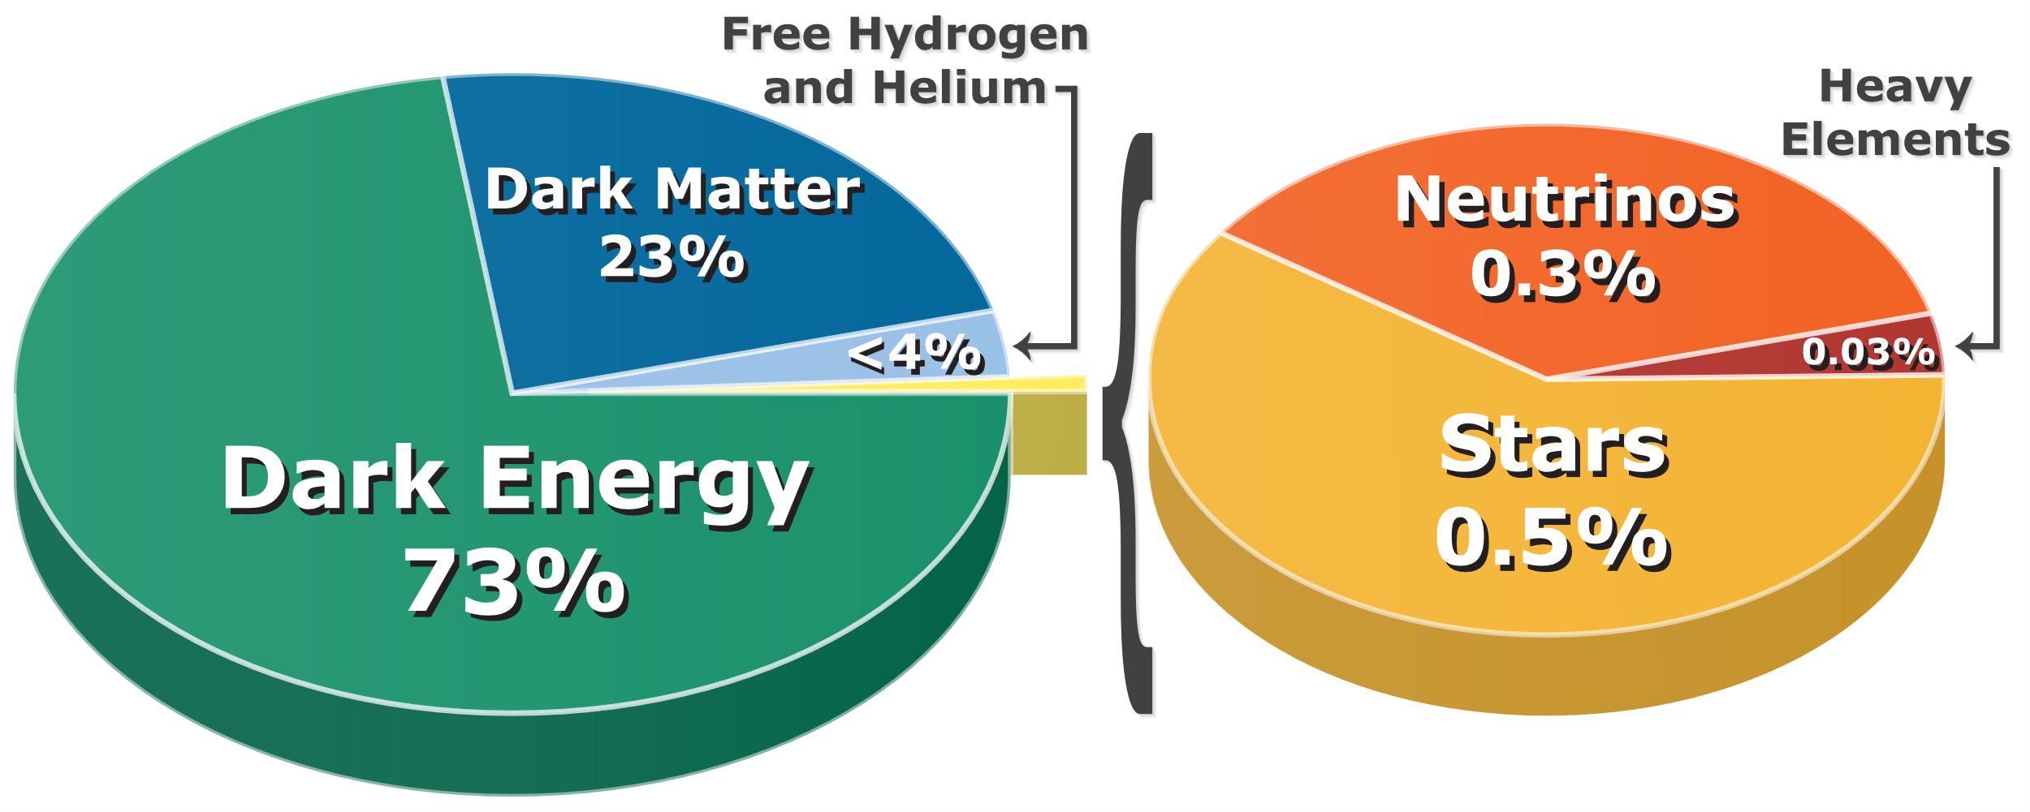
Contents of the Universe
We have a pretty consistent picture of the current contents of the Universe
Remarkable that so much of it is still completely unknown!
Ben Finney - CC BY 3.0, https://commons.wikimedia.org/w/index.php?curid=20998071
U3A Timaru
17/6/2024
Notes:
The vast majority of the Universe is dark. It’s remarkable that the ordinary stuff we spent so long understanding in the first half of this course actually only makes up about 0.5% of the Universe!

Slide 32
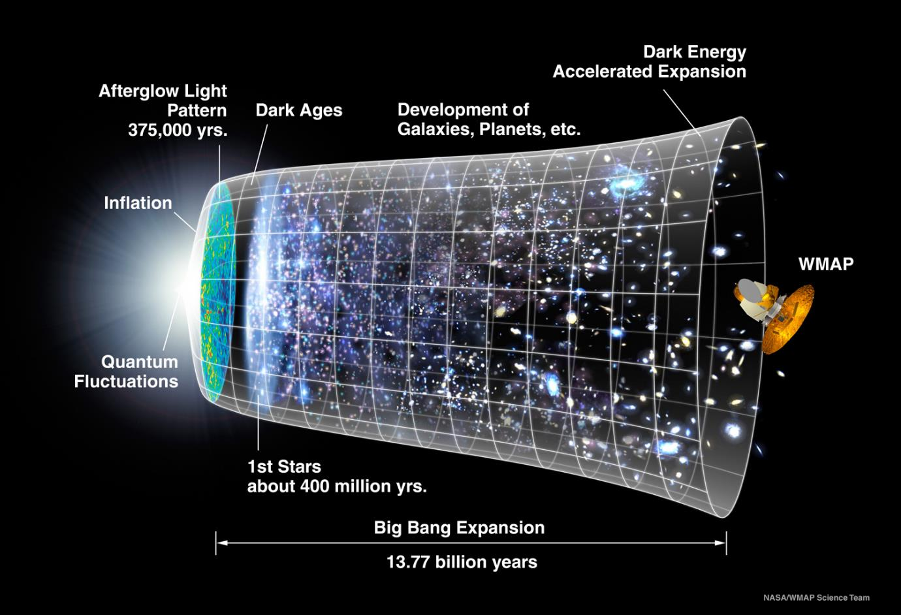
History of the Universe
https://map.gsfc.nasa.gov/media/060915/index.html
U3A Timaru
17/6/2024
Notes:
By now we have put together what seems to be a pretty solid picture of the history of the Universe and how the different components evolved to form what we see today, which is encapsulated in this image. You already know most of what’s in this picture by this point – let’s go through it bit by bit and see how everything fits together. You’ll note the age given here is slightly different to the one I gave you (13.5 Gyr) – it depends quite sensitively on the exact values you put in for H0, Omega_m etc. 13.8 is the current best estimate.

Slide 33
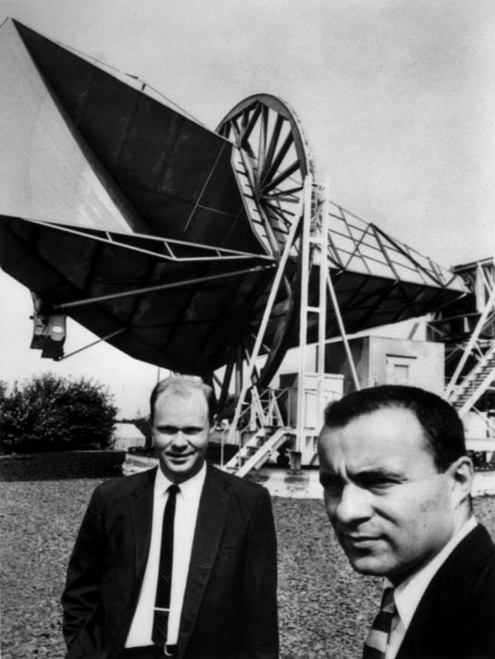
Cosmic Microwave Background
In 1964 scientists working at Bell Labs observed an all-sky radio glow
Realizing it must be astronomical, they consulted nearby astrophysicists and realized they had detected the leftover radiation from the Big Bang
Penzias and Wilson were awarded the Nobel Prize for Physics in 1978 for its discovery
Penzias and Wilson with the Holmdel Horn Antenna used to detect the CMB. https://www.bell-labs.com/about/history-bell-labs/stories-changed-world/Cosmic-Microwave-Background-Discovery/
U3A Timaru
17/6/2024
Notes:
Surprisingly similar story to the beginnings of radio astronomy! They were trying to make an ultrasensitive radio receiver, eliminating all the sources of noise they could find including pigeon poop in the horn. There was one they just couldn’t get rid of and eventually realized it must be astronomical.

Slide 34
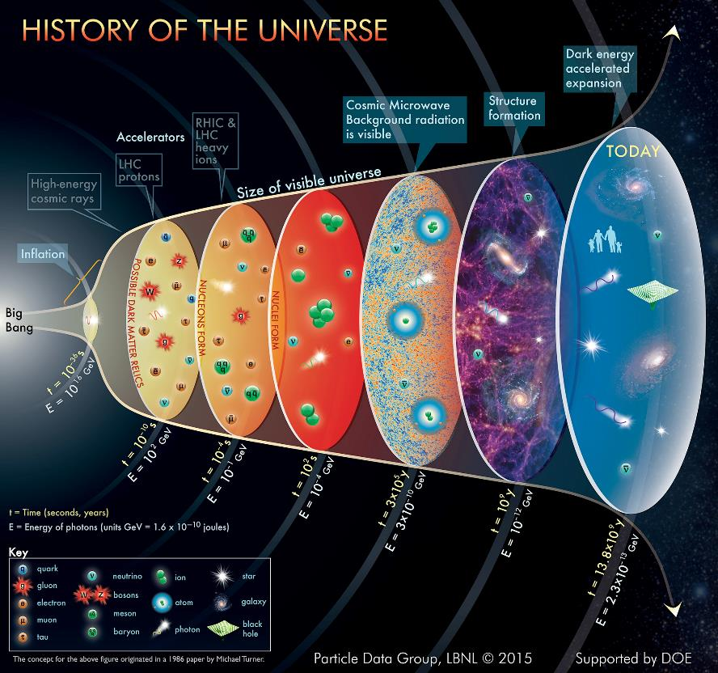
Cosmic Microwave Background
Straight after the Big Bang, everything was very hot and dense
When the Universe cooled enough for electrons and protons to combine to form atoms, photons no longer interacted with matter
They have been travelling ever since…
A particle physicist’s view of the history of the Universe!
https://www.particleadventure.org/history-universe.html
U3A Timaru
17/6/2024
Notes:
They’re all concerned with what happens in the first 10^-4 s after the Big Bang, when weird stuff is happening. So straight away after the Big Bang we see there’s a period of very rapid expansion called inflation. Then, as the Universe expands and cools, we get successive milestones where different kinds of particles are able to form. Quarks → neutrons and protons → nuclei (nucleosynthesis) → atoms (recombination) and CMB is released.

Slide 35

Cosmic Microwave Background
The CMB fits naturally with theories involving a Big Bang and is very hard to explain with theories that lack one
It had been already predicted by cosmologists as early as 1948
James Peebles was awarded the Nobel Prize for work including this prediction in 2019
From https://www.nobelprize.org/prizes/physics/2019/peebles/facts/
See also Nobel Prize Lecture recording
U3A Timaru
17/6/2024

Slide 36
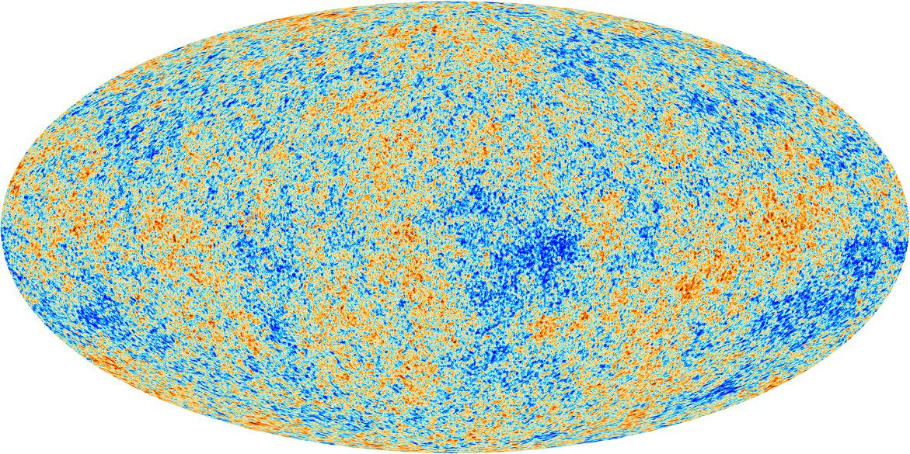
CMB anisotropies
Subtracting off the mean temperature and the dipole reveals small anisotropies (1 part in 100000)
These anisotropies are showing the matter density fluctuations present when the atoms combined
Together with supernovae, these fluctuations allow us to pin down the properties of the Universe
Planck’s view of the Cosmic Microwave Background anisotropies.
Credit: ESA/Planck collaboration, http://www.esa.int/spaceinimages/Images/2013/03/Planck_CMB
U3A Timaru
17/6/2024
Notes:
This is a frozen picture of what the matter in the Universe looked like at the time of recombination, when the photons were scattered for the last time. Picture of the Universe at 0.003% of its current age, our earliest observation

Slide 37
Contents of the Universe
We have a pretty consistent picture of the current contents of the Universe
Remarkable that so much of it is still completely unknown!
Ben Finney - CC BY 3.0, https://commons.wikimedia.org/w/index.php?curid=20998071
U3A Timaru
17/6/2024
Notes:
The vast majority of the Universe is dark. It’s remarkable that the ordinary stuff we spent so long understanding in the first half of this course actually only makes up about 0.5% of the Universe!

Slide 38
History of the Universe’s expansion
This is our current understanding
Perlmutter, Schmidt and Riess were awarded the Nobel Prize in 2011 for this discovery
U3A Timaru
17/6/2024
Notes:
Our simple picture of the three options for the evolution of the scale size of the Universe has got a lot more complicated! So what do our supernovae data tell us about this, can we distinguish between some of these possibilities?

Slide 39
Future of the Universe
As we currently understand it, the Universe will expand forever at an accelerating rate!
All the galaxies (except for the very nearby ones) will appear further and further away, eventually becoming outside our visible horizon
But before that:
  The Sun will become a red giant and engulf the Earth (about 6 billion years from now)
  The Milky Way will merge with Andromeda (6 billion years)
  All the stars run out of fuel (100,000 billion years from now)
Some cheerful reading: https://medium.com/carre4/the-future-of-the-universe-and-the-late-explosion-of-black-stars-88563ed7887
U3A Timaru
17/6/2024

Slide 40
History of the Universe
https://map.gsfc.nasa.gov/media/060915/index.html
U3A Timaru
17/6/2024
Notes:
Next frontiers: cosmic dawn, epoch of reionization, JWST currently finding galaxies forming earlier than we thought possible

Slide 41
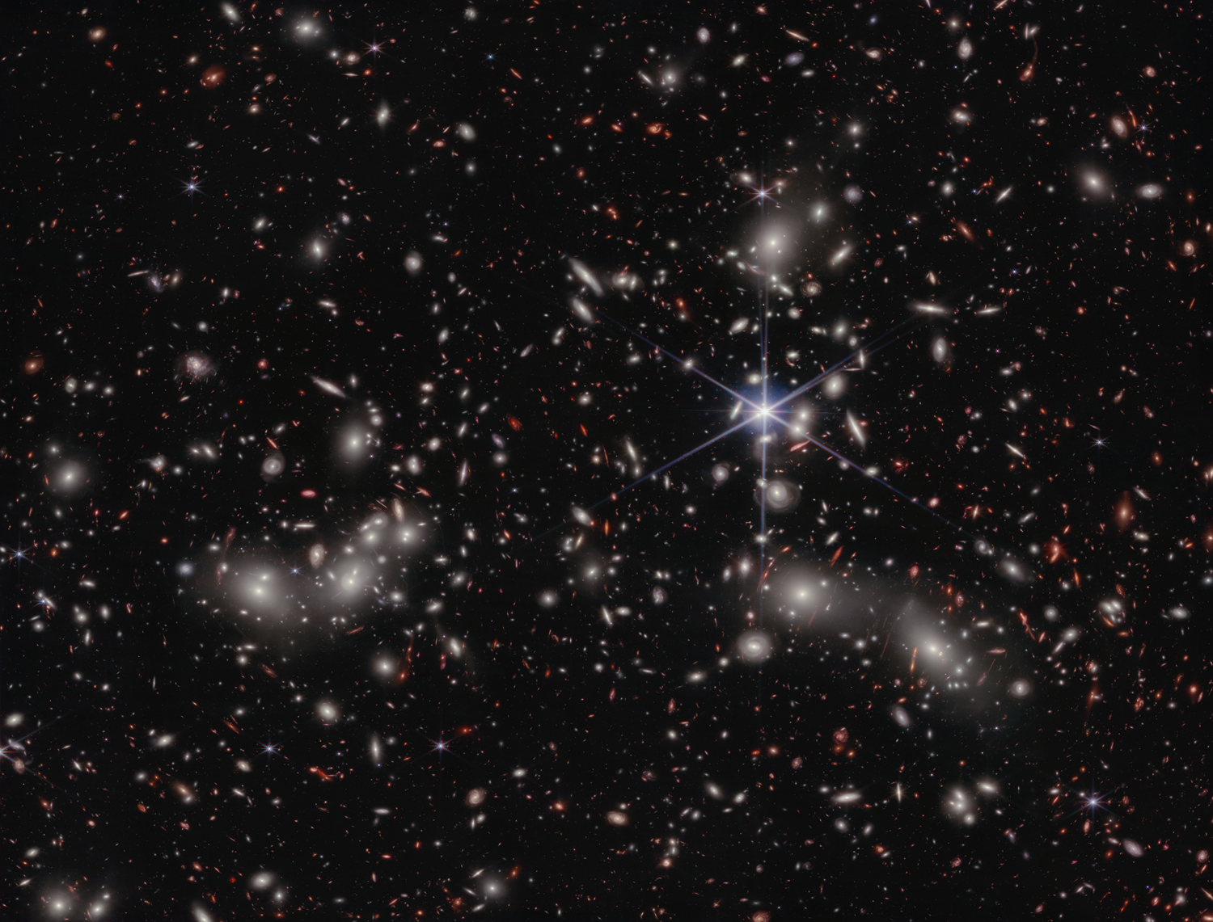
Thank you!
Questions?
Pandora’s Cluster, as viewed by the JWST
NASA, ESA, CSA, Ivo Labbe (Swinburne), Rachel Bezanson (University of Pittsburgh)
U3A Timaru
17/6/2024
Notes:
Next frontiers: cosmic dawn, epoch of reionization, JWST currently finding galaxies forming earlier than we thought possible

Slide 42
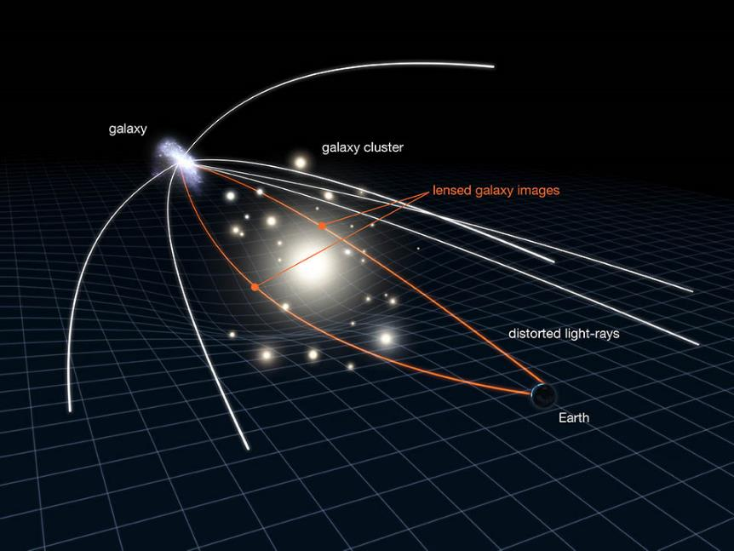
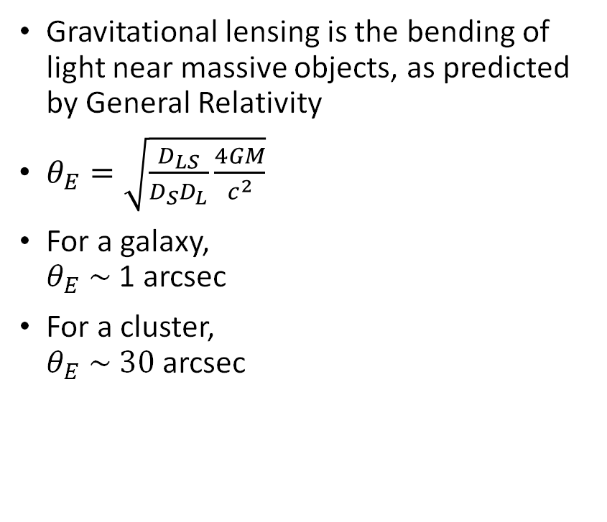
Gravitational lensing
Gravitational lensing is the bending of light near massive objects, as predicted by General Relativity
$θ_{E}=\sqrt{\frac{D_{LS}}{D_{S}D_{L}}\frac{4GM}{c^{2}}}$
For a galaxy,
$θ_{E} \sim$ 1 arcsec
For a cluster,
$θ_{E} \sim 30$ arcsec
Credit NASA, ESA & L. Calcada. From http://www.spitzer.caltech.edu/images/3583-ssc2011-05b-Gravitational-Lensing-in-Action
U3A Timaru
17/6/2024
Notes:
We saw how gravitational lensing works for galaxies – as a reminder, you have a massive object which distorts the space nearby, like a weight on a rubber sheet. Then light rays passing near the object are deflected toward it. If the background and foreground objects are pointlike and exactly aligned, we get an Einstein ring with this diameter. For a cluster we’re talking about 10^14 – 10^15 solar masses

Slide 43
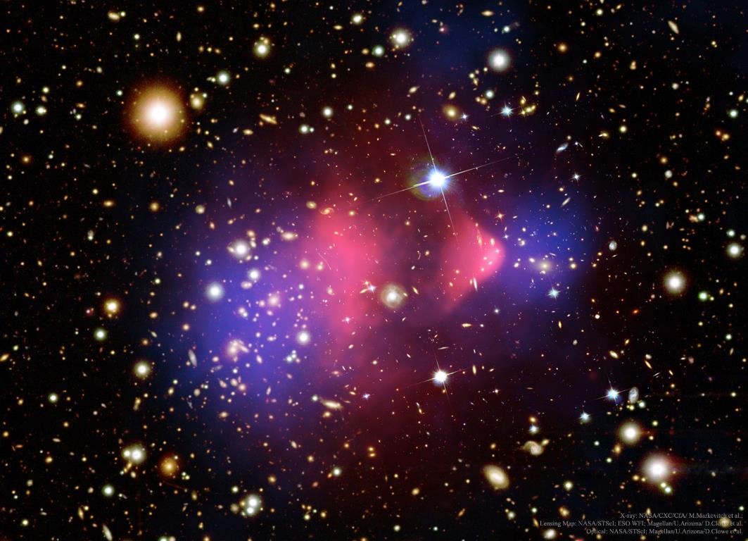
Bullet Cluster
Credit: X-ray (pink): NASA/CXC/CfA/M. Markevitch et al.;
Lensing Map (purple): NASA/STScI; ESO WFI; Magellan/U.Arizona/D.Clowe et al.
Optical (background): NASA/STScI; Magellan/U.Arizona/D.Clowe et al. https://apod.nasa.gov/apod/ap170115.html
U3A Timaru
17/6/2024
Notes:
A merging cluster system where the two individual clusters have just passed through each other for the first time. Background is optical, pink is X-ray and purple is mass distribution inferred from gravitational lensing

Slide 44
Bullet Cluster
Dark matter + galaxies
Credit: X-ray (pink): NASA/CXC/CfA/M. Markevitch et al.;
Lensing Map (purple): NASA/STScI; ESO WFI; Magellan/U.Arizona/D.Clowe et al.
Optical (background): NASA/STScI; Magellan/U.Arizona/D.Clowe et al. https://apod.nasa.gov/apod/ap170115.html
Dark matter + galaxies
U3A Timaru
17/6/2024
Notes:
A merging cluster system where the two individual clusters have just passed through each other for the first time. Background is optical, pink is X-ray and purple is mass distribution inferred from gravitational lensing

Slide 45
Bullet Cluster
gas
dark matter + galaxies
gas
dark matter + galaxies
U3A Timaru
17/6/2024
Notes:
There’s a separation of the different components of the clusters, they are not sitting nicely together like we’ve said they do for relaxed clusters

Slide 46

Bullet Cluster
Density of galaxies is fairly low
As the subclusters move through each other, the probability of galaxy-galaxy collisions is fairly low
Galaxies are not slowed down by the collision
On the other hand, the gas particles are spread evenly throughout the subclusters so have a higher collision probability
As the gas particles collide, they exert frictional forces on each other and overall the gas slows down
Gas is slowed down by the collision, lags behind the galaxies
U3A Timaru
17/6/2024
Notes:
What can we infer from this? Let’s start by thinking about the galaxies. So this makes sense so far. What about the dark matter component?

Slide 47
Bullet Cluster
The behaviour of the dark matter in the collision can give us an insight into its nature
We see that the main mass distribution is distributed like the galaxies!
This means that the dark matter is collisionless (“cold”)
Like the galaxies, during the collision the dark matter particles have moved past each other without colliding
The dark matter is not slowed down by the collision and stays with the galaxies, ahead of the gas
U3A Timaru
17/6/2024
Notes:
Thinking about the dark matter component, by comparison with the other two we can get some insight into what kind of matter it could be. The dark matter, like the gas, seems to be spread evenly throughout the cluster. So you would kind of expect it to go with the gas, but it doesn’t.

