Slide 1
Ageing and Chronic Health Conditions - a side effect of growing old
Ulrich Bergler, Research Fellow, University of Otago Christchurch - 20 May 2024

Slide 2
Ageing
When does it start?
How old do I feel?
Growing old is not for sissies!

Slide 3
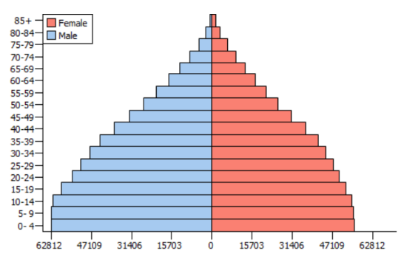
The population pyramid
2010 India

Slide 4
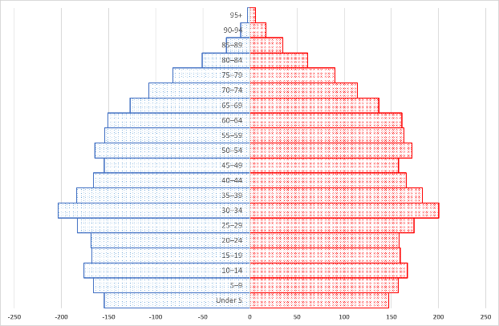
The population pyramid
2023 NZ estimated resident population

Slide 5
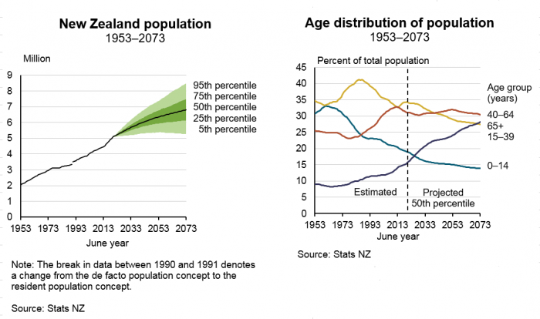

Slide 6
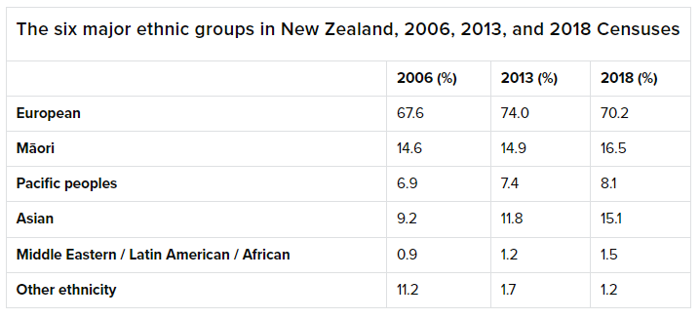
NZ Ethnic diversity

Slide 7
In Summary
We are getting older!
As individuals and as a society,
and ethnically and culturally more diverse.

Slide 8
Chronic Health Conditions
What are we talking about?
Cancer(s)
Diabetes
Cardiovascular disease (conditions of heart and blood vessels)
Respiratory diseases (conditions affecting lungs and respiratory tract)
Stroke
Gout
Mental Health conditions
Traumatic Brain Injury
And more …
Source: TePaeTata_A4.pdf

Slide 9
Chronic Health Conditions
Prevalence [%] at age range 55 to 64 years
Source: https://www.cdc.gov/nchs/health_policy/adult_chronic_conditions.htm
Age 55 to 64 years | Total | Male | Female
1+ CC | 69.5 | 66.7 | 71.1
2+ CCs | 37.1 | 32.3 | 41.5
3+ or more CCs | 14.4 | 11.1 | 17.4

Slide 10
Chronic Health Conditions
Prevalence [%] at age range 65 years and over
Source: https://www.cdc.gov/nchs/health_policy/adult_chronic_conditions.htm
Age 65 years and over | Total | Male | Female
1+ CC | 69.5 -> 85.6 | 66.7 -> 83.0 | 71.1 -> 87.6
2+ CCs | 37.1 -> 56.0 | 32.3 -> 51.4 | 41.5 -> 59.4
3 or more CCs | 14.4 -> 23.1 | 11.1 -> 21.2 | 17.4 -> 24.6

Slide 11
Chronic Health Conditions
Aotearoa context
One in four Kiwis live with multiple CCs (25%).
Often experienced by several generations in the same whānau.
Māori and Pacific people develop CCs 10-20 years earlier, experience more barriers to health care, such as lack of culturally appropriate services, location and transport specific challenges, financial and socio-economic limitations.
Source: https://www.tewhatuora.govt.nz/for-health-professionals/clinical-guidance/diseases-and-conditions/long-term-conditions/about-chronic-health-conditions/#about-chronic-health-conditions

Slide 12
Chronic Health Conditions
Cancer(s)
Affects around 23,000 people every year (new diagnoses).
Approximately 10,000 death per year.
Is the leading cause of health loss.
Significant inequities:
Māori are 20% more likely to develop and twice as many are likely to die from cancer.
Pacific people also have higher incidence and mortality rates.
Around 30-50% of all cancers are preventable.

Slide 13
Chronic Health Conditions
Diabetes
Approximately 278,000 people in NZ live with diabetes.
90% of cases are type II diabetes, more prevalent in older people.
Significant inequities:
Māori and Pacific people develop diabetes 10 to 20 years earlier.
They experience worse outcomes e.g., higher rates of limb amputations.
Diabetes is one of the big issues on population level.

Slide 14
Chronic Health Conditions
Cardiovascular diseases
Leading cause of health loss in NZ.
1 in 2 people aged 40 years and over has hypertension.
Approximately the cause of death in 1/3 of cases.
For half of Māori, Pacific, and Asian people death from heart disease is premature and avoidable.

Slide 15
Chronic Health Conditions
Respiratory diseases
Account for around 10% of hospital admissions.
Related to poor air quality.
Māori and Pacific children have a high burden due to higher rates of exposure to damp and mouldy homes.

Slide 16
Chronic Health Conditions
Stroke
Second most common cause of death.
Leading cause of impairment in adults.
Incident rate increases with age.
Largely preventable.

Slide 17
Chronic Health Conditions
Mental health conditions
Wide range of specific conditions with different impact on individuals and whānau.
Over 50% of Kiwis will experience mental distress and addiction challenges at some point.
Economic cost of about 5% of GDP.
Māori are more affected and experience worse outcomes.
Loneliness has high prevalence among older people.

Slide 18
Multiple Chronic Conditions
What condition tend to co-occur?
Single conditions can easily be described:
=> x% of males at the age of 65 have hypertension, with a life expectancy of…
Two co-occurring conditions can be described:
=> Of those males, y% also have diabetes, with z% of those being Pacific
Then it gets more difficult and complex:
=> medical knowledge of the conditions
=> statistical methods => presentation of data
=> limited by available data

Slide 19
Multiple Chronic Conditions
What condition tend to co-occur – two CCs
 | AMI | Cancer | CHD | COPD | Dementia | Diabetes | Gout | Mental health | Stroke | TBI | # of CCs | 2+ CCs (%)
AMI |  | 27.93 | 96.41 | 28.31 | 9.26 | 36.37 | 24.73 | 50.19 | 13.01 | 13.12 | 4.03 | 99.37
Cancer | 2.01 |  | 16.19 | 18.82 | 6.69 | 21.95 | 15.65 | 43.98 | 7.59 | 10.09 | 2.77 | 79.21
Coronary heart disease | 6.95 | 3.58 |  | 12.34 | 5.61 | 16.31 | 10.72 | 23.73 | 5.83 | 6.28 | 3.43 | 91.74
COPD | 2.04 | 4.17 | 2.45 |  | 3.10 | 12.94 | 8.52 | 23.22 | 3.27 | 4.75 | 3.08 | 85.55
Dementia | 0.67 | 1.48 | 1.11 | 0.53 |  | 7.80 | 3.83 | 25.75 | 6.34 | 7.65 | 3.76 | 95.47
Diabetes | 2.62 | 4.86 | 3.24 | 2.23 | 0.46 |  | 10.07 | 13.51 | 2.35 | 3.24 | 2.79 | 78.69
Gout | 1.78 | 3.46 | 2.13 | 1.47 | 0.23 | 2.43 |  | 6.81 | 1.22 | 1.79 | 3.00 | 83.80
Mental health | 3.62 | 9.73 | 4.71 | 4.00 | 1.52 | 3.26 | 1.04 |  | 1.23 | 2.55 | 2.68 | 76.40
Stroke | 0.94 | 1.68 | 1.16 | 0.56 | 0.37 | 0.57 | 0.19 | 0.47 |  | 0.99 | 3.69 | 91.92
Traumatic brain injury | 0.95 | 2.23 | 1.24 | 0.82 | 0.45 | 0.78 | 0.28 | 0.98 | 0.07 |  | 3.20 | 84.38
Population (%) | 7.21 | 22.13 | 19.84 | 17.22 | 5.90 | 24.15 | 15.34 | 38.31 | 6.59 | 9.30 | 1.66
Older adults living with others – excludes individuals who live alone, or in care settings

Slide 20
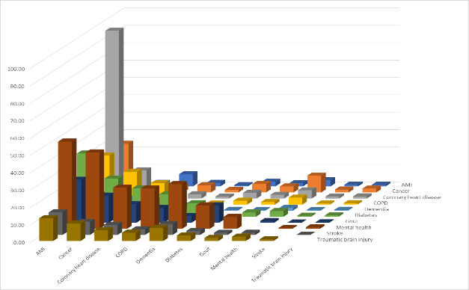
Multiple Chronic Conditions
What condition tend to co-occur – two CCs

Slide 21
Multiple Chronic Conditions
What condition tend to co-occur – two CCs
 | AMI | Cancer | CHD | COPD | Dementia | Diabetes | Gout | Mental health | Stroke | TBI | # of CCs | 2+ CCs (%)
AMI |  | 27.93 | 96.41 | 28.31 | 9.26 | 36.37 | 24.73 | 50.19 | 13.01 | 13.12 | 4.03 | 99.37
Cancer | 2.01 |  | 16.19 | 18.82 | 6.69 | 21.95 | 15.65 | 43.98 | 7.59 | 10.09 | 2.77 | 79.21
Coronary heart disease | 6.95 | 3.58 |  | 12.34 | 5.61 | 16.31 | 10.72 | 23.73 | 5.83 | 6.28 | 3.43 | 91.74
COPD | 2.04 | 4.17 | 2.45 |  | 3.10 | 12.94 | 8.52 | 23.22 | 3.27 | 4.75 | 3.08 | 85.55
Dementia | 0.67 | 1.48 | 1.11 | 0.53 |  | 7.80 | 3.83 | 25.75 | 6.34 | 7.65 | 3.76 | 95.47
Diabetes | 2.62 | 4.86 | 3.24 | 2.23 | 0.46 |  | 10.07 | 13.51 | 2.35 | 3.24 | 2.79 | 78.69
Gout | 1.78 | 3.46 | 2.13 | 1.47 | 0.23 | 2.43 |  | 6.81 | 1.22 | 1.79 | 3.00 | 83.80
Mental health | 3.62 | 9.73 | 4.71 | 4.00 | 1.52 | 3.26 | 1.04 |  | 1.23 | 2.55 | 2.68 | 76.40
Stroke | 0.94 | 1.68 | 1.16 | 0.56 | 0.37 | 0.57 | 0.19 | 0.47 |  | 0.99 | 3.69 | 91.92
Traumatic brain injury | 0.95 | 2.23 | 1.24 | 0.82 | 0.45 | 0.78 | 0.28 | 0.98 | 0.07 |  | 3.20 | 84.38
Population (%) | 7.21 | 22.13 | 19.84 | 17.22 | 5.90 | 24.15 | 15.34 | 38.31 | 6.59 | 9.30 | 1.66

Slide 22
Multiple Chronic Conditions
What about three and more CCs
Using interRAI data we analysed CCs of older adults seeking home support services.
31,704 people, mean age 82.3 (8.0), 59.9% female
Limitations: no details on specific type or degree of health condition.

Slide 23
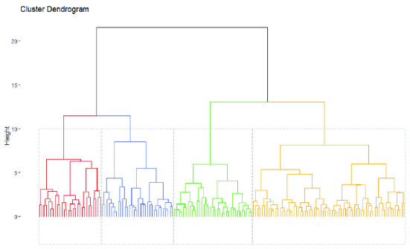
Multiple Chronic Conditions
What about three and more CCs
Hierarchical cluster analysis
Determines clusters based on similarity / dissimilarity
Result is a dendrogram and the descriptive statistics for each cluster

Slide 24
 | Cluster 0 (No CC) | Cluster 1 (COPD) | Cluster 2 (Depression) | Cluster 3 (Stroke) | Cluster 4 (Cancer) | Cluster 5 (Diabetes) | Cluster 6 (Cog. Imp.) | Cluster 7 (CHD) | Cluster 8 (CHF)
Total in cluster | 2,791 (8.8%) | 2,702 (8.5%) | 4,612 (14.5%) | 4,572 (14.4%) | 4,977 (15.7%) | 3,992 (12.6%) | 4,290 (13.5%) | 2,237 (7.1%) | 1,531 (4.8%)
Coronary Heart Disease | 0% | 39.6% | 29.2% | 39.8% | 32.6% | 36.8% | 0% | 100% | 45.4%
Congestive Heart Failure | 0% | 26.8% | 13.9% | 17.2% | 15.2% | 18.6% | 0% | 0% | 100%
COPD | 0% | 100% | 20.2% | 14.1% | 17.2% | 0% | 0% | 0% | 0%
Diabetes | 0% | 23.2% | 4.1% | 22.3% | 18.0% | 100% | 0% | 0% | 0%
Cancer | 0% | 0% | 0.4% | 0% | 100% | 3.7% | 0% | 0% | 0%
Stroke | 0% | 0% | 0% | 100% | 16.1% | 3.3% | 0% | 0% | 0%
Cognitive Impairment | 0% | 41.6% | 67.3% | 65.0% | 48.7% | 57.3% | 100% | 54.1% | 45.8%
Depression | 0% | 0% | 100% | 23.0% | 20.6% | 28.7% | 0% | 0% | 0%
Mean (SD) number of conditions | 0 | 2.3 (1.0) | 2.4 (1.0) | 2.8 (1.1) | 2.7 (1.2) | 2.5 (1.0) | 1 (0) | 1.5 (0.49) | 1.92 (0.68)

Slide 25
In Summary
There are many chronic health conditions,
and even more combinations of chronic health conditions.
Understanding of multiple CCs is incomplete and complex.

Slide 26
What can you do?
Known factors
Family genetics and learnt habits
Lifestyle
Age
Prevention & Treatments
Diet and exercise
Screening
Medications
Surgery or other interventions

Slide 27
Medications and ageing
Backdrop
As we collect health conditions the medication count tends to increase
Medications are typically tested in young people
Older bodies react to medications differently
Adverse drug side effects
Drug interactions
=> Polypharmacy

Slide 28
Medications and ageing
Polypharmacy
Polypharmacy refers to the concurrent use of multiple medicines by a person.
Not a problem by default.
Some drug are more likely to cause adverse side effects than others.
Sedative and anticholinergic drugs are of concern for older people.
Known to increase the risk of falls and hip fractures.
Deprescribing is a method to reduce medications when adverse effects outweigh the benefits.

Slide 29
Deprescribing
What is it?
A structured process to review patient medications by a health professional.
Consider benefit of continued use verses possible impact of not taking.
Consider alternative medications, or combinations of medications.
Manage changes in medications e.g. tapering off.
It is not just stopping a possibly critical medication, nor a DIY process!

Slide 30
Deprescribing
Barriers
It takes time and is not always feasible.
Requires collaboration between GP, Specialists, Pharmacist, and patient
Reluctance by patients to change meds.
Limited knowledge of drug-drug interactions in older people.
Possible and fears of possible side effects or worsening of symptoms.

Slide 31
Deprescribing
Drug Burden Index medications
DBI is a measure of possible adverse reactions of a medication.
Total of all DBI scores of a person’s medication provides a total score of burden.
A score of 0.5 is equivalent to one medication at its effective dose.
It has previously been demonstrated that each additional unit of DBI has similar negative effects as three additional physical comorbidities.

Slide 32
Deprescribing
Deprescribing trial of DBI drugs
We conducted a trial to test a method to improve deprescribing focussing on:
Sedatives are medicines that work on the central nervous system to relieve pain, anxiety, aid sleep, or have a calming effect.
Anticholinergics are a broad group of medicines that act on the neurotransmitter, acetylcholine. They are also called antispasmodics.
Both classes have shown to increase the risk of falls and hip fractures.

Slide 33
Deprescribing
Deprescribing trial of DBI drugs
Conducted in Canterbury (Christchurch & Timaru) Between 25 September 2018 and 30 October 2020
Following a needs assessment, a Pharmacist reviewed the person’s medications.
Suggestions for changes were sent to the person’s GP for follow up.

Slide 34
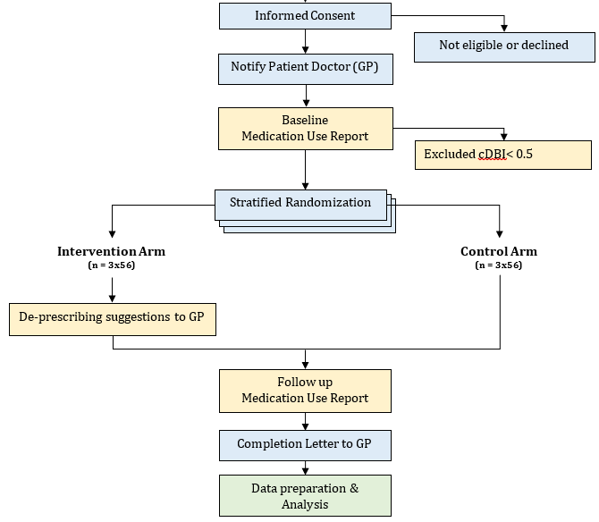
Deprescribing
RCT
Conducted in Canterbury (Christchurch & Timaru)
25/09/2018 - 30/10/2020
Stratified by frailty
Outcome: change in DBI

Slide 35
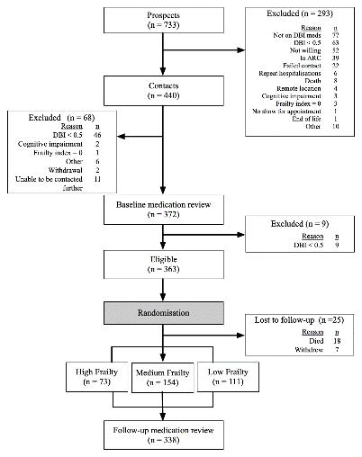
Deprescribing
RCT Results
Started with 733 prospects
Engaged with 440 people
Randomized 363 participants
Results from 338 participants
Involved 226 GPs in 98 medical centers

Slide 36
Deprescribing
RCT Results
Mean age 79.9 (SD 7.0) years
66.4% females
97.5% NZ European
The six most commonly used medicines at the initial medication review were codeine, citalopram, zopiclone, doxazosin, gabapentin, and amitriptyline.
Near equal change in DBI between intervention and control arm => no effect
Change depended largely on the level of DBI / number of meds taken at baseline
Study was disrupted by COVID-19 lockdown

Slide 37
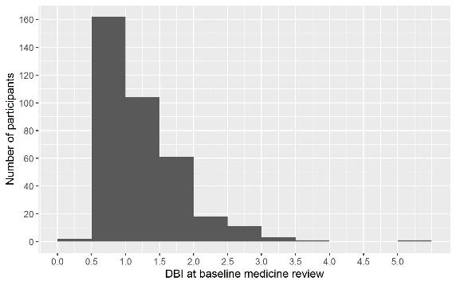
Deprescribing
RCT Results – DBI Histogram

Slide 38
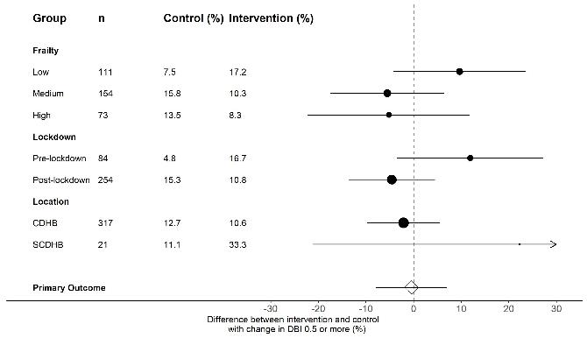
Deprescribing
RCT Results of subgroup analyses

Slide 39
In Summary
Polypharmacy creates risks for older persons.
Deprescribing is an important intervention, but difficult to implement.
Our trial failed to detect an effect of our deprescribing protocol.

Slide 40
Deprescribing
RCT Results – Economic analysis
Wanted to know if frailty and DBI are predictors of healthcare cost?
Obtained administrative health information for study participants for the 6 months following their enrolment into the study (consented) :
Cost of medications and dispensed medication
Outpatient services
Hospital admissions and cost of admissions / treatments
Cost of aged residential care admissions
No visibility of GP visits, specialists, or privately funded medical treatments
Excluded cost of the intervention

Slide 41
Deprescribing
Pareto Analysis
Show cohort’s cost structure broken down into $1,000 increments.
Show the number and % of individuals contributing to the total cost.
In a business it allows to discern the important from the desirable.
Assuming ~ 20% of causes create 80% of the problems

Slide 42
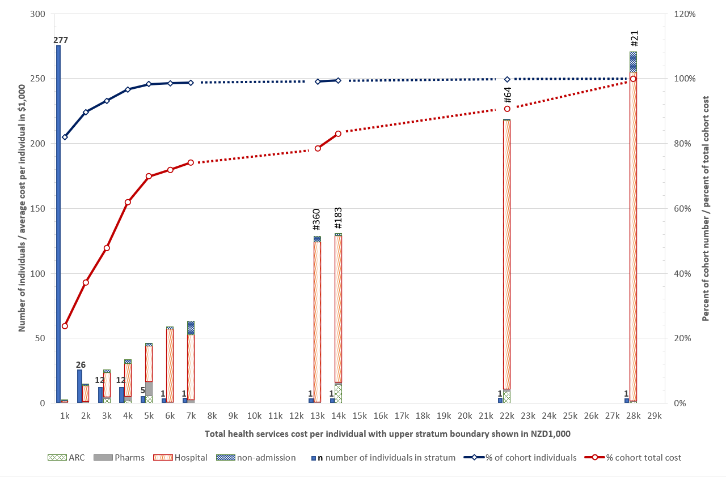
RCT Health Economics Results
Notes:
The analysis shows that 4 participants (1.2% of participants; study identifications 360, 183, 64, and 21) accounted for 26% of total costs incurred, and the 15 highest-cost individuals, or 5% of the cohort, accounted for 43% of the total cost incurred. In contrast, 277 participants or 82% of the cohort, incurred individual costs of <$1000 (USD650), contributing just 24% to the total cost.

Slide 43
Deprescribing
RCT Results – Economic analysis
Cost ranged from NZ$15 to NZ$270,681 pp over six months post-recruitment.
Four individuals accounted for 26% of this cohort's total healthcare cost.
Frailty is associated with increased healthcare costs.
DBI only associated with pharmaceutical costs, not overall healthcare costs.
Notes:
One SD higher DBI (0.64) -> 18% higher pharmaceutical cost. DBI no robust relationship to non-pharmaceutical cost.
One SD higher FI (0.13) -> 27% higher healthcare cost.

Slide 44
In Summary
In our cohort 277 of the participants (82%) accounted for 24% of the cost and 4 individuals (1.5%) incurred 26% of the total cost.
Economic considerations for deprescribing interventions need more research and analysis.

Slide 45
Next steps
Current and future work
Using administrative health data to gain a better understanding of:
Pacific older persons’ health
Vision and Hearing impairment among older adults
Dental / oral health changes when transitioning to aged residential care
Hip fractures
Neurological conditions
Providing Cognitive Stimulation Therapy for early dementia outside urban areas

Slide 46
Ageing – a journey with side effects
Population demographics
Chronic health conditions Complexity of co-occurring CCs
Medications and ageing
Polypharmacy
Deprescribing
Economics
Next steps

Slide 47
Ulysses by Alfred, Lord Tennyson
‘Old age hath yet his honour and his toil;
Death closes all: but something ere the end,
Some work of noble note, may yet be done.’

Slide 48
Sir Tom Moore
30 April 1920 – 2 February 2021
The best recent example Captain Sir Tom Moore aged 99 during the Covid outbreak
Aimed to raise 1000 pounds for the NHS - raised over £35 million!

Slide 49
CANTERBURY EDUCATION AND RESEARCH TRUST FOR THE HEALTH OF OLDER PERSONS
About Us
A Christchurch-based charitable trust (CC32596) to promote and improve the education of young doctors and other health workers in the field of older persons’ health care. We are:
A Charitable Trust established in 1989
Based at the University of Otago, Christchurch, as a trust administered within University of Otago financial services
Trustees are represented by:
Age Concern, University of Canterbury, University of Otago, ARA Institute of Canterbury, Older Persons Health Service at Burwood Hospital, The Community

Slide 50
CANTERBURY EDUCATION AND RESEARCH TRUST FOR THE HEALTH OF OLDER PERSONS
Why Do We Exist?
Foster aged care research.
Develop the aged care health workforce through interdisciplinary teaching for undergraduate and postgraduate students.
Promote health education for the benefit of older people.
Advocate for aged care services.
Improve interdisciplinary teaching of older persons health for all health students.

Slide 51
CANTERBURY EDUCATION AND RESEARCH TRUST FOR THE HEALTH OF OLDER PERSONS
Our Long-term Goals
Seeks to make our older persons’ health care teams the best available.
Their training must have priority, they must be aware of the latest research, and must apply this to their day-to-day practice.
We aim to:
Continue to promote teaching and research in this important field.
Encourage young professionals from diverse backgrounds to specialise in the field.
Advocate for health services development for older people.

Slide 52
CANTERBURY EDUCATION AND RESEARCH TRUST FOR THE HEALTH OF OLDER PERSONS
Contact Details
University of Otago Christchurch
Professor Dick Sainsbury
P.O. Box 4345
Christchurch
dsain@xtra.co.nz
Bank A/C 01-0822-0027261-00

Slide 53
Q & A

