Slide 1
Alana Fitzgerald, Timaru Airport
Notes:
Tena koutou, thanks for having me
Aurora last month?
Sunspots size of Earth. Pretty face of real hazard
Big problem outside of magnetosphere. Day before, was at talk by geophysicist at Vic, who’s part of research led by Otago which is modelling the effect…
https://www.space.com/return-aurora-causing-sunspot-june-solar-storm-prospects (technically the AR from the May storms rotating back around)
https://www.geonet.org.nz/news/7CXlGbEfwGAiCITzbEkFYc

Slide 2
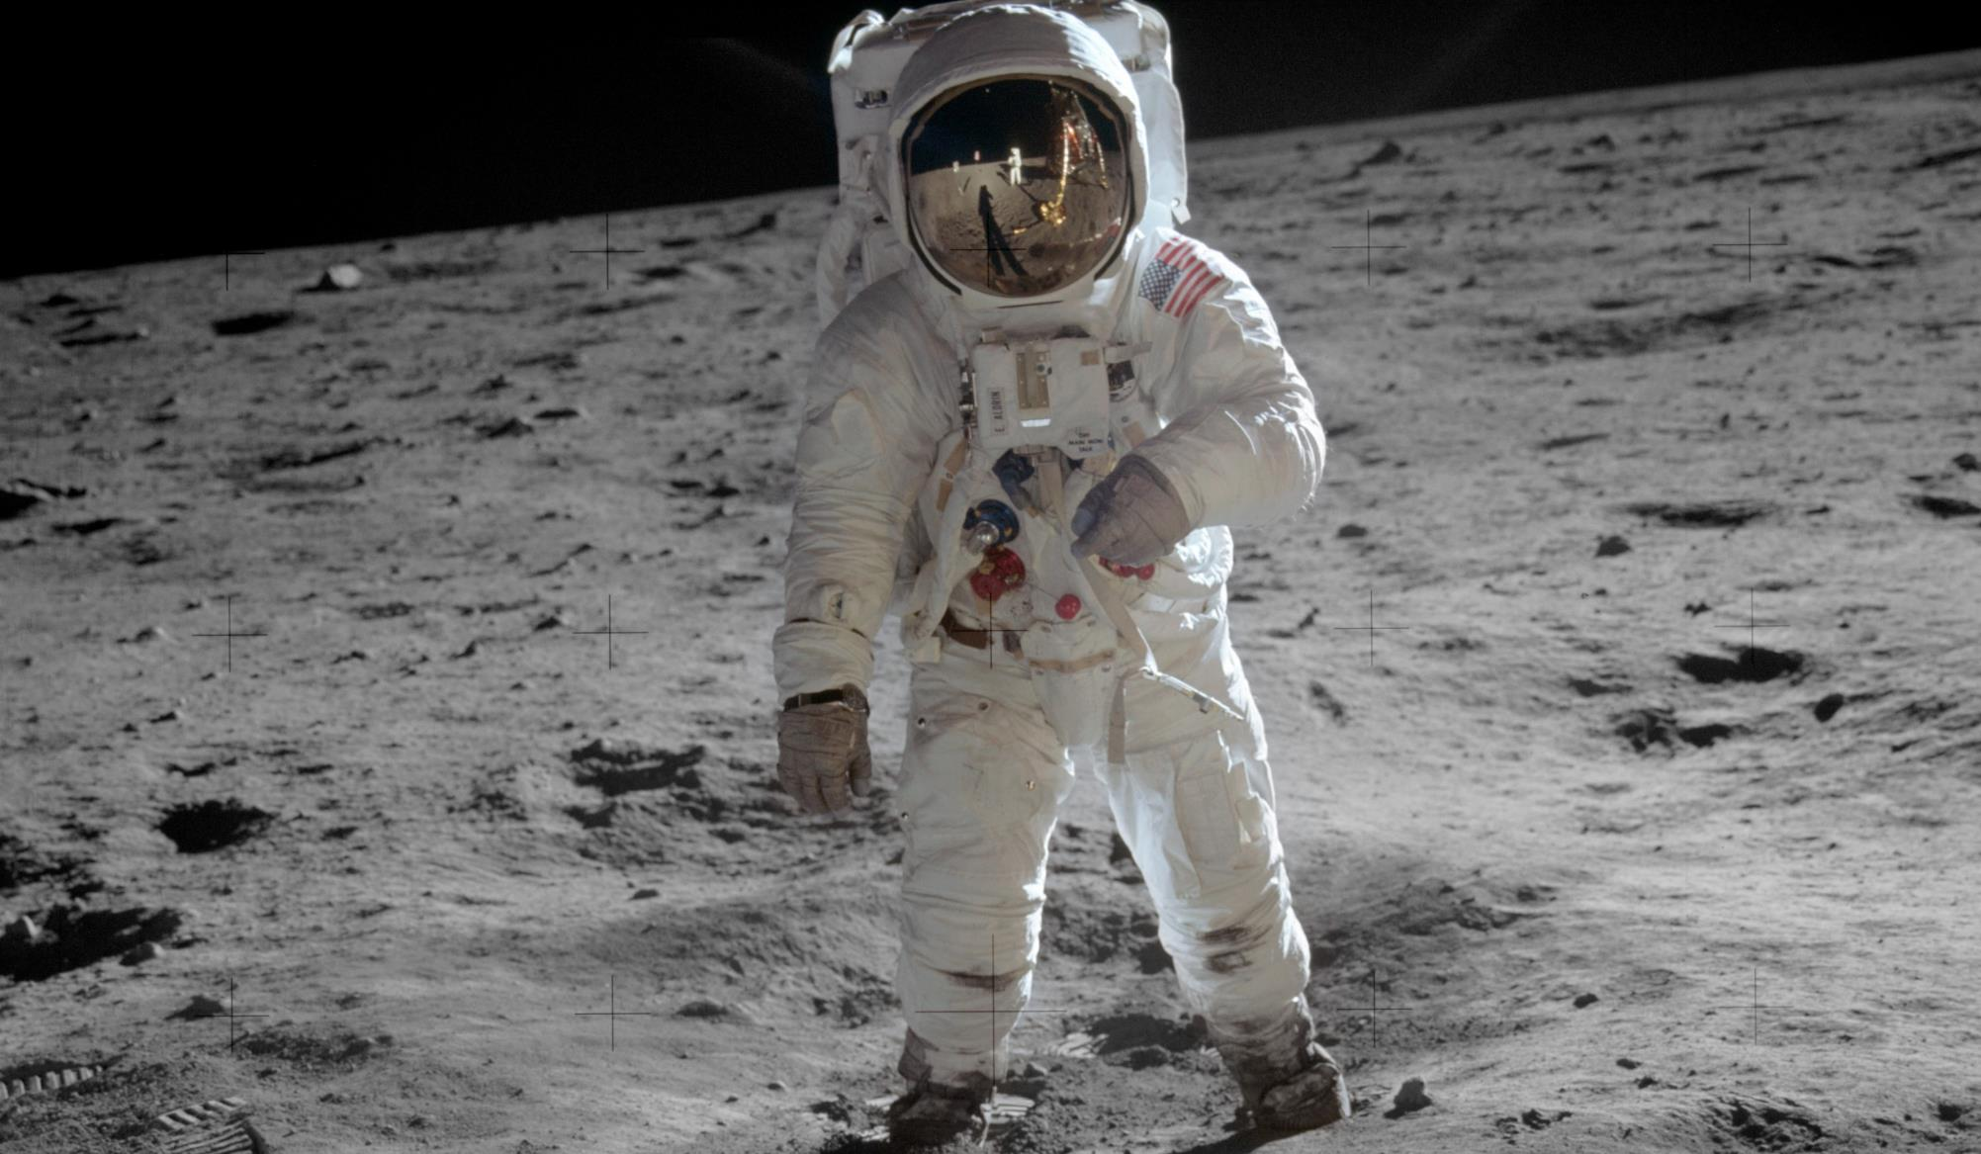
A Song of Ice and Solar Flares Returning humans to the Moon this decade
Daniel Wrench
U3A Timaru
June 2024
Notes:
Who remembers the Moon landing?
Who is aware that NASA is planning to send astronauts back to the Moon in the next few years?
Very excited. Thinking about the hazard of space weather, but also the recent discovery of a potential resource on the Moon, and finally some inspiration from George R.R. Martin…
Ice and solar flares are key parts of the science of this story, but there is also fascinating engineering, and politics that help explain why now, after 50 years?

Slide 3
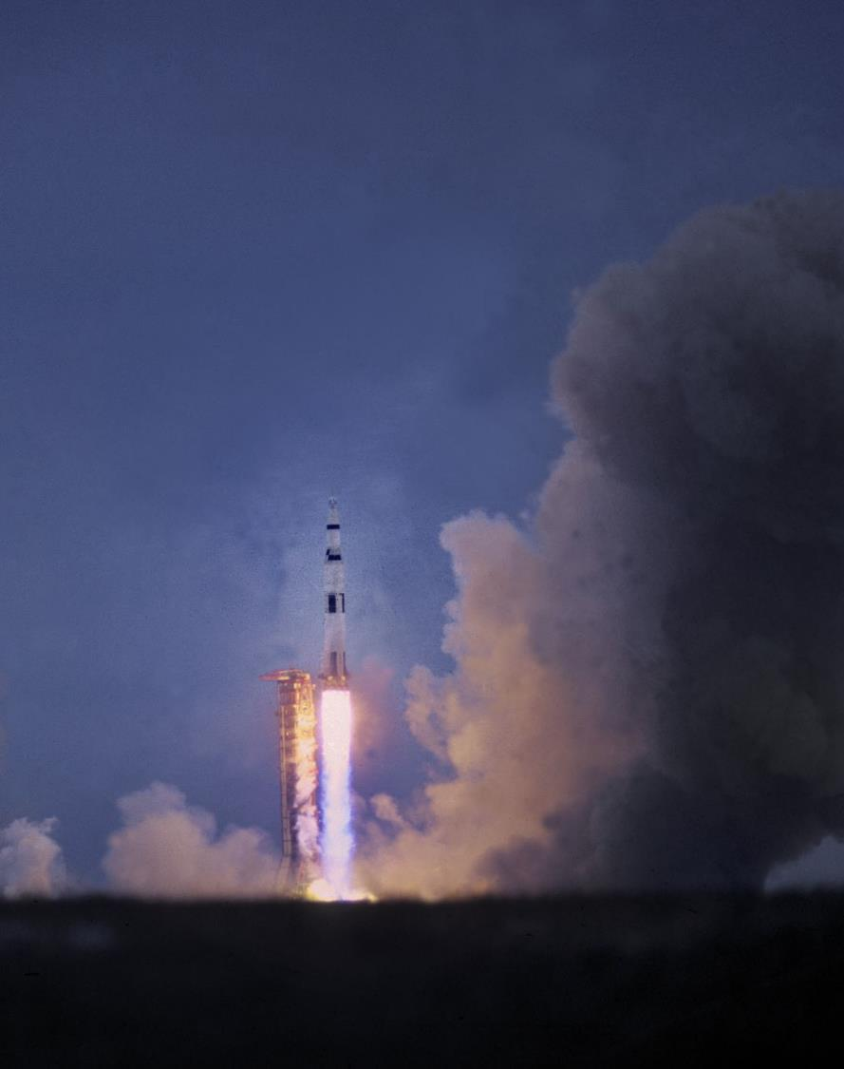
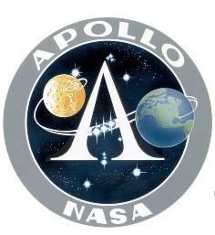
Getting people to the Moon (and beyond) requires 3 things
1961-1972
2022-
A reason to go
Nationalism
Economic benefit
Scientific discovery
Stepping stone?
A way to get there
Rocket
Capsule
Lander
A means to stay safe
Notes:
Yes politics, because Despite rise of commercial space, staggering costs and lack of profit means sending humans to the Moon still requires a government led effort. Once again, the US government – those as we’ll see, they’re not the only ones looking to go.
Three things have to align to make such an endeavour happen.
Dive into the contrasts between these factors for Apollo and Artemis, as we’ll see, balance of factors is very different.
Starting with the reason to go, the key contrast is that Apollo was all about that first one.

Slide 4
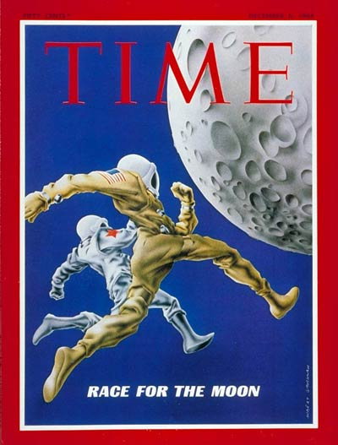
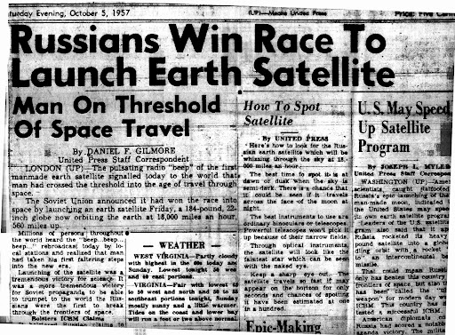
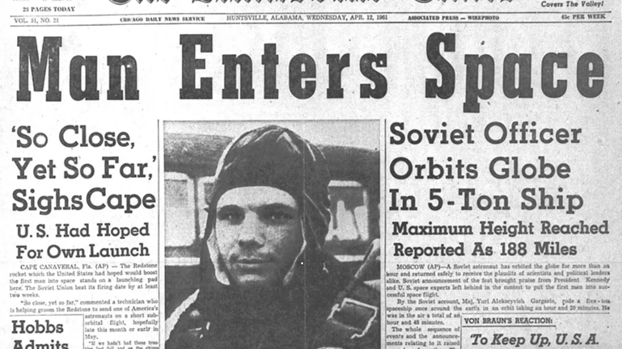
Getting people to the Moon (and beyond) requires 3 things
1961-1972
A reason to go
Nationalism
Economic benefit
Scientific discovery
Stepping stone?
A way to get there
Rocket
Capsule
Lander
A means to stay safe
Notes:
Apollo, well-worn story: Cold War space race.
Sense of foreboding amongst the public. Need to prove America’s competence to themselves, but also the scores of newly independent countries that decolonised after WWII.

Slide 5
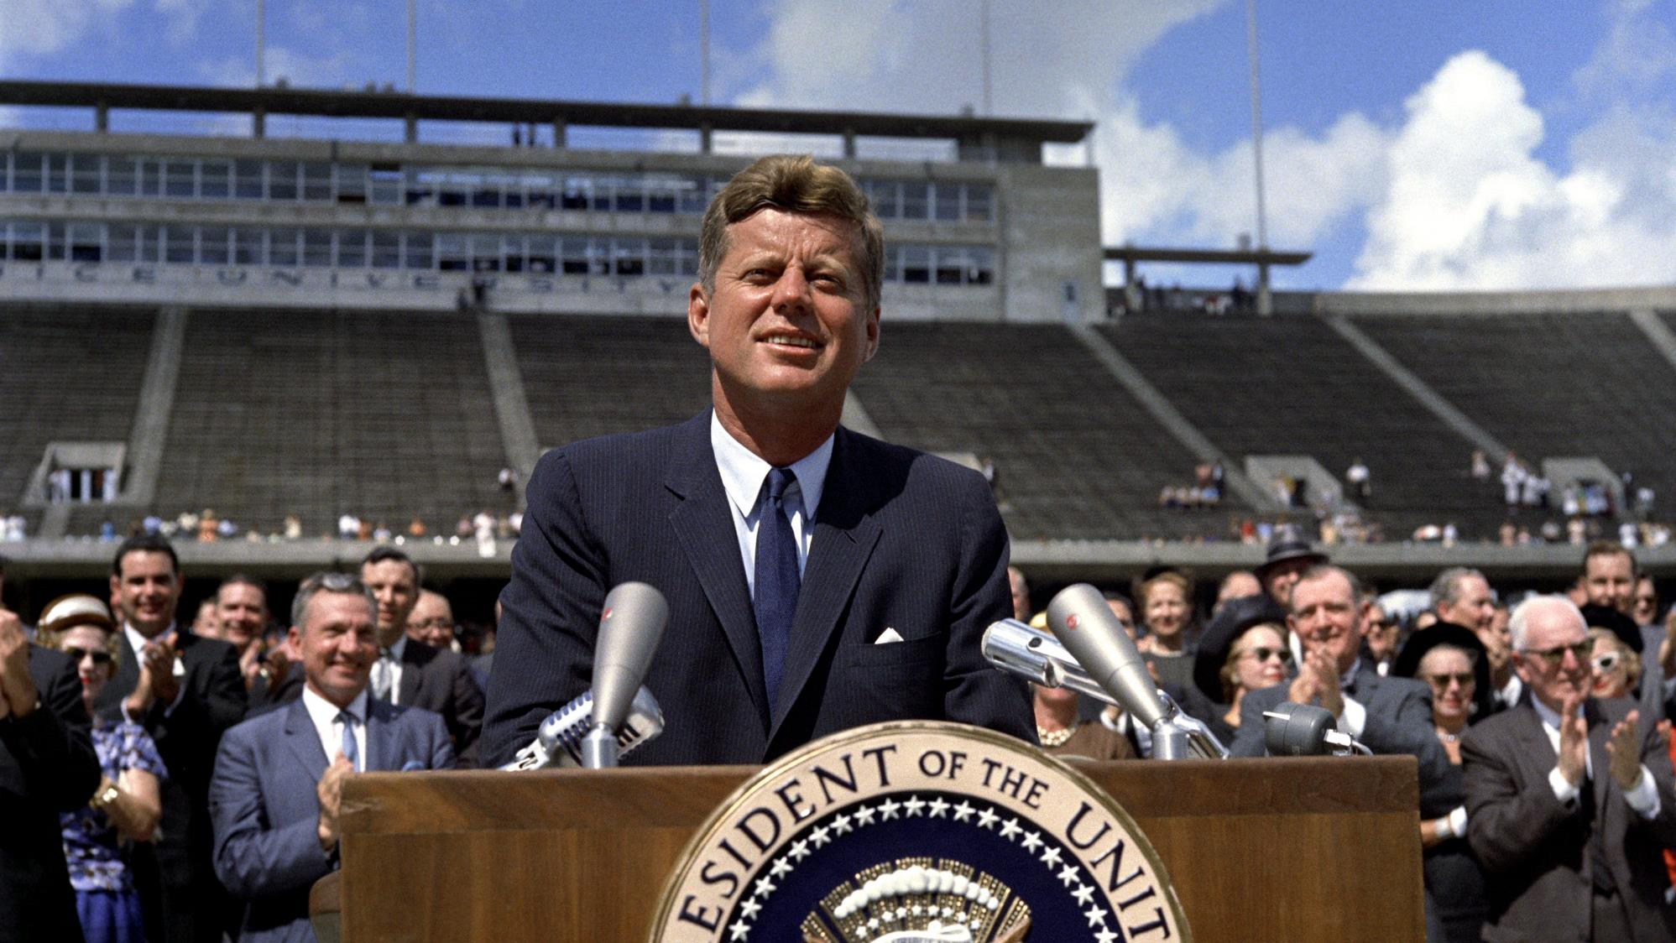
Let’s explore the universe with a banner of freedom and peace!
Please, let’s beat the Soviets at something
And do it before the decade is out!
1962
Notes:
Noble adventure -> beating the Soviets.
New goalposts 400,000km away. With a deadline: ambitious, but achievable.
Masterpiece of oratory, captured mood of the nation in needing to beat the Soviets
Also inspired spirit of adventure and tacking hard challenges because they are hard (even if they are very expensive)
This rallying cry worked,
Source: https://www.jfklibrary.org/asset-viewer/archives/jfkwhp-1962-09-12-a#?image_identifier=JFKWHP-KN-C23643

Slide 6
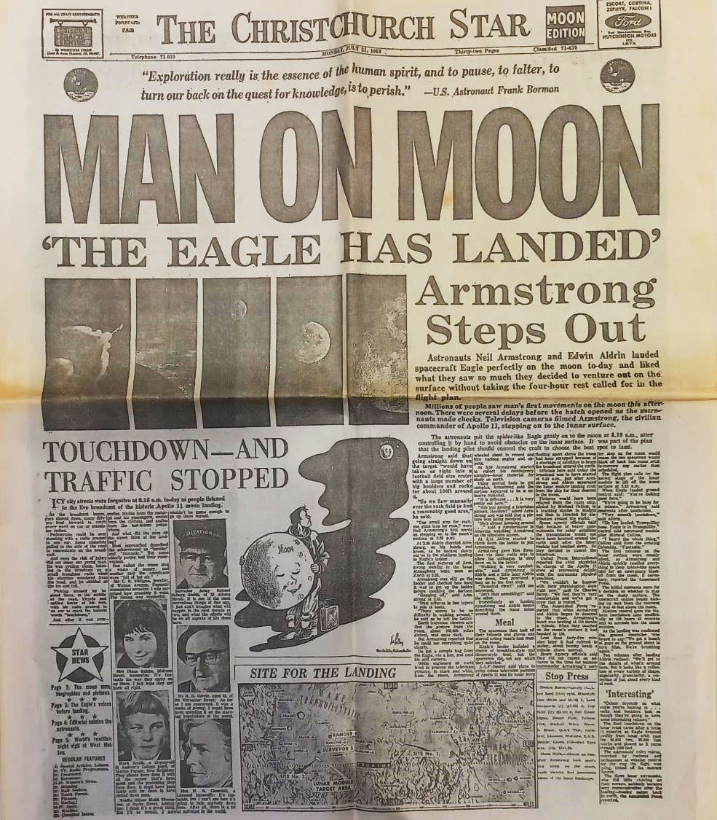
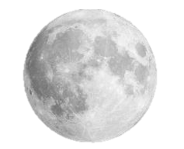
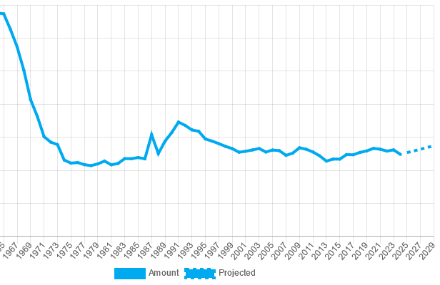
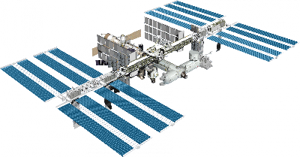
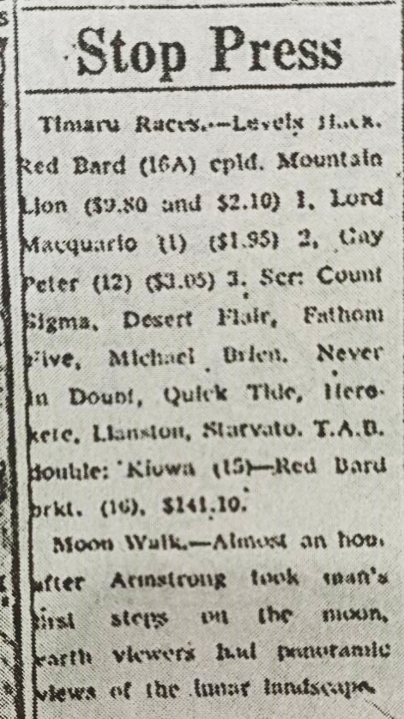
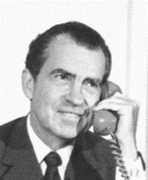
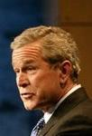
History of NASA’s budget
Notes:
Source: https://www.planetary.org/space-policy/nasa-budget
Pursestrings of Congress opened. Funded NASA to the tune of $300 billion USD in today’s money on over the 60s. With an estimated workforce of 400,000, they met now-dead Kennedy’s deadline with 6 months to spare. July 1969, Neil made his one small step, and the world stood still, crowded around radios and TV sets to watch this crowning achievement of not just the US but of humanity. Christchurch Star: stop press – never mind the space race
American taxpayer got not just one landing, but 6, out of 7 attempts. But… we’d beaten the Russians – wasn’t even much of a competition in the end - and there was only so excited people could get about grey rocks, even ones from space. (makes me sad as a former geologist)
Combine that with the Vietnam War and civil unrest, US had no appetite to continue such a costly program, and funding plummeted. After peaking at 4% of federal budget in 1965, NASA’s allocation has since hovered between 1 and 0.4% of all US government spending, and therefore human spaceflight has been confined to low-earth orbit.
What has happened? Nixon took phone call, major influence on rest of century: ASTP, STS. Individual space stations by US and Russia: coming together to build ISS: 15 countries. Continuously occupied for coming up to 24 years. Major achievement of shuttle.
Major shortcomings. Shuttle disasters. Speech by Bush Jr.

Slide 7
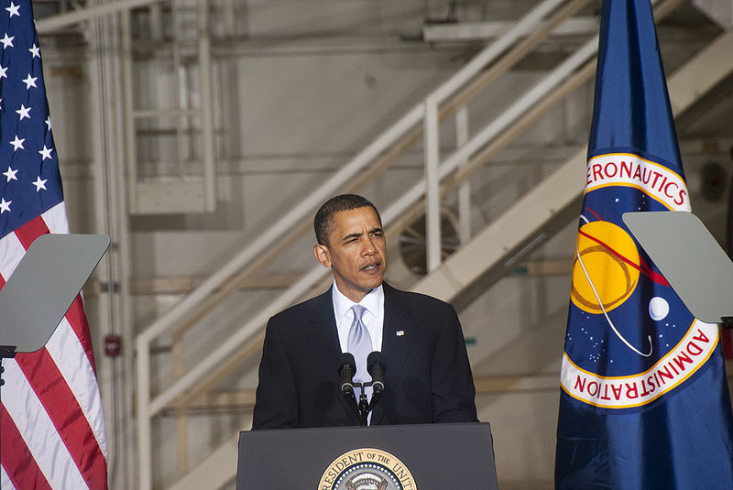
2004
2010
To an asteroid! And Mars in the 2030s?
Mate, you’re dreaming
Back to the Moon, by 2020!
Notes:
Vision for Space Exploration. All very nice to say, but when you don’t articulate a strong reason, you’re not gonna get the cash.
Next president gonna come along see how behind schedule you are and cancel it.
Keep in mind these timeframes: 16 years, 20 years. Compared with JFK’s 9 year-deadline.
https://georgewbush-whitehouse.archives.gov/news/releases/2004/01/20040114-3.html

Slide 8
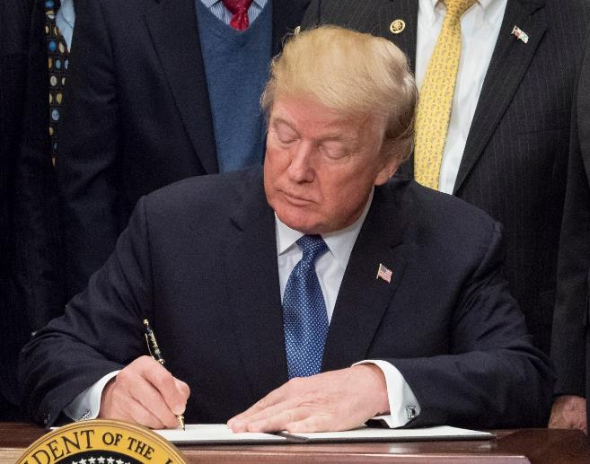
To the Moon!
2017
2019
Notes:
2017, Trump administration re-directed NASA to the Moon. NASA says 2028 doable.
VP, as head of revived National Space Council, says not good enough.
https://www.nasa.gov/news-release/new-space-policy-directive-calls-for-human-expansion-across-solar-system/
https://www.flickr.com/photos/nasahqphoto/31654423388/

Slide 9
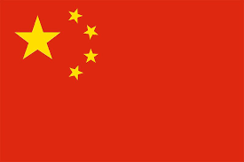
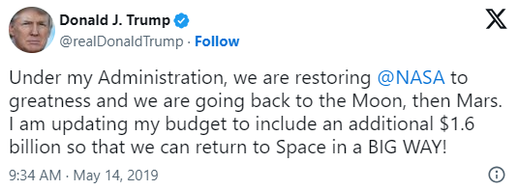
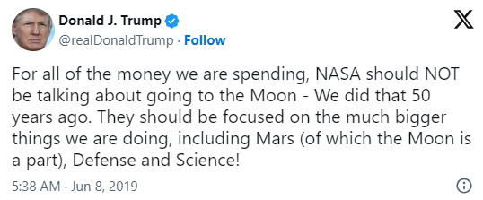
To the Moon!
By 2024!
2017
2019
Notes:
Trying to have his Kennedy moment. 5 years! Certainly not the soaring oratory and poetic vision of Kennedy’s speech, and 5 years was never going happen. But for the first time since JFK, a sense of urgency. Artemis born
Pence gets big photo on this slide because he really made his mark – Trump never gave any major space policy speeches. In fact, in not un-typical fashion, was occasionally a bit incoherent about his own administration’s policy. Also not un-typical, came via Tweets…
…which do highlight the Moon-Mars tension. Obama himself said “we’ve already done that” when he cancelled Bush’s plan. NASA has landed on the sensible plan: learn to live on the Moon to prepare for Mars.
Ok, we have a deadline, albeit a crazy one. The other thing that we’ve learnt helps, is a competitor. China on the rise: space station, fourth successful lunar landing from 4 attempts: spacecraft currently on its way back to earth with first samples from far side. Goal of landing people there by 2030.
Brings us to the new state of affairs
Pence quotes (March 26, 2019):
"That's just not good enough. We're better than that. It took us eight years to get to the moon, the first time, 50 years ago, when we had never done it before, and it shouldn’t take us 11 years to get back”. Well, it probably will. “What we need now is urgency,” Pence said. “Make no mistake about it, we’re in a space race today, just as we were in the 1960s, and the stakes are even higher.
https://www.nasa.gov/news-release/new-space-policy-directive-calls-for-human-expansion-across-solar-system/
https://www.flickr.com/photos/nasahqphoto/31654423388/

Slide 10
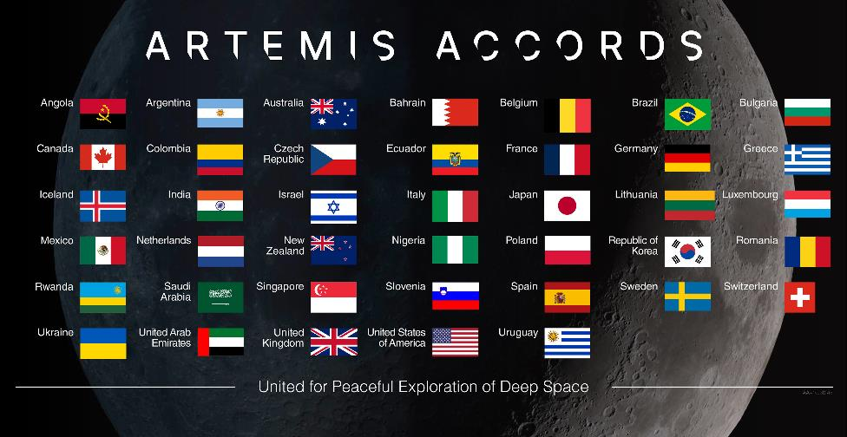
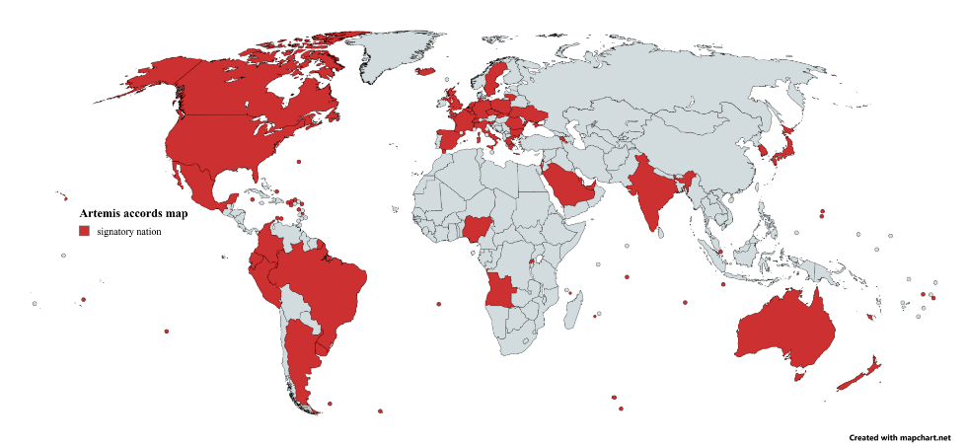
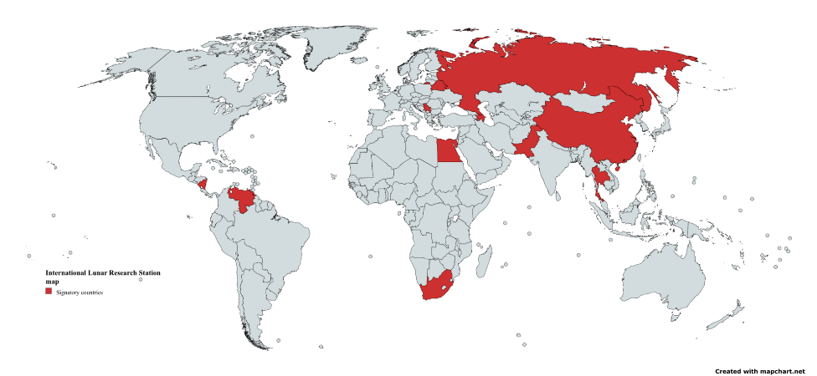
21st century space race International cooperation and competition
International Lunar Research Station
Notes:
SPD-1 explicitly mandated going back with international partners. Been building coalition: 43 nations signed so far, including NZ
Meanwhile ILRS is a planned scientific base for the 2030s, co-founded by China and Russia in 2021.
Useful thing about setting up these coalitions: national security and diplomatic benefit - makes the program much harder to cancel (ISS)
As well as China, seen Japan, India, and commercial companies all attempt to land robots on the Moon in the last 10 years; varying degrees of success. Moon rush.
The other major Trump space policy: explicit focus on international commercial partners. Hard to exaggerate impact of SpaceX, including on Artemis, as we will see later on.

Slide 11
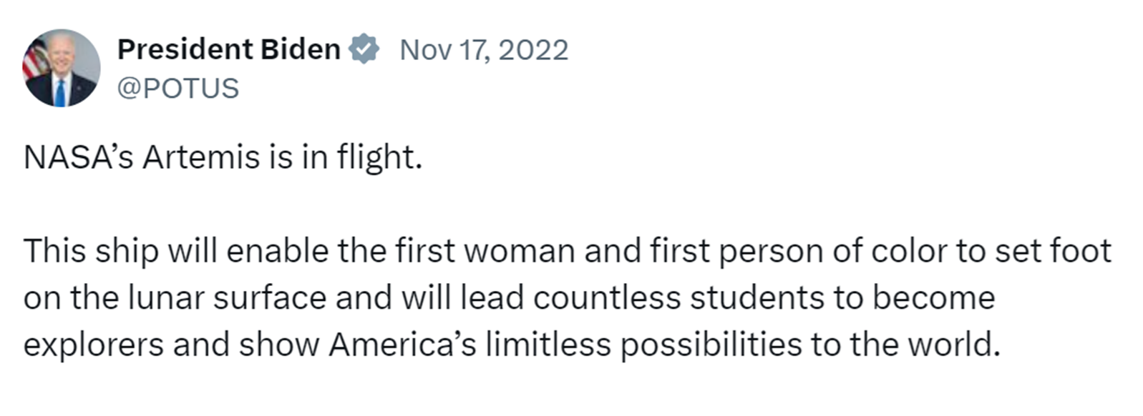
Artemis survives a change of administration
Notes:
Remarkably, Biden came in, and the program was not cancelled! Space advocates were shocked and jubilated. Bipartisan support.
Marketed very well: not about going back, doing something we’ve already done. Putting first woman on the Moon, first person of colour. Points to broader language change at NASA: talks about crewed rather than manned missions, humanity not mankind. Decent goal, because…

Slide 12
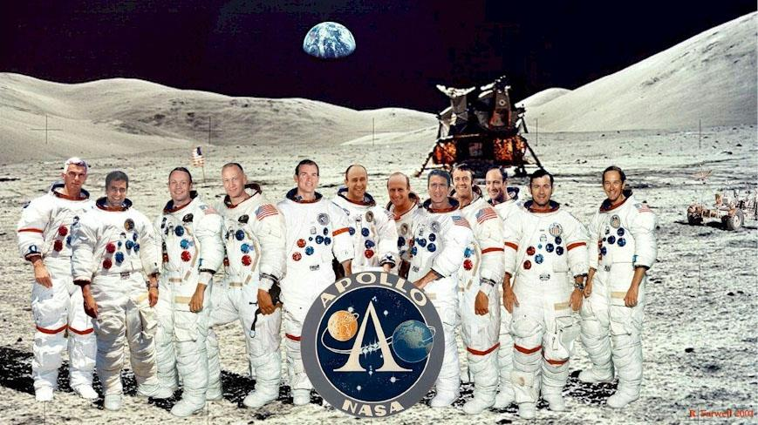
Scientist!
Notes:
White American male military test pilots (+geologist).
Product of its time: one woman in mission control for Apollo 11.
Good to see a more diverse crew.
Four still alive. Sure they are hoping to see others follow in their footprints in the lunar soil.
Source: Bob Farwell, https://www.nasa.gov/history/alsj/alsj.funpix.html

Slide 13
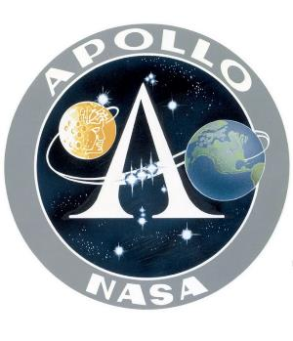
Recap: Reasons to go
Nationalism
Beat the Russians
Nationalism
Beat China
Put first woman and person of colour on the Moon
Go with international partners
Scientific research
Create a long-term presence… and use as a stepping stone to Mars
Notes:
Where does this leave us?
Apollo about one thing – and a particularly eloquent President to summon the nation, and perhaps even his death to spur on the effort in his honour.
Last two points are particularly salient with a recent discovery on the Moon. What does it mean to be a stepping stone: to learn how to use the resources on another world, rather than having to bring everything with you.

Slide 14
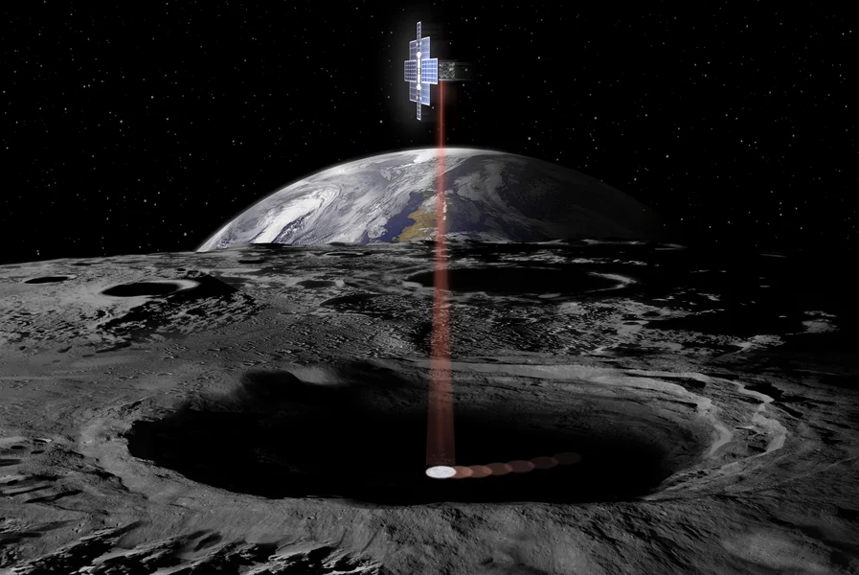
A very cool discovery
Notes:
After Apollo, samples showed no sign of water: Moon must be completely dry.
However, permanently shadowed craters. 2009, discovered chemical signature of water ice in these craters. Lots of unknowns: know it’s there, but don’t know how much or how easily accessible. If it is accessible, could be a real boon for exploration and settlement.
Thinking really far ahead, could make the moon a gas station for exploring the rest of the solar system. Fuel up, and then much easier to escape lunar gravity than Earth. It’s thought that if we can learn to use resources on the Moon, then great practise for Mars.

Slide 15
Notes:
Theoretical lunar water cycle. Likely originates from comets or solar wind.
Moon less boring than guessed. << geologically diverse than Earth, but significance is as a time capsule of the early solar system: contains rocks billions of years old, which would since have been recycled many times on Earth by erosion and plate tectonics.
So that’s the science and potential resource utilisation that are the final part of the motivation for going this time around. Time for second requirement.
https://trailblazer.caltech.edu/index.ht

Slide 16
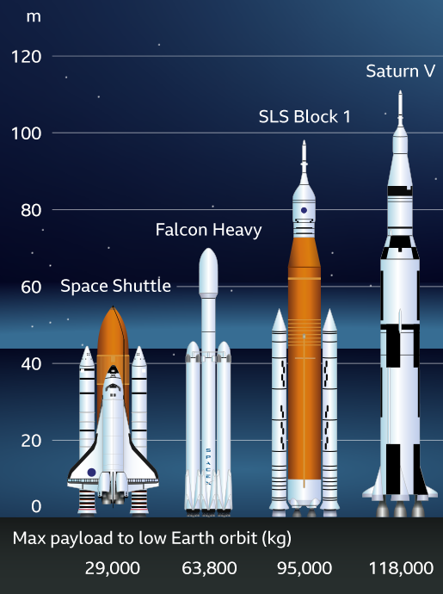
REQUIREMENT #2 A way to get there Rocket + capsule
Notes:
To the Moon and back again. Apollo had a perfectly optimised mission architecture for this: starting with the Saturn V rocket, designed by ex-Nazi.
Artemis however is this product of cancelled government programs and the commercial industry; resulting in a hodgepodge of vehicles, varying degrees of capability and cost.
Starting with this big orange rocket called Space Launch System. Not only much more boring name than Saturn V, but also less capable. Shuttle technology. “Senate Launch System”.
Expensive and delayed. But, Boeing and the other contractors got their act together eventually, first launch end of 2022
Source: https://www.bbc.com/news/science-environment-62563720

Slide 17
Artemis I November 2022
Notes:
Turned Florida night into day. Performed perfectly. Finally, NASA once again has a rocket capable of taking humans beyond LEO. Where do they sit? Inside the second major component, the capsule.

Slide 18
COMMAND AND SERVICE MODULE
Notes:
Life support
Apollo had the cool rocket name. Artemis has the cool capsule name. Computers a bit better, you’d hope: Bit bigger, 4 crew instead of 4
Service module built by ESA. No offense to them, but once again under-powered relative to Apollo! Neither SLS nor Orion designed for a moon landing!
Source: Adapted from https://www.americaspace.com/2019/11/04/artemis-updates-2019-11-03/

Slide 19
Artemis I December 2022
Notes:
But it also did well on its first test flight, performing a month-long loop around the Moon as part of Artemis I. Set record for farthest distance travelled by a spacecraft designed to carry humans: 430,000km. From which it took this stunning photo, before gently splashing down back on Earth.
But before we land, we need to make sure the life support systems work. Maybe most importantly, the toilets. That is job of the next mission.

Slide 20
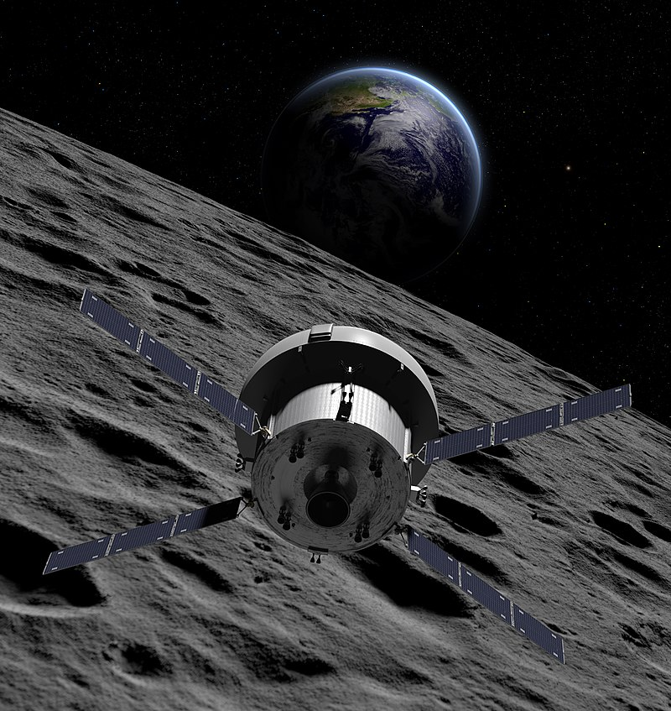
Artemis II September 2025
Notes:
Artemis II, currently slated for late next year. 10-day trip, loop around the Moon and come back
Roughly equivalent to Apollo 8.
Diverse crew: even a Canadian! Anticipate Europeans and Japanese on future flights.
Won’t be landing. Brings us to the third vehicle.

Slide 21
A way to get there: Lander
Notes:
Third vehicle needed. Apollo: tucked away neatly inside the Saturn V, just below the command and service module. But SLS and Orion weren’t designed with a moon landing in mind, so NASA had no lander in development and no room inside the rocket.
Under new commercial paradigm, put out a call to industry to come up with something.
SpaceX were the cheapest, and had the track record of sending astronauts to the ISS for several years.
However, you might say their proposal was slightly bigger.
Source: Everyday Astronaut YT

Slide 22
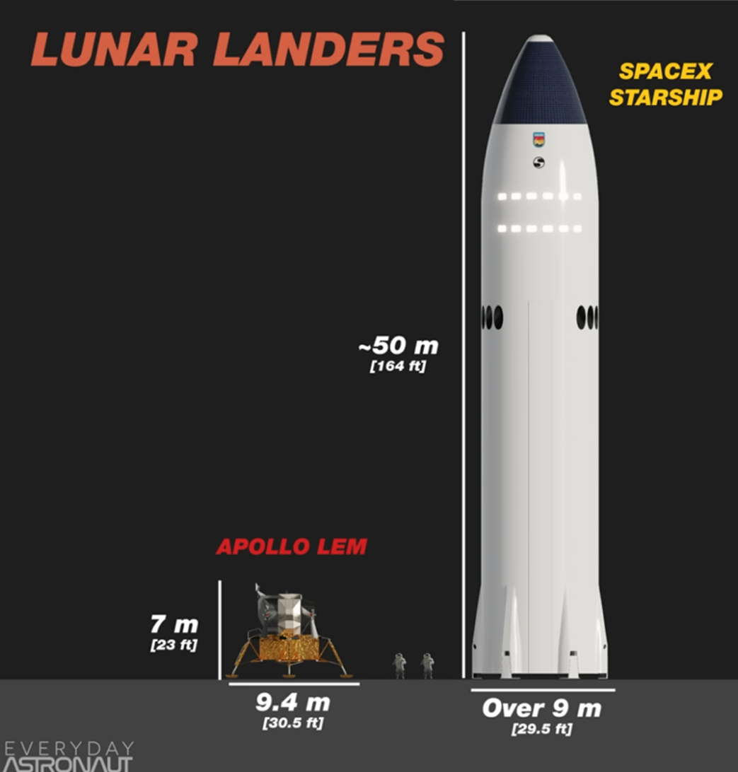
Notes:
Why so big? Originally designed to send 100 people to Mars, the long-term goal of SpaceX. Just like the rest of the Artemis vehicles: not designed with a moon landing in mind! But because already investing so much capital in it, SpaceX was able to offer for half the price of the next cheapest option, despite being the most silly looking.
Only talking about 2 people for the first landing: like “delivering pizza with an aircraft carrier”. In spite of this, SpaceX and Starship I think are the main enabling factor of this second Moon program, just like the Cold War was for Apollo. Without their innovation and investment in this system, NASA wouldn’t have been able to afford a lander, and whole program could have been in jeopardy.
Obviously not fitting inside SLS, so needs its own rocket, which as you might expect, is also quite large.

Slide 23
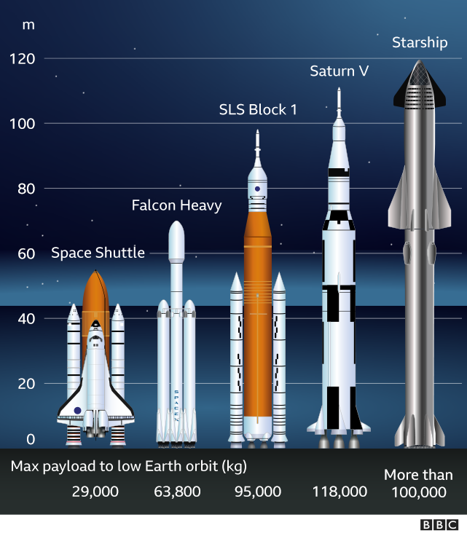
Notes:
Even taller than Saturn V, double the thrust, and designed to be fully and rapidly reusable.
Will truly change the game if it is successful, including making the fully disposable SLS redundant. But it’s not there yet.
Lander = most unproven and technically challenging part of the whole program. But SpaceX have proven they can do incredible things (albeit not on Elon Musk’s timelines). And we are seeing progress.
A rocket factory has sprung out of the ground in South Texas effectively overnight, and is as we speak bending stainless steel into the biggest flying objects ever made.

Slide 24
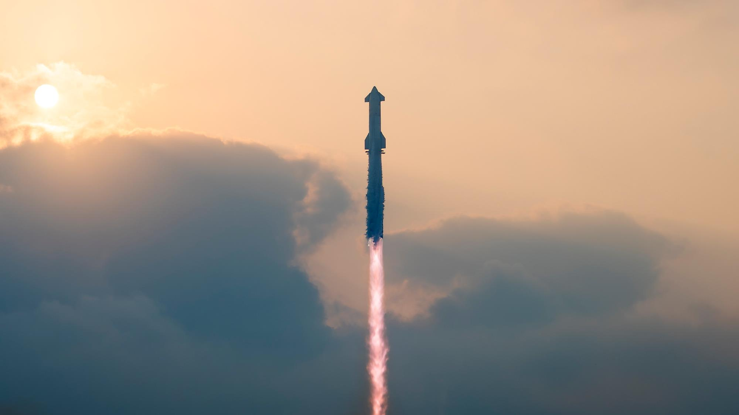
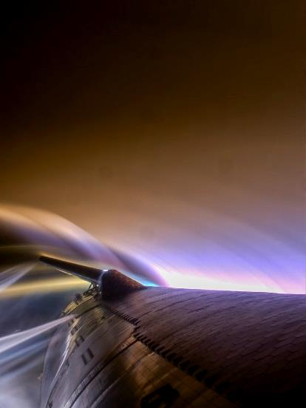
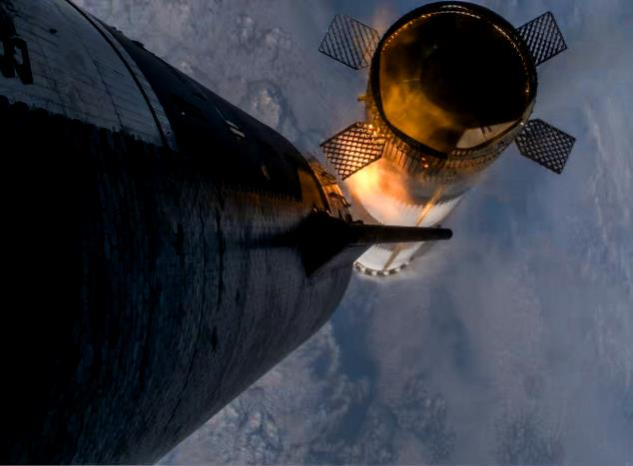
Fourth test flight of Starship
Notes:
3 weeks ago. Made it to orbit. First, time softly landed both booster and ship in the ocean (though ship did start to fall apart during re-entry)
Next milestones: land landings, in-orbit refueling, and land without people on the Moon.
Only then NASA will be ready to put astronauts in it.

Slide 25
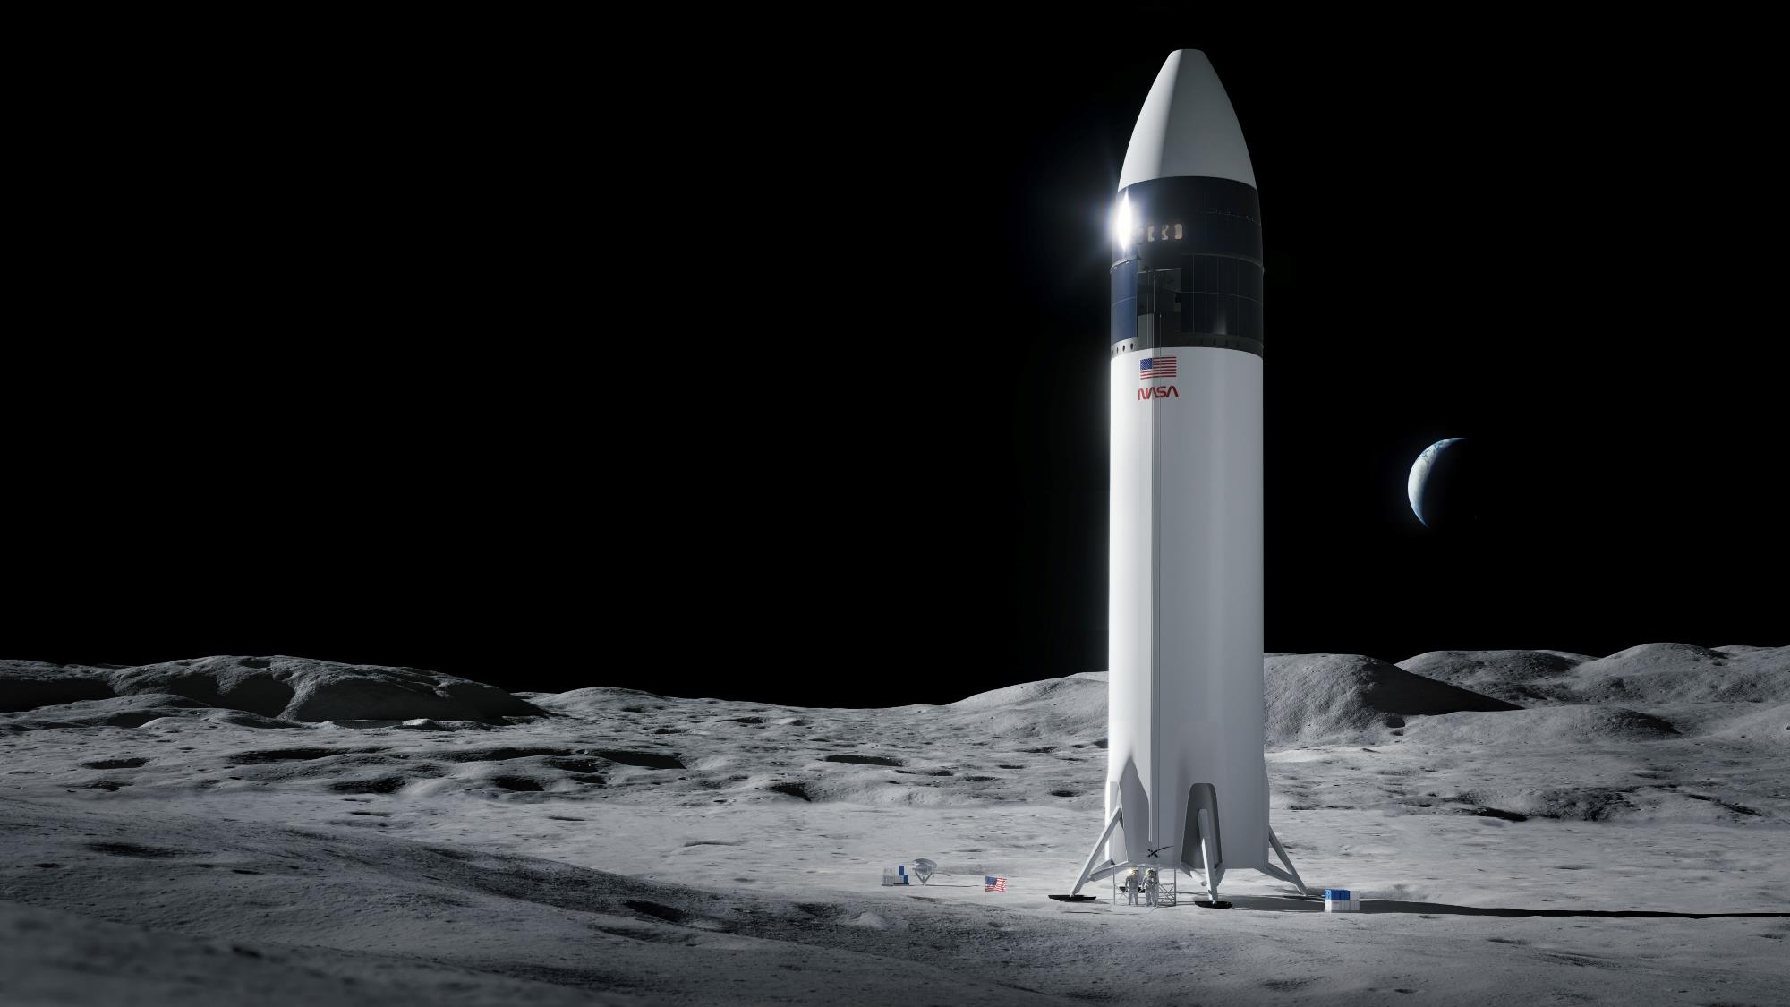
Artemis III 2024 2026?
Notes:
Plan is Artemis III will see the first woman on the Moon, as part of a week-long stay at the Moon’s South Pole.
2024, everyone’s accepted, not happening (sorry Mike Pence) – 2026 latest official schedule.
Given the hurdles to overcome – need spacesuits as well – 2028 would be a reasonable bet.
Another part of the reason to go is to have something to do there. What did Apollo astronauts do there?

Slide 26
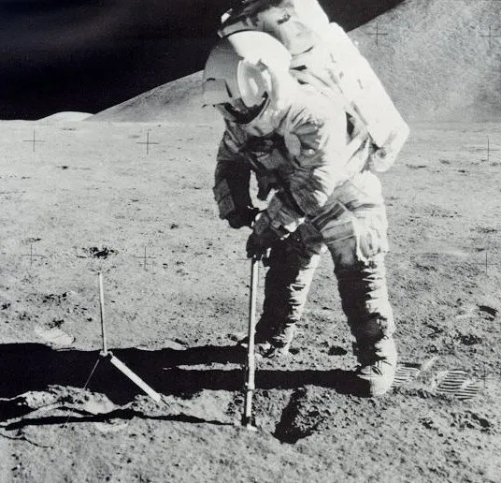
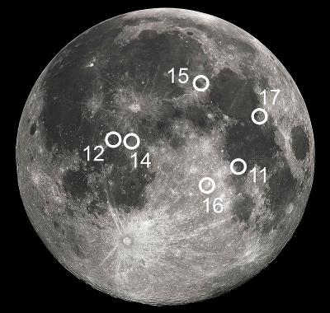
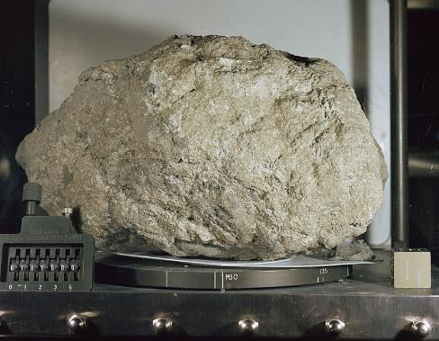
Apollo XI-XVII 1969-72
6 landings
12 moonwalkers
80 hours of moonwalking
90km traversed
400kg of rocks collected
2 golf balls hit
Notes:
Diary of Apollo landings. Series of camping trips
Plant flag, maybe unveil a plaque
Pick up some rocks, try not to fall over in bulky spacesuit in low gravity
Later missions: go for a drive, pick up some more interesting rocks
In terms of the physical legacy of Apollo on the Moon, i.e. the stuff they left there, was nothing more than this: a modest lander, a flag, a few science experiments, some piles of rubbish and maybe a rover. Artemis has a vision of a much bigger footprint:
https://www.britannica.com/place/Moon/Lunar-rocks-and-soil
Alan Shephard hit a golf ball 40 yards on Apollo14

Slide 27
2030s?
Notes:
(not only giant lander) What NASA envisions by the 2030s is a “sustainable presence”: proper base camp with habitats, pressurised rovers (built by Japan!), maybe ice mining operation
Certainly plenty of space onboard those oversized landers to bring home some big rocks
Having a sustained presence is going to be very hard. Many more challenges when you’re there for a month, and not just a weekend.
What exactly are those challenges. Brings us to third requirement

Slide 28
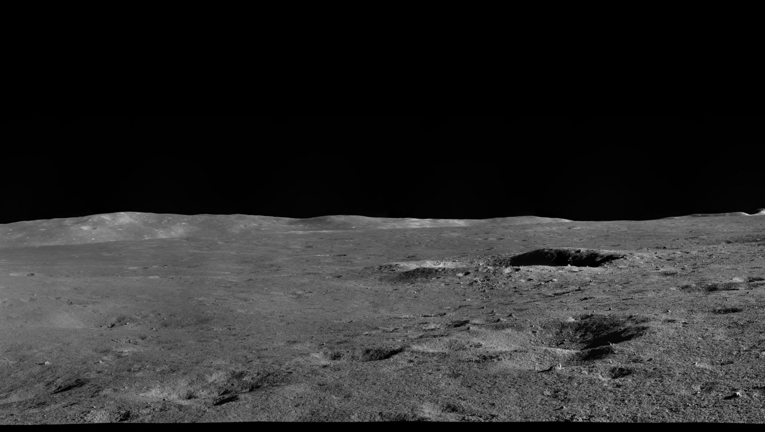
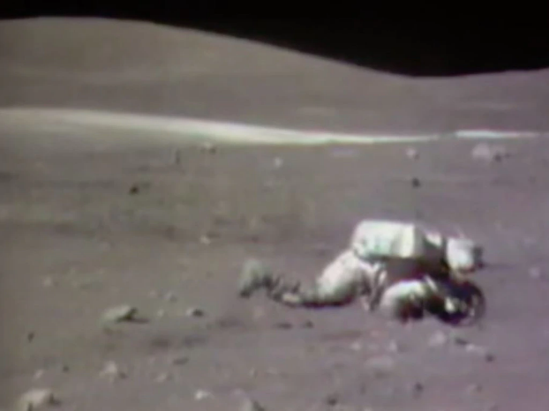
A means to stay safe from lunar hazards
Dust
1/6th gravity
Temperature swings
Space weather
220°C
-170°C
Notes:
Colder than Timaru in winter?

Slide 29
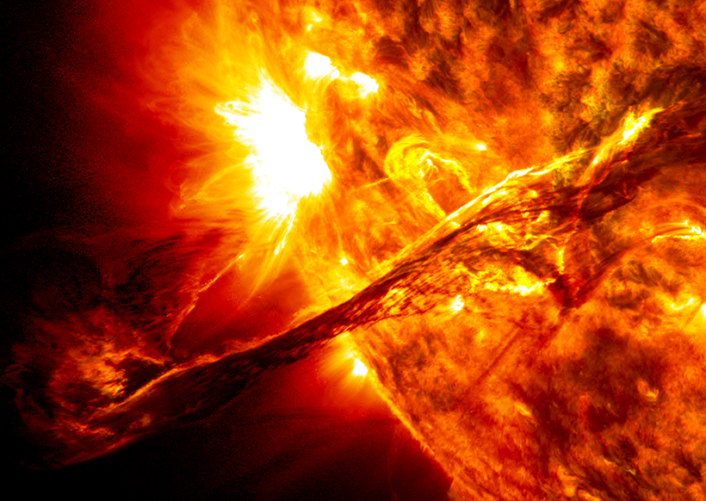
Space weather
Solar flares
Bursts of electromagnetic radiation
Can cause radio blackouts
8min travel time
Coronal mass ejections (CMEs)
Bursts of solar material (plasma)
Distort Earth’s magnetosphere, causing geomagnetic storms
Can damage satellites, electricity grids, gas pipelines, astronauts
1-2 days travel time
Notes:
Sun’s surface, while appearing to us as a very bright but nonetheless unchanging source of light, is a writhing mess of magnetic fields and plasma. When these magnetic fields become tangled up, they can snap and release vast amounts of energy, in two particular forms.
CME took out Quebec’s power for 9 hours in 1989
Detonated sea mines off coast of Vietnam in 72 (right between A16 and 17)
1859: set fire to telegraph stations and woke up gold miners with global aurora

Slide 30
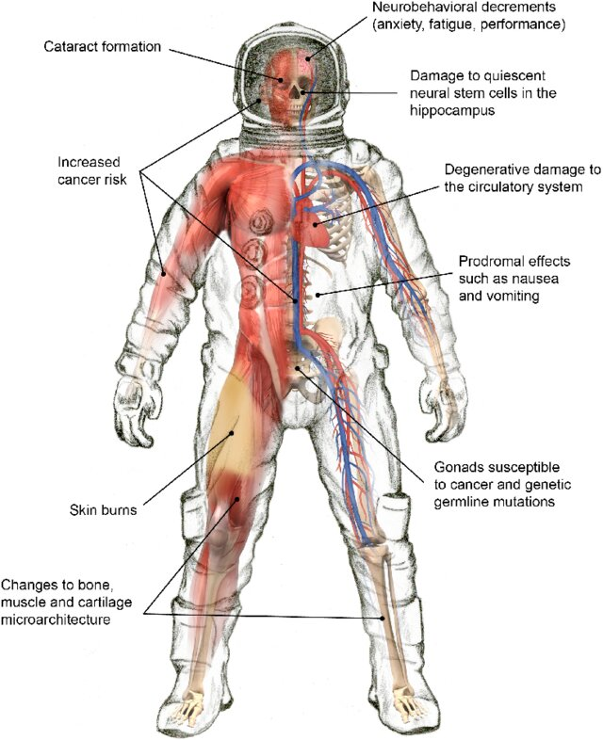
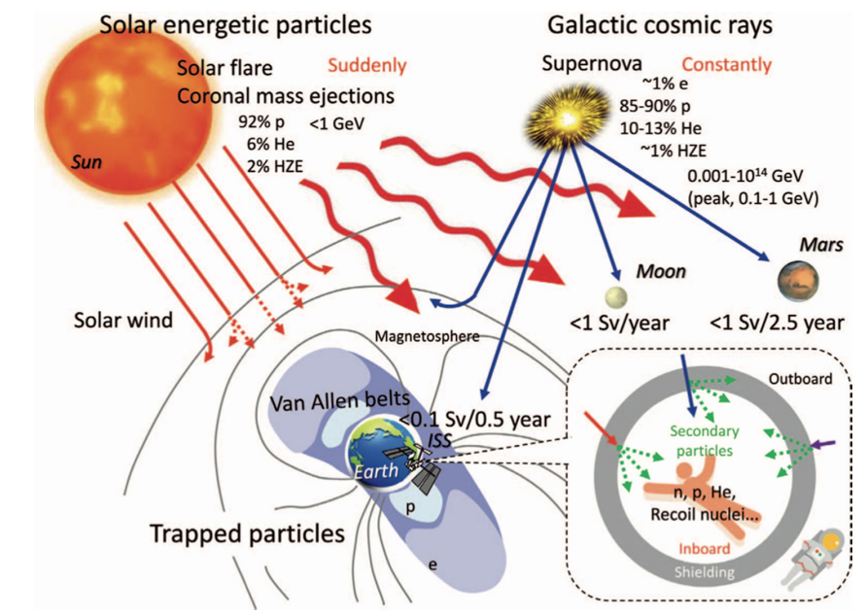
Radiation sources and effects
Notes:
Components of the space radiation environment. Operational space radiation environment is comprised of three sources of ionizing radiation, energetic protons from solar particle events, relativistic heavy ions of the galactic cosmic ray spectrum, and trapped electrons and protons in the Van Allen Belts
Radiation poses risk to all cells in the body.
Acute (short-term) effects: sickness, cognitive impairment
Chronic long-term effects: increased cancer risk https://www.nasa.gov/hrp/radiation/space-radiation-risks/
What can be done??? Shielding. Not as important on Mars as it has an atmosphere, but will be vital on the Moon for protecting from solar storms. Especially in the coming years.
Source: ESA and Fig. 1 from Chancellor et al., 2021 (https://doi.org/10.1080/26896583.2021.1897273)

Slide 31
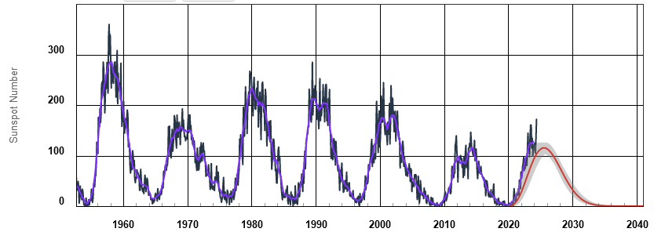
11-year solar cycle
Notes:
Expect more aurora!

Slide 32
Notes:
To wrap up, let’s return to this vision of the next 10-20 years: a multinational scientific base at the Moon’s South Pole. As I’ve described, there’s still a lot to do to make this a reality. New rockets and longer stays bring major technical challenges with getting there and staying safe. And a big part of solving these challenges is money. Even though there’s bipartisan support in Congress, there isn’t close to the same level of funding that we saw in the early 60s, probably because there’s no longer an existential geopolitical rivalry and a dead President’s dream to bring the US together and provide a very compelling reason to go. All of which means that NASA’s latest public timelines are simply unrealistic.
But this time around, 50 years later, we have new advantages. We have a global space sector with a history of cooperation on the ISS, and an innovative private industry led by SpaceX and our own Rocket Lab. Having more countries and companies involved increases complexity of the program, but it makes it harder to cancel, and reduces the financial burden on the American taxpayer. A taxpayer, who as surveys have shown, has never been that supportive of big space programs, even during Apollo.
And perhaps most crucially, the Artemis program was founded on both a deadline and a long-term vision, aiming not just to go back to the Moon but to put the first woman there and prepare for Mars.
So, the reality we’re left with is, for the first time in half a century, and only the second time in history, there is momentum to push humanity beyond low Earth orbit. Personally, I couldn’t be more excited.
Before I finish, what’s New Zealand’s role in all of this? Are we just spectators, getting ready to crowd around our phones instead of the radio to witness the next giant leap? Absolutely not. The commercial and international focus of this new era has already included us. Made clear by the administrator of NASA during a speech he gave at the Beehive last year.

Slide 33
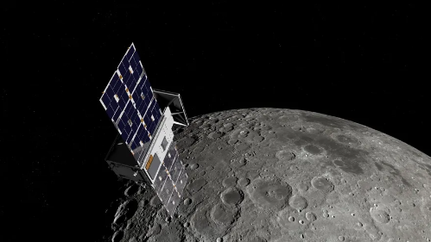
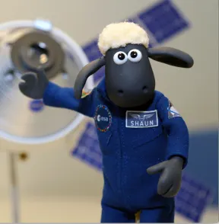
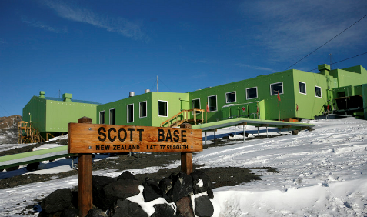
Coda: Aotearoa in space
Notes:
CAPSTONE
NZ wool was onboard Artemis 1, in the form of air filters built by Auckland company Lanaco. Used for critical emergency protection systems onboard Orion.
Antarctica, Artemis Accord signatory
solar flares research, how space weather affects us back on Earth
All we need is some Kiwi astronauts, and there really could be…

Slide 34
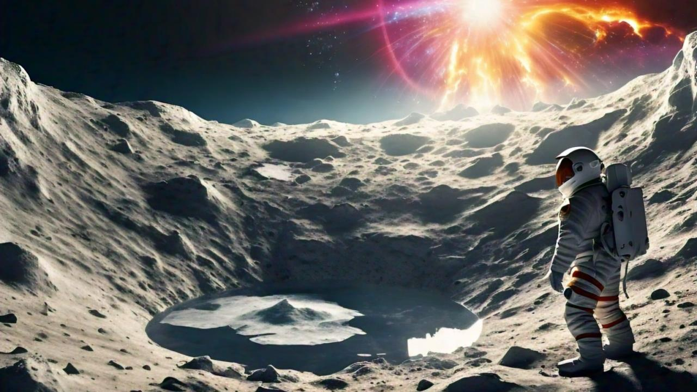
A Waiata of Ice and Solar Flares Te Hokinga ki te Marama
Daniel Wrench
U3A Timaru
June 2024
Artwork generated by Meta AI
Notes:
Kia ora koutou, thanks very much

